Slide 1


Notes:
Introduction to freelancing
Freelancing is not a job title. It’s not a job or a type of career. It’s the way in which you do your work. Freelancers hire themselves and their services to companies. Effectively, they trade their time for money.
Some people are freelance by choice. Others are freelance because that’s the only way they can work in the creative industries.
One of the defining features of the creative industries is a high reliance on freelancers. 32% of the creative industries workforce as a whole is self-employed (including freelancers), compared with 16% of the UK workforce (Oct 2019 - Sept 2020, DCMS, 2021).
In parts of Creative Industries such as screen production the proportion of freelancers is at 50%.
In the last decade and across the whole economy there has been a rapid growth in self-employment, with self-employed people representing 15.3% of employment in 2019, up from 12% in 2000.

Slide 2



Introduction to Freelancing
Notes:
Introduction to freelancing
Freelancing is not a job title. It’s not a job or a type of career. It’s the way in which you do your work. Freelancers hire themselves and their services to companies. Effectively, they trade their time for money.
Some people are freelance by choice. Others are freelance because that’s the only way they can work in the creative industries.
One of the defining features of the creative industries is a high reliance on freelancers. 32% of the creative industries workforce as a whole is self-employed (including freelancers), compared with 16% of the UK workforce (Oct 2019 - Sept 2020, DCMS, 2021).
In parts of Creative Industries such as screen production the proportion of freelancers is at 50%.
In the last decade and across the whole economy there has been a rapid growth in self-employment, with self-employed people representing 15.3% of employment in 2019, up from 12% in 2000.

Slide 3
Introduction to Freelancing
Session Aims
By the end of this session, we will have answered the following questions:
Part 1: What is freelancing?
Part 2: What does a freelance career look like?
Part 3: To freelance or not to freelance?
Part 4: How do you build a sustainable freelance career?
Notes:
Introduction to freelancing
Freelancing is not a job title. It’s not a job or a type of career. It’s the way in which you do your work. Freelancers hire themselves and their services to companies. Effectively, they trade their time for money.
Some people are freelance by choice. Others are freelance because that’s the only way they can work in the creative industries.
One of the defining features of the creative industries is a high reliance on freelancers. 32% of the creative industries workforce as a whole is self-employed (including freelancers), compared with 16% of the UK workforce (Oct 2019 - Sept 2020, DCMS, 2021).
In parts of Creative Industries such as screen production the proportion of freelancers is at 50%.
In the last decade and across the whole economy there has been a rapid growth in self-employment, with self-employed people representing 15.3% of employment in 2019, up from 12% in 2000.

Slide 4

What is freelancing?
PART 1
Notes:
Opportunity to find out what prior knowledge or experience students might have
Part 1: What is freelancing?
Screen industries guide to freelancing – The Freelance Toolkit, ScreenSkills

Slide 5

Part 1: What is Freelancing?
Where does the term “freelancing” come from?
What other terms are often used to describe freelance working modes and patterns?
What is the difference between working freelance and being employed?
Notes:
Where does the term “freelancing” come from?
What other terms are often used to describe freelance working modes and patterns?
What is the difference between working freelance and being employed?

Slide 6

The Evolution of Freelancing
Notes:
The evolution of freelancing
Where does the term freelancing come from?
The term "freelancing" can be traced back several centuries. It derives from the medieval era, specifically the 14th and 15th centuries, when skilled individuals known as "free lances" offered their services to various parties. During this time, Europe was experiencing widespread warfare, and armies often faced shortages of soldiers. To meet this demand, mercenaries or freelance fighters would offer their services to different armies or factions, fighting for the highest bidder. These freelance fighters were not permanently attached to any particular army, but rather operated as independent contractors, hence the term "free lances.”
The term "free lance" itself referred to the weapon these mercenaries carried, a long, slender spear called a "lance". These fighters would offer their skills and combat expertise to whoever was willing to pay, without committing to a long-term allegiance. They were essentially self-employed warriors who worked on a project-by-project basis.
Over time, the concept of freelancing extended beyond the realm of warfare and became associated with various skilled trades and professions. Artists, writers, and craftsmen began adopting the term to describe their independent work arrangements, where they would offer their services to different patrons or clients on a per-project basis.
In the 19th and early 20th centuries, the term "freelance" started to be commonly used in literary and journalism fields. Freelance writers, for example, would write articles or stories and sell them to multiple publications without being employed by any specific newspaper or magazine. This further solidified the idea of freelancing as a form of independent work.
In recent decades, the rise of the digital age and the gig economy has further popularized freelancing across many different industries. With the advent of online platforms and marketplaces, freelancers can now connect with clients and offer their services globally, expanding their reach and opportunities for independent work.
Today, freelancing encompasses a wide range of professions, including writing, graphic design, programming, consulting, and more. It is a viable career choice and works well for those seeking flexibility, autonomy, and the ability to work on diverse projects with different clients. The term "freelancing" continues to evolve as new industries emerge and the nature of work undergoes further transformations.

Slide 7

Words and terms used to describe freelancers
Working for myself
Sole trader
Self employed person
Gig worker
Side hustler
Portfolio career
Multi-hyphenate (or slasher)
Contractor
Notes:
Words and terms used to describe freelancers:
According to HMRC (His Majesty’s Revenue and Customs). If you start working for yourself, you’re classed as a sole trader. This means you’re self-employed - even if you have not yet told HMRC.
You’re self-employed if you run your own business as an individual and work for yourself. This is also known as being a sole trader.
When you work in this way you can keep all your business’s profits after you’ve paid tax on them. You’re personally responsible for any losses your business makes. You must also follow certain rules on running and naming your business.
What is the gig economy/gig worker?
For many years, musicians and comedians have used the term “gig” to describe the one-off performance appearances that they make. The gig economy gets its name from this; each piece of work undertaken by self-employed individuals being similar to an individual “gig” for entertainers. It is a free-market system where those contracting the work and the independent workers providing the work, engage in usually an on-demand, short-term work arrangement. A gig worker works in the gig economy.
A working definition of the gig economy was created in consultation with the Department for Business, Energy and Industrial Strategy (BEIS) and the Institute for Employment Studies as, “The gig economy involves the exchange of labour for money between individuals or companies via digital platforms that actively facilitate matching between providers and customers, on a short-term and payment by task basis.”
(Gig) workers are usually paid an agreed rate on completion of the projects, tasks or “gigs” instead of being paid for the amount of time that they work, although some gigs may be on an hourly or daily rate basis.
For example, rather than being paid an hourly rate, a gig delivery driver may be paid a set amount per delivery made or for a set number of deliveries per day. Each individual gig or assignment usually accounts for only a part of a gig worker’s total income.
The internet and apps are now key to the gig worker, whether they are full-time or part-time workers. Employers or consumers can request services or products and can be matched to a gig worker. The app or internet can help work out payments and charges, ensure that the worker has the right skills, do marketing for the worker, and advertise gig jobs for an individual or a company.
Side hustle
A side hustle is a piece of work or a job that you get paid for doing in addition to doing your main job.
What Is a Portfolio Career?
A portfolio career is a way to define a career that encompasses several related or unrelated jobs. Also known affectionately as “slashers”, or “multi-hyphenates”. People with portfolio careers may boast various job titles, like writer/photographer or graphic designer-stylist.
If you have a portfolio career you can hold a variety of job types (e.g. full-time job, gig worker, or freelancer) and you may work various positions simultaneously or at different points in time.
For example, a writer might pen articles for an online magazine and write press releases for a corporate business too. Or a worker might have a full-time job as an account manager that pays the bills but doesn’t soothe their soul, so they pursue their creative passions with part-time work as a DJ at nights and on weekends.
Why creative industries encourage portfolio careers - ScreenSkills.
Contractor
A contractor is a professional who provides services to clients for a set period or for the duration of a project. The term refers primarily to those working in construction, engineering or technology. Generally, contractors are experts in a certain skill and businesses hire them for projects that require their specialist services.

Slide 8

Freelancing vs Employment
( 2 mins 33 sec )
Watch the film on Vimeo
Notes:
Video: Freelancing vs Employment
There are lots of ways freelancing is different to employment.
Did this surprise you?
Is it appealing? Why?
Is it daunting? Why?
Do you know anyone who is a freelancer?
What do they do?

Slide 9


Activity: Sort the cards
Features and terminology associated with freelancing
Features and terminology associated with employment
Do any cards belong in both piles?
Notes:
Freelance
I have to find the next project that I’m going to work on
I negotiate my own rates and contracts with clients
I get paid including tax and national insurance
submit an invoice and wait for payment.
I have my own equipment and tools to do my work and use those to deliver for all my clients.
I’ve got 3 projects on the go with different clients.
I have the flexibility to choose when and where I work
I’m responsible for reporting my income and paying tax and/or national insurance each year through self-assessment
If I don't work, I don't get paid
Employment
My work is subject to performance reviews and evaluations.
My schedule is set by my boss / line manager
The company provides all my equipment.
I receive benefits such as health insurance and pension.
I have a designated workspace provided by the company.
I am paid minus any tax and National Insurance contributions
My boss / line manager is responsible for my workload and finding work for me to do
I get paid when I'm on holiday
My pay is regular (weekly / 4 weekly / monthly)
Open to interpretation
I work full time
I pay taxes
I have a regular place I work from

Slide 10

End of Part 1: Time to reflect
Where does the term “freelancing” come from?
What other terms are used to describe freelance working modes and patterns?
What is the difference between working freelance and being employed?
Notes:
Freelance working / self-employment
Paid by the job
Invoice for services and wait for payment
Submit a tax return and responsible for paying tax and National Insurance owing
No work no pay (usually)
Self-funded pension
Provide own tools / equipment
Flexible hours
Flexible schedule
Source your own work
Employment
Steady income
Salary paid regularly into bank
Tax and National Insurance deducted at source
Paid holiday
Company pension scheme
Company provides tools / equipment
Employer determines hours
Work as directed
Employer provides work

Slide 11

What does a freelance career look like?
PART 2

Slide 12

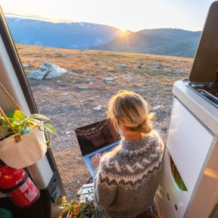


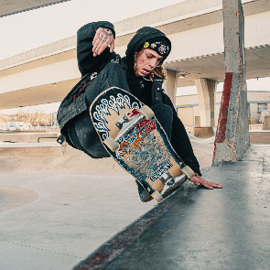
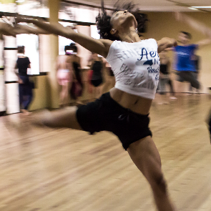






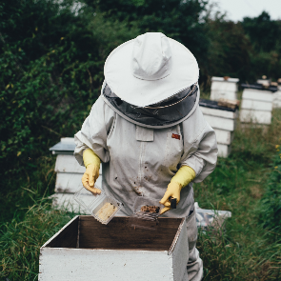

Part 2: Which of these people are working?
Notes:
What does a freelance career look like?
All of these may be working as freelancers or they may not be.
If they were working what might their work be?
E.g. Skate board image could be: professional skate boarder, skateboard instructor or someone skateboarding as a hobby.

Slide 13

Friendly Freelancers
( 4 mins 03 sec )
Watch the film on Vimeo
Notes:
Video – Friendly freelancers
TERMINOLOGY NOTE: Daily / dailies is a term specific to Film and TV which describes production crew who are contracted for occasional days usually during filming. From a UK tax perspective these people are booked according to the Seven Day Rule. The seven-day rule applies to those who work in the entertainment industry, with a succession of different employers, and are engaged for 6 days or fewer for each contract. Employers need not deduct income tax from payments made to these employees. However, National Insurance will be deducted in the usual manner. Examples of where dailies are required include:
when there are bigger than usual scenes (e.g. large crowd scenes)
filming in busy locations (e.g. city centre)
complex scenes to shoot (e.g. stunt sequences).

Slide 14

What does a freelance career look like?
What are the qualities of a successful freelancer?
What does a freelancer’s schedule of tasks look like – across a year, a month, a week, a day?
Notes:
Discuss what the qualities and schedules of freelancers look like based on the video.

Slide 15


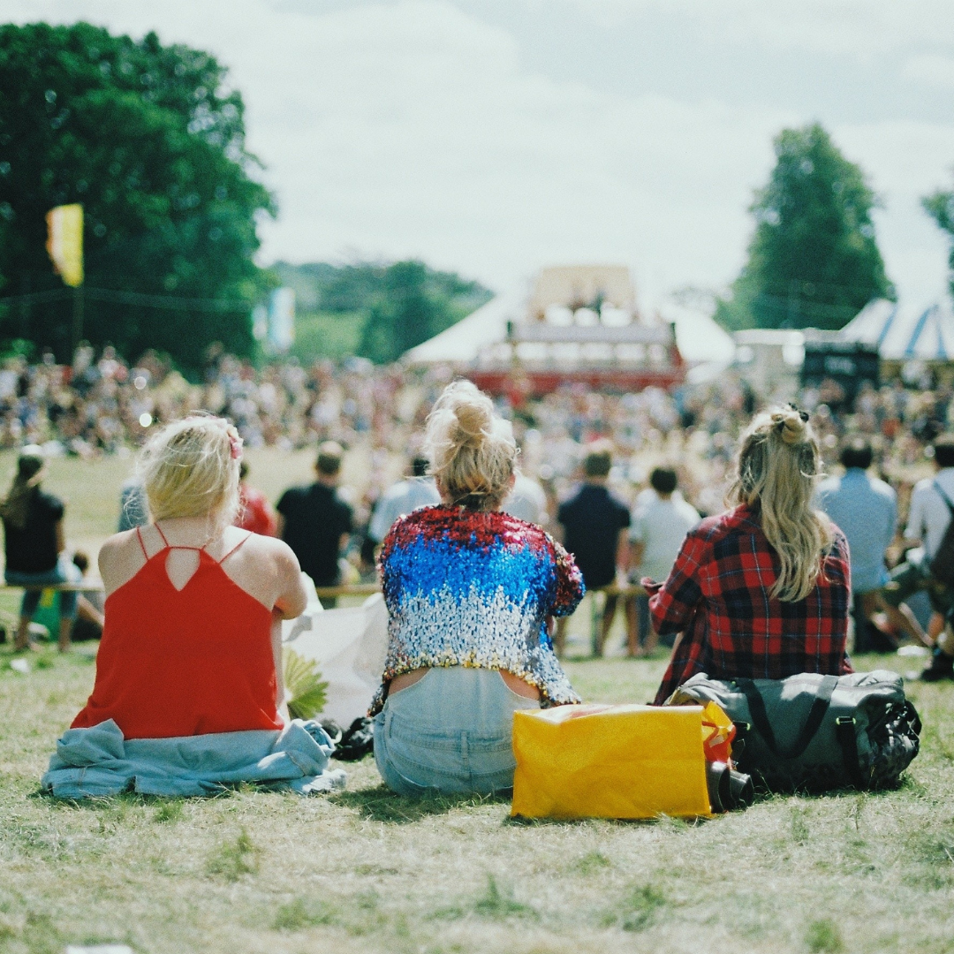


Activity: Imagine going behind the scenes of a successful freelancer
Examples of successful freelancers include mobile hairdresser, popstar, festival producer and influencer
What qualities can you identify that make them a successful freelancer?
What might their schedules look like?
Notes:
Activity
Imagine going behind the scenes of a successful freelancer.
Consider either a freelancer you know or use one of the examples
mobile hairdresser
popstar
festival producer
influencer
Thinking back to the video you’ve just watched.
In pairs: try and answer these 2 questions:
What qualities can you identify that make them a successful freelancer?
What might their schedules look like?

Slide 16
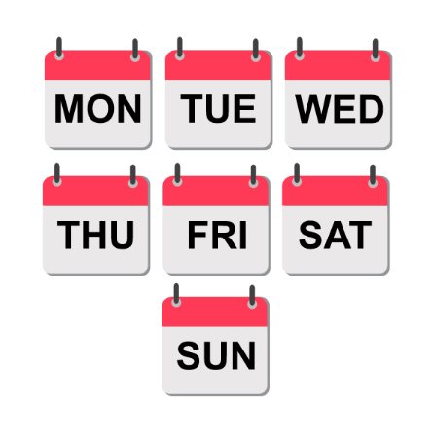


Activity: How often does a freelancer do each of these activities?
WEEKLY
MONTHLY
ANNUALLY
Notes:
Now it's time to drill down into what a freelancer’s schedule looks like weekly, monthly and annually. A freelancer has many tasks to do to both working 'in' their freelancing (doing work for clients) and working 'on' their freelancing (building and sustaining their freelance career).
Different types of tasks will be done with differing amounts of regularity.
Just like in your daily life you brush your teeth twice a day but you likely only visit the dentist once or twice a year. Consider how regularly these tasks might be done by a freelancer.
Activity can be done as a call out to whole class group, in pairs or in small groups. If done in groups get them to report back to whole class – discuss where differences of opinion are found.

Slide 17

Sort this list of activities into frequency
Filing Tax Return
Social media posting
Contacting potential clients
Developing new skills
Going to events to meet people
Agreeing brief with client for new work
Sending invoices
Managing personal finances
Assessing your pricing
Preparing proposals / pitches for clients
Organising your time / prioritising tasks
Researching opportunities / new clients
Building your freelance brand
Analysing your skills
Updating your online profile(s)
Assessing where you could find new opportunities
Checking if payments have been received
Following up with clients you’ve pitched to
Delivering client work
Updating your website
Checking in with previous clients
Calculating how much you need to live on
Researching your sector and current trends
Pitching yourself to your networks
Notes:
Activity:
Sort this list of activities into the frequency with which a freelancer might need to do them
weekly
monthly
annually
Do some activities fall into more than one category?
Think about why you’ve chosen that frequency for each activity.
Some activities are easier to put into specific frequencies – the ones highlighted in bold could be in more than one column. Freelancers need to be agile. Having a list like this can help keep you thinking about what you need to do.
Suggested answers (bold could in more than one column)
Weekly
Social media posting
Sending invoices
Managing personal finances
Preparing proposals / pitches for clients
Organising your time / prioritising tasks
Pitching yourself to your networks
Delivering client work
Checking if payments have been received
Monthly
Contacting potential clients
Developing new skills
Going to events to meet people
Agreeing brief with client for new work
Researching opportunities / new clients
Assessing where you could find new opportunities
Following up with clients you’ve pitched to
Updating your website
Checking in with previous clients
Researching your sector and current trends
Updating your online profile(s)
Annually
Filing Tax Return
Assessing your pricing
Building your freelance brand
Analysing your skills
Calculating how much you need to live on

Slide 18
End of Part 2: Time to reflect
What does a freelance career look like?
What are the qualities of a successful freelancer?
What does a freelancer’s year/month/week/day look like?
Can you give some examples of successful freelancers and what their careers look like?
Can you identify how frequently freelancers do different tasks?

Slide 19
To freelance or not to freelance?
PART 3
Notes:
To freelance or not to freelance?
We’ve heard a lot about freelancing so far – but what do freelancers themselves think are the pros and cons? What do you think about freelancing? What are the pros and cons for you? What are examples of freelance roles in the creative industries? And is the work you are interested in doing likely to be freelance?

Slide 20
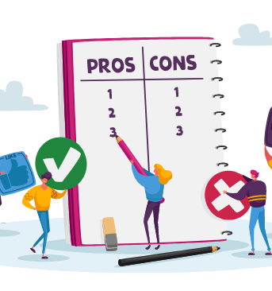
Part 3: To freelance or not to freelance
What are the pros and cons of freelancing?
What are examples of freelance roles in the creative industries?
Notes:
To freelance or not to freelance?
We’ve heard a lot about freelancing so far – but what do freelancers themselves think are the pros and cons? What do you think about freelancing? What are the pros and cons for you? What are examples of freelance roles in the creative industries? And is the work you are interested in doing likely to be freelance?

Slide 21
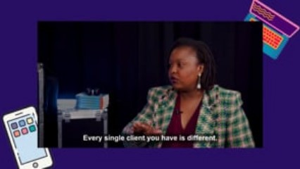
Pros and cons of freelancing
( 2 mins 50 sec )
Watch the film on Vimeo

Slide 22


Activity: Sort the cards
Pros of freelancing
Cons of freelancing
Do any cards belong in both piles?
Notes:
Pros and cons cards – which of these do you consider a pro and which a con? Are any cards both a pro and a con?
Autonomy and independence: having control over my career decisions and direction
Insecurity: work can be feast or famine so my workload can very busy or very quiet
Flexibility: the ability to work on my own terms and have a flexible schedule.
Social media: alongside my paid work I need to keep on top of my social media by scrolling through and posting regularly
Wide variety of work: every day and every client project is different
Administration and operations: organisation, time management and dealing with taxes are down to me
Potential for fast growth: the opportunity to "climb the ladder" quickly by working on multiple projects in a short space of time
Finances: clients pay me at irregular times which means I need to keep a close eye on my bank balance
Clients: choose who I want to work with and on what sort of projects
Self motivation: it's up to me to source the work for me to do
Portfolio work: working on a wide range of different projects and/or in different sectors over the course of a year
Well being: need to manage my own well being and not push myself beyond my capacity
Flexibility: doing the same role for different clients can be remarkably different
Forward planning: I don't know what work I will be doing in 6 or 12 months time

Slide 23



Examples of freelance roles
Social Media marketer
Musician
Photographer
Provides social media marketing services to brands, companies and/or marketing agencies
Performs at gigs, booked to play at private events, records own music for streaming and/or commissioned to compose
Provides photography services to companies, individuals, weddings, products and/or sells images and/or teaches photography
Notes:
Examples of freelance roles and the sorts of services they might fulfil for different clients.
Consider whether their clients are likely in a Creative Industries sector or not?
Do creative freelancers need to work for clients in the Creative Industries?
NO
Many creative industries freelancers work in the wider Creative Economy – this is where they deliver their creative services but they are delivered to companies who operate outside the Creative Industries.
Examples could include:
A filmmaker making a film for a tractor manufacturing company
A graphic designer creating a logo for a coffee shop
An artist commissioned to produce a painting for the entrance area of a new building
A web designer creating a website for a recruitment company

Slide 24



Examples of freelance roles
Voice Actor / Artist
Make-Up Artist
Jewellery Maker
Provides voice acting services for films/TV shows (narration for documentaries and characters for animation), commercials, radio stations and events
Provides make-up services for video shoots, photo shoots and live events in creative and non-creative sectors. Can also work directly with individuals.
Provides jewellery making services through bespoke commissions for individuals or companies as well as creating items for sale in store and online.
Notes:
Examples of freelance roles and the sorts of services they might fulfil for different clients.
Consider whether their clients are likely in a Creative Industries sector or not?
Do creative freelancers need to work for clients in the Creative Industries?
NO
Many creative industries freelancers work in the wider Creative Economy – this is where they deliver their creative services but they are delivered to companies who operate outside the Creative Industries.
Examples could include:
A filmmaker making a film for a tractor manufacturing company
A graphic designer creating a logo for a coffee shop
An artist commissioned to produce a painting for the entrance area of a new building
A web designer creating a website for a recruitment company

Slide 25
End of Part 3: Time to reflect
To freelance or not to freelance?
What are the pros and cons of freelancing?
What are examples of freelance roles in the creative industries?

Slide 26
How do you build a sustainable freelance career?
PART 4
Notes:
Background information:
Articles:
Secret Ingredients to being a great freelancer – The Guardian
The evolving freelance world – Freelancersweek.org
Podcast:
How you can find your niche and why it's important to have one? – Freelance Corner
Video:
What makes a successful freelancer? with Alison Grade

Slide 27

Part 4: How do you build a sustainable freelance career?
How do you get started in freelancing?
What are the areas you need to work on to build a sustainable freelance career?
Notes:
How do you get started in freelancing?
What are the areas you need to work on to build a sustainable freelance career?

Slide 28
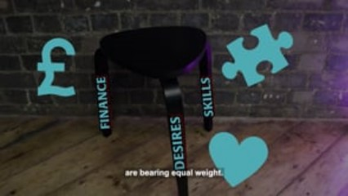
Building a sustainable freelance career
( 1 min 24 sec )
Watch the film on Vimeo

Slide 29
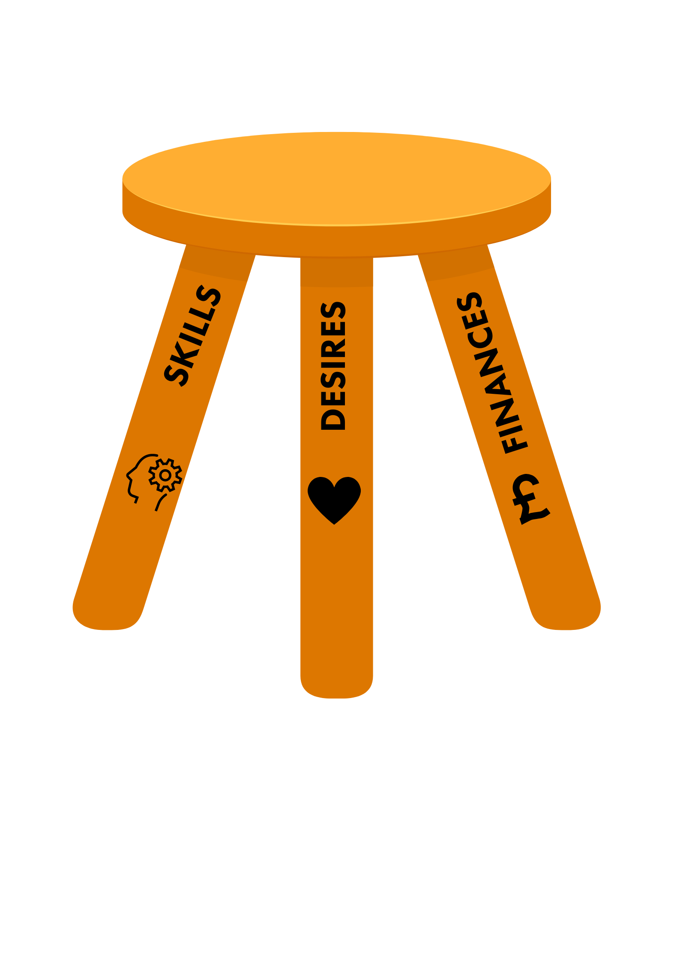
Activity: How do you get started in freelancing?
STEP 1: Decide which Creative Industries sector you want to work in...
Have a discussion with the person next to you and be ready to feedback to the class:
What creative industries sectors do you know?
What areas excite you the most and why?
What could you see yourself doing?
Notes:
Step 1: Decide which Creative Industries sector you want to work in
Discuss with person next to you:
Which Creative Industries sectors do you know (see wider Discover Creative Careers website)
Which are area of creative industries interests you?
What could you see yourself doing?
Remember also you don’t need to be a creative person to work as a freelancer in the Creative Industries. You could be a project manager, accountant, lawyer, paramedic, carpenter etc. – there’s a role for everyone. It’s all about working out where.
Examples:
All Creative Industries companies will need finance and legal experts at different times.
Most projects with more than 2-3 people will need some form of project management.
First aid support is required at festivals and on big film/tv shoots.
Carpentry skills are needed wherever construction is needed – e.g. theatre / film / tv set design and construction.
If you would love your work to be within the creative industries but are not sure you are a creative there will still be a role for you!

Slide 30
Activity: How do you get started in freelancing?
STEP 2: Identify the SKILLS you have that you could offer to clients
Create a mind map:
What skills do you have, or are you developing at school/college?
Now discuss:
When and how often might a client need your skills (services)?
How long might they need them for?
Notes:
Step 2 SKILLS: Identify the skills you have that you could offer to clients.
Activity: create a mind map of the skills you have / are developing.
Discuss: when, how often and how long a client might need your skills/services.

Slide 31
Activity: How do you get started in freelancing?
STEP 3: Calculate your future FINANCES.
Complete the personal finances worksheet to:
Estimate much will you need to live and pay bills
Estimate how much tax and national insurance you will have to pay.
    It is critical that you balance the amount of work and money coming in, with the amount of money you need to spend to live and work.
Notes:
Step 3 FINANCES: Calculate your future finances
See worksheet below for finances.
Encourage students to consider figures for each line on the worksheet. They may want to do research online to ensure their estimates are accurate (e.g. prices of rental properties).
Once they’ve completed the sheet they need to be reminded that:
This calculates what someone needs to live on after they’ve paid taxes.
Freelancers invoice clients and are paid including tax and NI (which they then report to HMRC via self-assessment).
Students now need to work out what their tax and National Insurance would be that would leave them the amount they’ve just calculated to live on. The HMRC ready reckoner is a simple way to calculate this - HMRC Ready Reckoner.
Complete the boxes on nation in UK and whether your sums are weekly / monthly.
Fill in an example weekly/monthly figure (suggest above £255 per week / £1100 per month or the results returned are zero).
The results give details on the Class 2 and Class 4 National Insurance contributions together with Tax owing.
For a freelancer to work out what they need to invoice across the year they need to add the following figures together:
Total Outgoings + Class 2 NI + Class 4 NI + Tax
This gives the total they need to invoice all their clients in a year in order to pay themselves their Total Outgoings (without allowing for any expenses of running their freelance operations).
NOTE: To calculate the total a freelancer needs to invoice across the year they would need to include an amount for their freelancer business expenses (the cost of running their freelance operations) these can include website costs, travel to and from meetings, office equipment – further details available at:
Sole-trader download on Tax and NI.

Slide 32
Activity: How do you get started in freelancing?
STEP 4: Work out which clients might DESIRE your services.
Look at the worksheet provided.
Which of these might need your services?
Will you provide services to Creative Industries companies or wider sectors?
Why do you think these might need your services?
If you have time, consider how you would make them aware of the services you are offering?
Notes:
Step 4 DESIRES: who are the clients that might need your services.
Below are examples of freelance roles and types of companies / individuals that might need their services to facilitate discussion.
Social Media Marketer
E.g. Sam Thodhlana, Digital Marketer
A small company that doesn’t have anyone managing their social media and/or a marketing department (e.g. local independent coffee shop) they often bring in a freelancer for their specialist skills as they don’t have these in the company and/or don’t need them full time.
A marketing agency who has a large volume of client work may bring in additional freelancer(s) to support with delivering for their clients. They need the social media marketer to add capacity to their team to enable them to deliver for their clients.
A large company, with a marketing department, would bring in a social media marketer because they have deep expertise in a specific platform (e.g. TikTok) that the company needs and doesn’t have that knowledge in-house. And/or to run a specific project which is outside business as usual and therefore they need extra capacity.
Musician
E.g. Violinist and composer
Musician booked to play a set at a private party / wedding / event for a company. Musician can be booked by individual(s), wedding venue, company, party planner, wedding planner etc.
Musician commissioned by a company who makes games or films/tv shows to compose the music for an upcoming production.
Musician records their own music compositions and uploads to streaming platform in order to obtain streaming royalties
Musician puts on a gig at a venue and sells tickets to the event.
Photographer
E.g. Kate Hollingsworth Photography
Wedding photography – clients are couples who are planning their weddings as well as wedding venues or wedding planners (who can recommend). Often wedding photographers are found via recommendations.
Brand / company photography – clients are companies (of any size – often local) who are looking to create a set of images that reflect their brand. Images are used on company marketing materials (e.g. websites, social media, press releases) as well for company pitches and brochures.
Teaching – clients can be schools and colleges as well as privately marketed workshops in local venues.
Questions for students:
Can you think of the sort of individuals and/or companies that might need your services?
It’s easy to focus on large companies but there are many more small companies in the UK than large ones. The number of private sector businesses in the UK at the start of 2022 was 5.5 million.
5.47 million businesses were small (0 to 49 employees) - 99.2% of the total business population
35,900 businesses were medium-sized (50 to 249 employees) - 0.7% of the total business population
7,700 businesses were large (250 or more employees) - 0.1% of the total business population
74% of businesses did not employ anyone aside from the owner(s)
Freelancers are well placed to serve the smaller businesses with fewer, if any, employees as they are more likely to have peaks and troughs of work and need a freelancer's specialist services.
How would you make potential clients aware of your services?
Examples would be:
Search engine online (note – it is not very likely an individual freelancer will have extensive SEO such that they come up on the front page of an internet search. This is likely to work only if the person searching has already heard of the freelancer by name as opposed to searching for ‘Graphic Designer’ or ‘Local photographer’).
Online database / directory – could be local or sector specific – more likely that you will get found here
Freelancer platforms – lots of freelancers on here so need to stand out
Social media – using #hashtags and sharing in groups can make people aware of you
Going to events / conferences and networking with people
Recommendations – this can be very valuable for more established freelancers – but less likely to happen when you are getting started
Letting people in your networks (basically anyone you know) that you are offering XXX freelancer services and asking them if they know anyone who might need these services
Emailing companies directly that you believe need your freelancer services (note – always try and work out who might be the person tasked with finding someone with your services as they are likely to be most receptive)

Slide 33

Extend activity:
Design a reel or an infographic to introduce yourself as a freelancer
What are the services you will offer?
Why will clients need your services?
How often and for how long will they need your services?
Who are your potential clients?
How will you make them aware of you?
How much will they pay for your services?
Notes:
Extend activity
Design a poster/infographic/reel to introduce yourself as a freelancer.
What are the services you will offer?
Why will clients need your services?
How often and for how long will they need your services?
Who are your potential clients?
How will you make them aware of you?
How much will they pay for your services?

Slide 34
End of Part 4: Time to reflect
How do you build a sustainable freelance career?
What are the areas you need to work on to build a sustainable freelance career?
How do you get started in freelancing?

Slide 35


Consolidate learning: What have you learned about freelancing?
What is freelancing?
What does a freelance career look like?
To freelance or not to freelance?
How do you build a sustainable freelance career?
Notes:
Consolidate learning: What have you learned about freelancing?
What is freelancing?
What does a freelance career look like?
To freelance or not to freelance?
How do you build a sustainable freelance career?
What did you learn today?
USE YOUR PREFERRED SUMMATIVE ASSESSMENT TOOL HERE:
Questioning in class
Exam-style test or online quiz (made in google or MS forms)
Homework essay
Podcast recordings or Short video-logs
Stretch and challenge questions for further discussion
Why do so many people in the creative industries work as freelancers?
Why might people think freelancing is “not a real job”? Do you agree?
Why do you think people give up, or are unsuccessful at freelancing?
Do you think freelancing could be secure and lucrative career choice?
Might your dream job/career involve working as a freelancer?
Might your dream job/career involve working with freelancers?
Why is it important that everyone develops a good understanding of freelancing?

Slide 36
There’s a career for you in the creative industries

