Slide 1
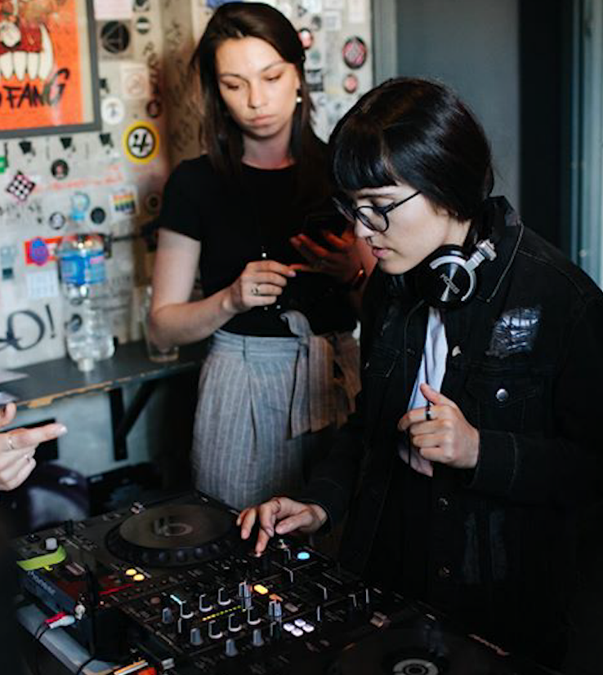
Introduction to the music industry
Notes:
Image © Discover Creative Careers, screenshot from Saffron Records insight film 2021

Slide 2

What does music mean to you?
Who listens to music?
Favourite song?
What artists do you listen to?
Any songwriters / composers you can name?
What different types of music are there?
Notes:
5 mins
Group discussion…
Get students to reflect on music they like and share ideas on genres, why they like it, etc.
Types = Rock, Classical, Funk, Punk, Grime, Classical, Folk, Pop, House, etc
Image: Photo by Marius Masalar on Unsplash

Slide 3

In Pairs / Small Groups - Task
Where else do you hear music?
Think about a whole day from when you wake up till when you go to sleep…
Give as much detail as you can – not just ‘On the television’ (there’s a clue!)
Write as many down as you can think of!!!
Notes:
3 minute exercise in pairs / small groups
Feedback at end – write up on whiteboard
- Possible answers: radio, tv adverts, tv shows (theme tunes specially written), films, computer games, online, tiktok, shops, sports games, events, birthday parties (happy birthday to you), parties, cafes etc. (on next slide)
Image: Photo by Juja Han on Unsplash

Slide 4
Where do you hear music?
Radio TV Adverts TV Shows (theme tunes!)
Film Soundtracks TikTok Shops Sports Games Events Theatres Birthday Parties Cafes Video Games Buskers
Religious Services Celebrations
Official Events Instagram
Notes:
2 minute exercise feeding back from pairs / small groups – write up on whiteboard
- Possible answers: radio, tv adverts, tv shows (theme tunes specially written), films, computer games, online, tiktok, shops, sports games, events, birthday parties (happy birthday to you), parties, cafes, etc.
HOW MANY DID EACH GROUP GET – ANYTHING ELSE?
Expand exercise by asking them WHY they think music is used in certain situations?
- For example, why is music used in films? To heighten atmosphere
Why is music used in adverts? To make the item seem more appealing / cooler
Why is music used in computer games?
Where else? Think shops, sports events, fairgrounds…. Etc.
Sometimes music can be a part of the action (a character playing or listening to music), or sometimes on in background, it appears at start and at end over credits, the also often throughout a film (think of good soundtracks), sometimes it is a well-known song and sometimes it is especially composed for the moment, it will always add atmosphere and impact the audience.

Slide 5
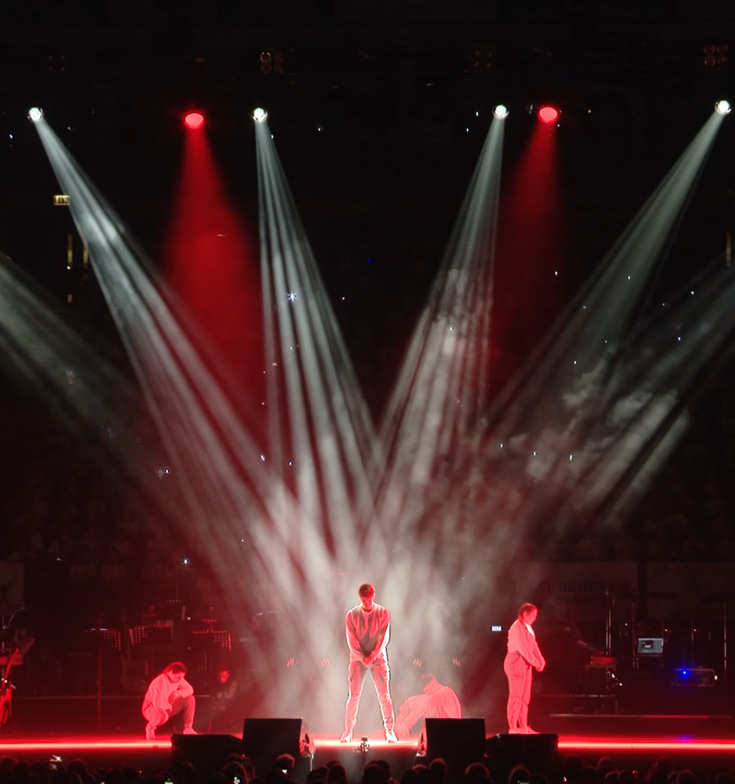
Jobs in music
Because music appears in SO MANY places a LOT of people are needed to make it happen… From the creators that you know to all the people behind the scenes.
Look up UK Music’s Careers Page on Website Here
EXERCISE: Everyone in the class chooses a job description to read
Notes:
4 mins –
Underline fact there are many different jobs in music CREATIVE & NON-CREATIVE or perhaps better put as AUDIENCE-FACING & NON-AUDIENCE FACING (many business roles need creative solutions, lots of marketing campaigns are highly creative etc. etc.)
On UK Music’s Careers page is a selection of different jobs in the industry – get pupils to look them up and then feedback. Individually, pairs, or small groups choose a different job so that they read and discuss – then feedback to class. Questions could be only Yes / No answers allowed – like 20 questions / or animal / vegetable / mineral game:
-Is this job in front of an audience?
-Would you say this job is technical?
-Does this job look after people? Etc.
Image © Discover Creative Careers, screenshot from Young Voices insight film 2021

Slide 6

Jobs in Music – Example 1
Cam Blackwood - Record Producer & Songwriter
Notes:
3 mins – (There are 3 of these films – if short on time you could show one – or come back to ones missed later in lesson)
Questions (you could set these – and others – before watching film or afterwards):
In Cam Blackwood’s film:
Who is the famous artist you can see playing a guitar? (George Ezra)
In which famous studio in London is Cam recording with a String Orchestra? (Abbey Road Studio)
How does Cam describe the days he does songwriting? (Laid back etc.)

Slide 7

Jobs in Music – Example 2
Charlene Hegarty - Talent Development & Projects Manager
Notes:
4 mins
In Charlene Hegarty’s film:
Where is The Oh Yeah Music Centre? (Belfast)
What does Charlene do when she works with artists / musicians? (understand vision, creatively support, educate about music industry)
What skills does Charlene say you need to do the kind of job she does? (communication, confidence, motivation etc.)

Slide 8
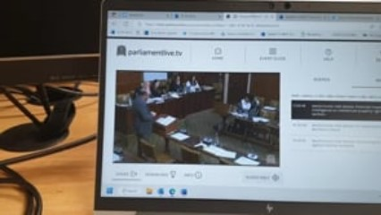
Jobs in Music – Example 3
Jennifer Geddes - Communications Manager
Notes:
3 mins
In Jennifer Geddes’ Film:
What jobs does Jennifer do as a part of her job? (write press releases, talk to journalists, update website, post to social media etc.)
Who does UK Music talk to and work with? (governments, MPs, councils, schools, universities, colleges, music industry etc.)
What did Jennifer do before the role at UK Music? (trained as journalist, promoting shows, writing reviews, running a music venue etc.)

Slide 9

Focus on Music in Media – Part 1
Chloe Kwok is a composer and musician currently working on video games at Rare Ltd.
Her composition used on Sea of Thieves Season 8 Accolades Trailer Watch Here
To find out more about Chloe and see many more examples of her work Watch Here
Notes:
5 mins –
Chloe is a musician and composer for video games – on the link ‘Watch Here’ is Sea of Thieves Accolade Trailer.
What do you like about the music and how it integrates with the video?
What games do you play and can you think of how the music adds to action?
Composing for video games is a bit different to composing a song you might play yourself – why is this?
- You have a creative brief from games company – you have a ‘customer’
- The games company decides what is used
- Video games have different stages and lengths of scenes with choices – notice the music change when characters make certain choices or arrive in certain locations

Slide 10
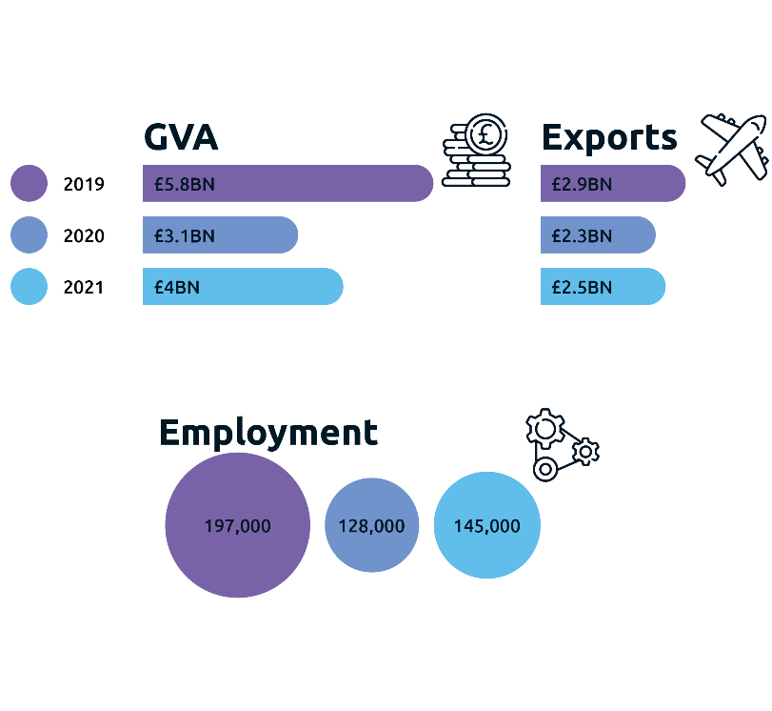
What is music worth? How many people work in music?
In 2021, the biggest selling album in the world was Adele’s ‘30’.
Ed Sheeran’s ‘=’ was the fourth best-selling album and Dua Lipa’s ‘Future Nostalgia’ was in sixth place.
Notes:
3 mins
GVA = Gross Value Added
Exercise = These are figures for 2019, 2020, and 2021 from UK Music’s report This is Music – Q. What do you think might have impacted music in 2019? (A: Covid, Brexit) – SEE END OF PRESENTATION FOR ADDITIONAL SLIDE AS FOLLOW-UP ON IMPACTS OF COVID IF WANTED
NB - After November 2023 you can also search for new 2022 report to compare figures.
See EXTRA SLIDES at end for figures on music tourism and maps for additional discussion

Slide 11
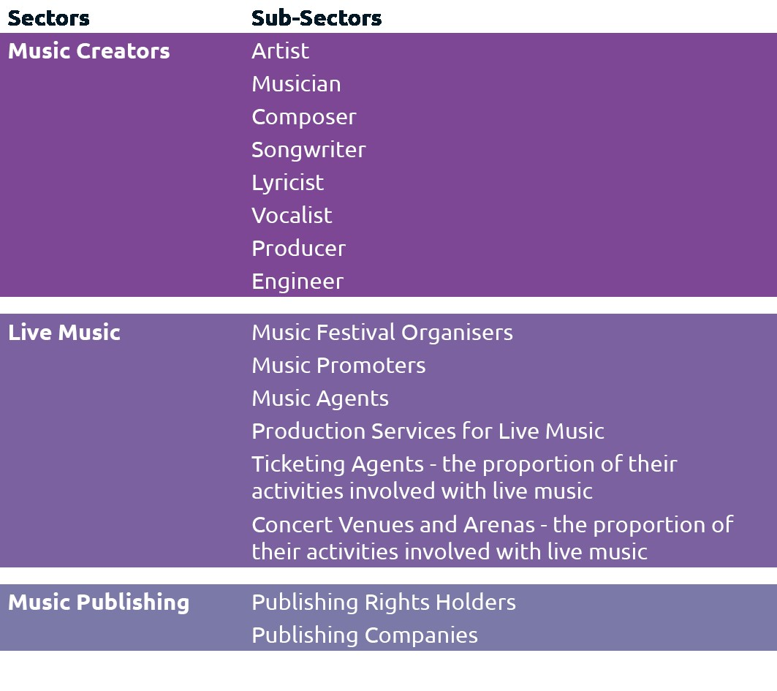
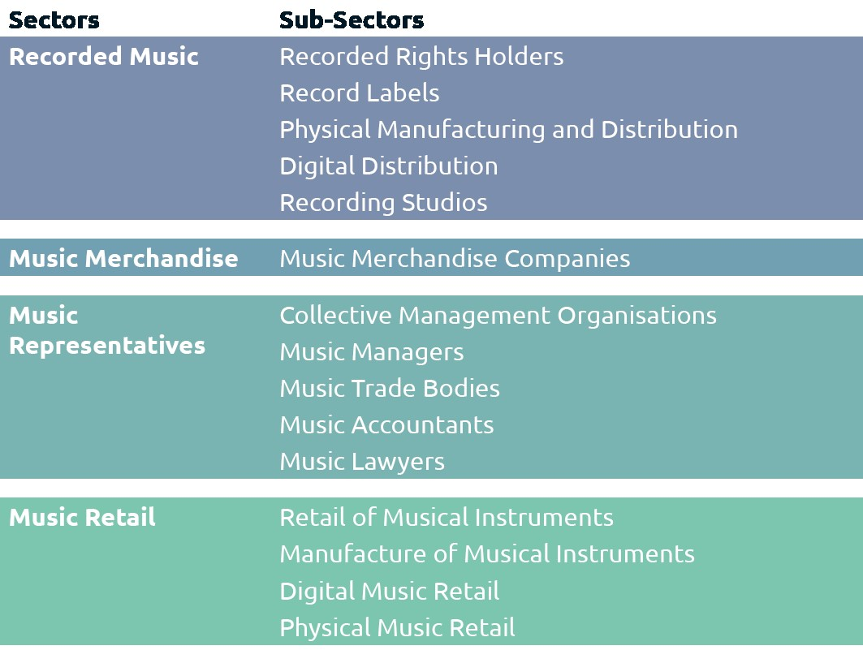
Music Landscape & Roles
Read more about the data in This is Music 2022 Here
Notes:
3 mins
The ‘Sectors’ show different parts of music industry that contribute to UK Music’s report This is Music’s GVA figure.
The ‘sub-sectors’ show different kinds of roles and activity in each sector.
Raise discussion around ‘employed’ and ‘freelance’ – you will have hopefully covered in Discover slides previously. Do they understand difference?
What roles and parts of industry do they recognise?
Has anybody done any of these (probably unpaid if they have) or experienced any: eg:
-Music creator – who plays instrument / sings / makes beats
-Live music – Anyone helped with friends gig? Or setting up concert? How about school plays etc. Who has attended a gig / concert?
-Sold a t-shirt of their band? Helped sell tickets for gigs / concerts? Made posters or shared social posts about events? How many of you have a band t-shirt? Any other merch? (Merchandise)
-Organised an event? Talked about a concert / gig with a venue – maybe you are the artist or helping a friend?
As extra exercise get class to look up report on www.UKMusic.org – new one out every November:
What are trends in report?
Which areas are strongest in growth terms?
What do you think of the use of case-studies?

Slide 12

Music Career Film – Beggars Group
Notes:
5 mins
Intro – Now we’re going to hear from two people working in music behind the scenes.
Caitlin Corrigan – Sync Coordinator
Peyam Zangana – Marketing Coordinator
Possible questions at end of film:
What is Beggars Group?
What do record labels do?
Sync Coordinator and Marketing Coordinator – what do they look after and what kind of tasks do they do?
Can anyone explain what ‘Sync’ is?
What about ‘marketing’?
What did Caitlin and Peyam like about their jobs?

Slide 13

Focus on Music in Media – Part 2
Shao Dow is an award-winning rapper, manga author and occasional ninja. Find Out More Here
'Inosuke Riddim' used as part of the soundtrack in Episode 3 of 'All or Nothing: Arsenal' series on Amazon Prime Video - Watch Here
'Thunder Roll' used as official trailer, lobby and emote music for popular game Fortnite by Epic Games - Watch Here
Notes:
5 mins
There is a great example of a ‘Sync’ (Synchronisation) here with ‘Inosuke Riddim’. Why does the video have music attached? Would it have been as exciting if just the visuals?
Watch (recommend at least 1 minute to get to first chorus) of ‘Thunder Roll’. This was commissioned especially for Fortnite so Shao Dow wrote it for this purpose. Does anyone play Fortnite? What does the class like about it? What do they think of how the music fits with the visuals? What other language is used? (A - Japanese)
If you have some more time encourage the pupils to look at Shao Dow’s website – link on slide – what do they notice? What other skills does he utilise to help his music career? Think about: storytelling / manga, appearances at Comicon style events, love of video games, merch (merchandise), live shows, his comic, collaborations, use of Japanese, his use of socials such as Instagram, martial arts, appearances on TV (Ninja Warrior), engagement with policy issues (he spoke in parliament about music), really good engagement with fans etc.
Image: Academy of Contemporary Music

Slide 14
Words / Ideas
Merch Sync Composition
Rights-holder Creative Brief Splits
Gig Contracts Session Musician
Tour Streaming DSP DAW
Artist Rider Technical Rider / Tech Spec
Marketing IP A&R
Notes:
3 mins
Quickfire round the class - See who knows what these are…. Ask class to research ones they don’t know… (on phones / computers – very quick) – work through a few.
What other terms have they seen / can they find that they aren’t sure about? Look for explanations.
Merch – merchandise (band t-shirts, posters etc.)
Sync – Synchronization – Music placed to accompany visual content
Composition – Creating original music
Rights-holder – The individual or company who owns the music
Creative brief – in composition for example if paid by someone else to write a piece they will give ideas and context Splits – How you agree to divide up rights etc. (for example look at different bands credits on songs, some will be all of band, some will be one or two people, some will be written by a songwriter not in the band at all)
Gig – a concert
Contracts – legally binding agreements
Session musician – someone playing in a studio or on a tour who isn’t the Featured Artist (for example Taylor Swift’s guitarist for many years Paul Sidoti)
Tour – A series of gigs / concerts that moves from city to city, country to country
Streaming – Listening to music online via DSPs
DSP – Digital Service Provider like Amazon, Spotify, Apple
DAW – Digital Audio Workstation that allow you to record, edit and produce music
Artist Rider – When an artist plays a gig / concert they might ask for certain items backstage – favourite drinks, food, etc.
Technical rider / tech spec – The items needed by an artist to perform at a venue – some equipment will be provided by the venue and the rest they will bring (all are different)
Marketing – Making fans / consumers aware of an artist’s releases, tours etc. to increase sales
IP – Intellectual Property – who owns the rights to a creative idea for example a song
A&R – Artist & Repertoire – Department within record label / music publisher etc. who find and nurture new talent

Slide 15
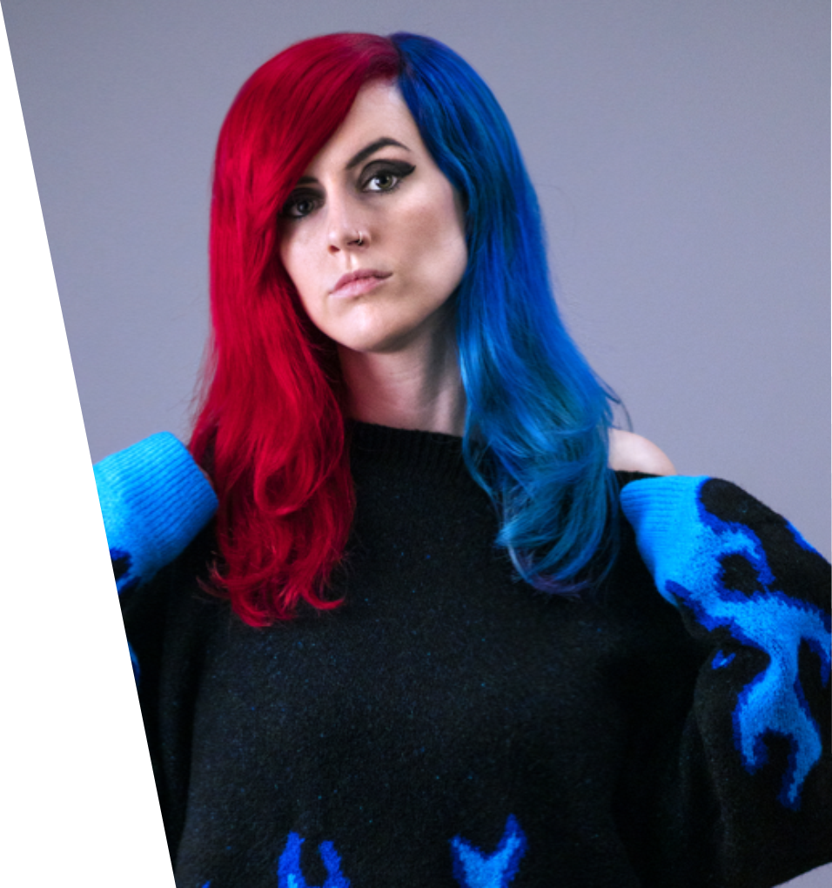
Focus on Music in Media – Part 2
Emma McGann is a songwriter, independent trailblazer and award nominated artist who has earned recognition from artists including Kylie Minogue, Nancy Sinatra and Beth Hart. Find out more about Emma Here
Emma creates lots of YouTube videos to teach the skills she’s learnt – find out how she created her own music video in Unreal Engine Here
Notes:
8 mins
Watch Emma McGann’s YouTube video on creating her own music video in Unreal Engine (whole video is 10 mins so watch all if you have time or show first few minutes)
Emma is a talented songwriter with lots of fans but also does lots of teaching videos to share her learning on all the skills she has gained.
What skills does Emma talk about in the video?
-Storyboarding, planning, mapping, rendering characters, etc
What skills are Emma using to make the video?
-Presenting, editing, filming, sound, making room look cool (set), explaining, teaching,
Look up other videos to help with songwriting, live-streaming, etc.

Slide 16

Reflection
In how many places does music appear?
What jobs have we heard about today?
Is music important to you?
What other skills did Emma McGann, Chloe Kwok, and Shao Dow have that helped them in their musical careers?
Do you need to play an instrument to get a job in music?
What did the company Beggars do and why is it important for music?
What did Caitlin and Peyam from Beggars love about their work?
What is the difference between Freelance and Employed?
What other words or ideas did you learn today?
Notes:
4 minutes
class discussion to reflect on learning raised – use questions as starting point but utilise own and allow conversation to flow…

Slide 17

Further info
www.ukmusic.org
Notes:
An additional exercise if more time or as homework would be looking up UK Music and our members (all accessible from www.ukmusic.org to find out what we all do….
Ask class to research now or as an exercise for discussion at next session.

Slide 18
Additional Exercises/Resources
Interested in Managing Artists? Try out the app Music Inc Here
Check out BIY People & Talent’s Top Tips Here
Read the Get Paid Guide Here
If you have composed music (and are over 16) submit it to BBC Introducing to get yourself heard – info Here
Search for your local PRS Foundation Talent Development Partners Here
Interested in careers in Live Events check out Production Futures Here
Notes:
Look through websites – ask pupils to have a search. Suitable for older pupils

Slide 19
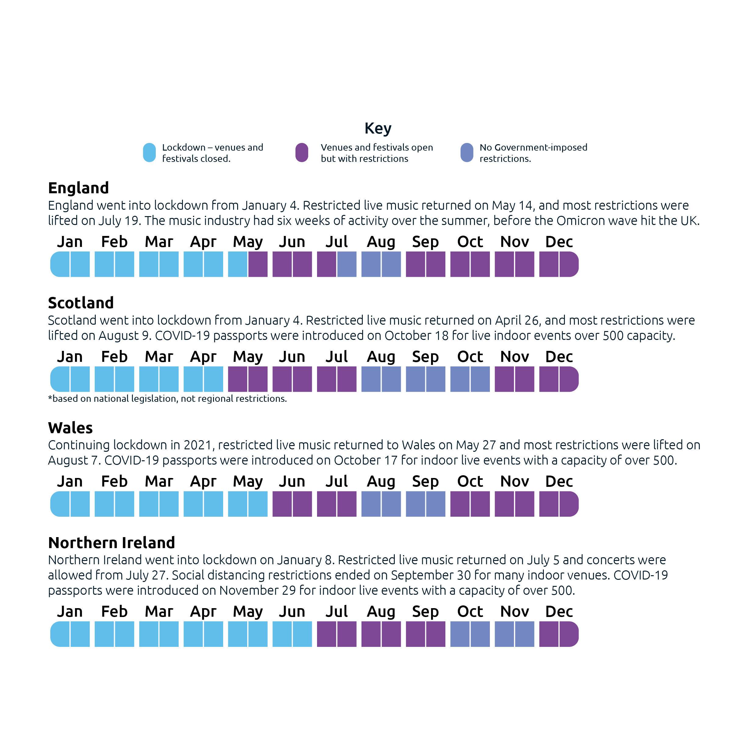
Notes:
ADDITIONAL EXERCISE
5 mins - This is what happened across the different Nations during Covid.
What impact would venues and festivals closing have had? How long did it go on for? How long were they fully ‘back to normal’ for in the year?
Source: This Is Music 2022 - UK Music

Slide 20
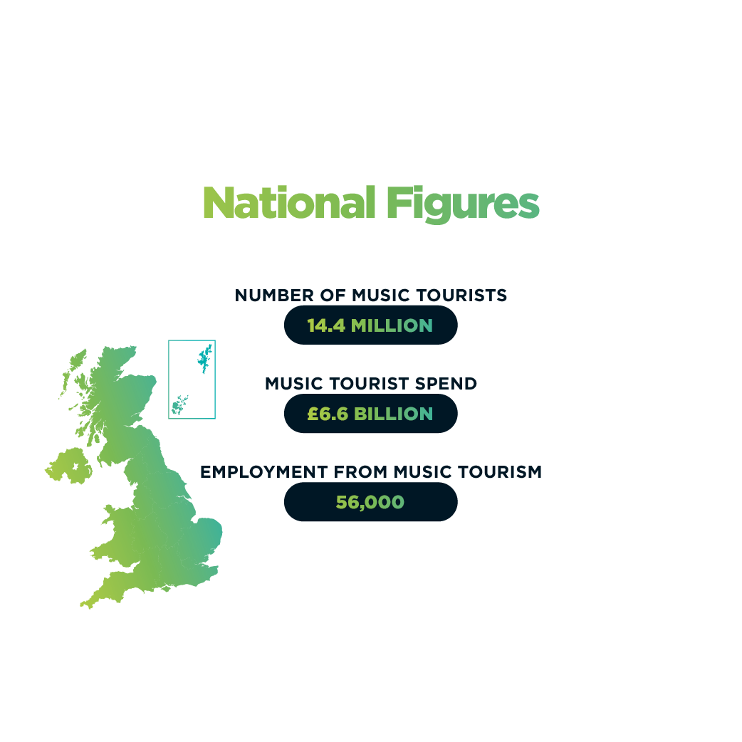
Here, There and Everywhere
Notes:
Additional Exercise - Region specific
UK Music’s report Here, There and Everywhere outlines the impact of the eagerly anticipated resurgence of live music in 2022 – the first full year of post-pandemic festivals, gigs and concerts in the UK, and shows the international reputation of the UK’s live music events.
Find your region in the below maps and discuss the local / regional music scene.
How do the figures compare to other regions?
What local venues / artists / festivals / recording studios / music development organisations do you know about?
How could you get involved more if interested in music? Think about school, community, town, region.
Source: Here, There and Everywhere 2023 - UK Music

Slide 21
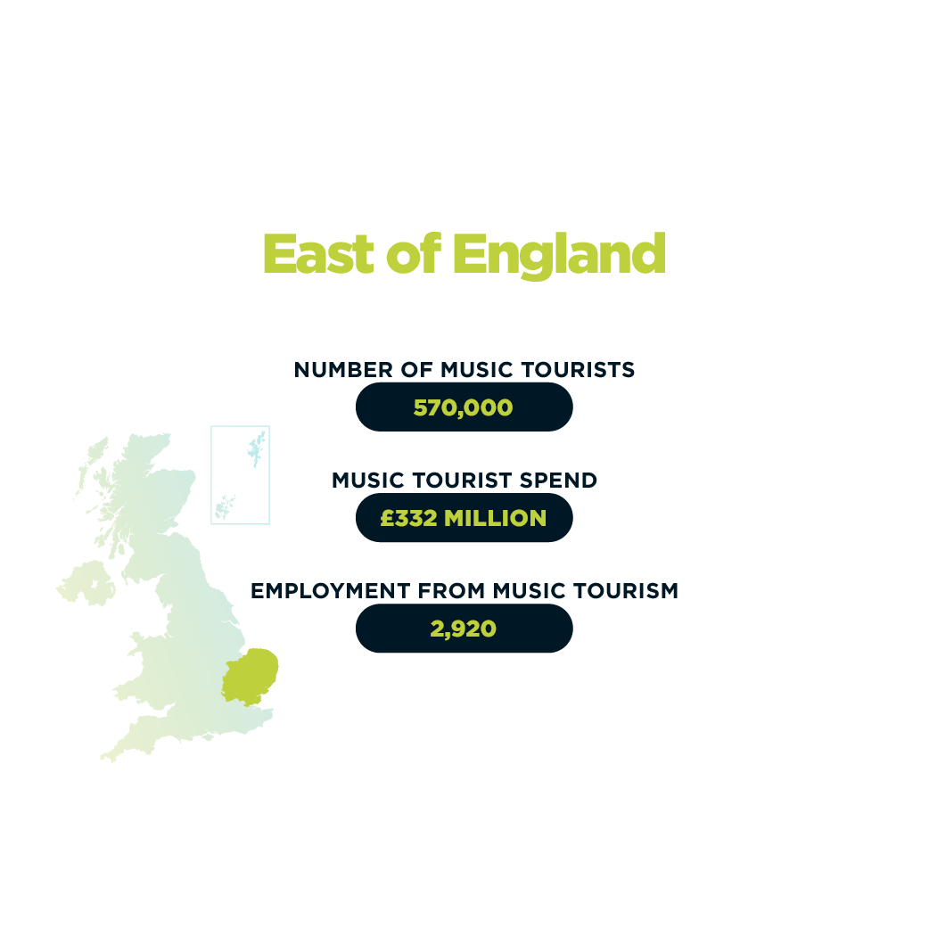
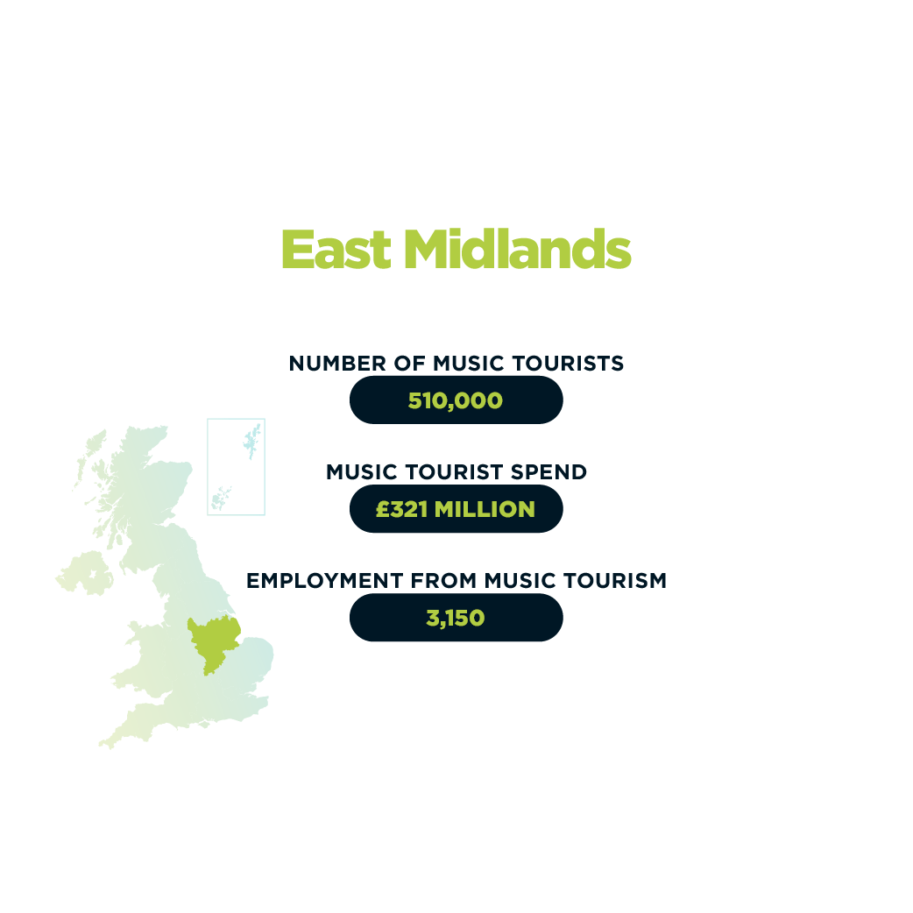

Slide 22
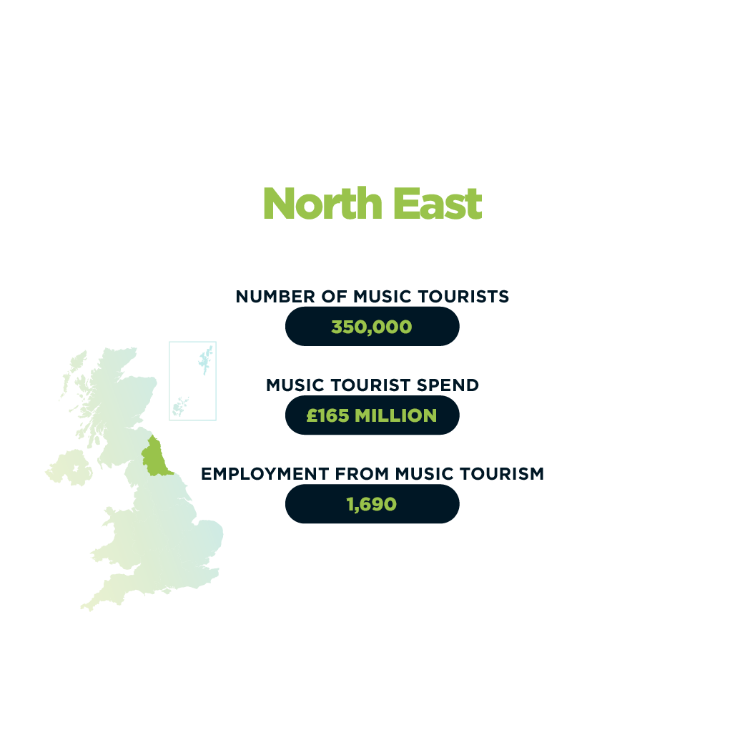


Slide 23
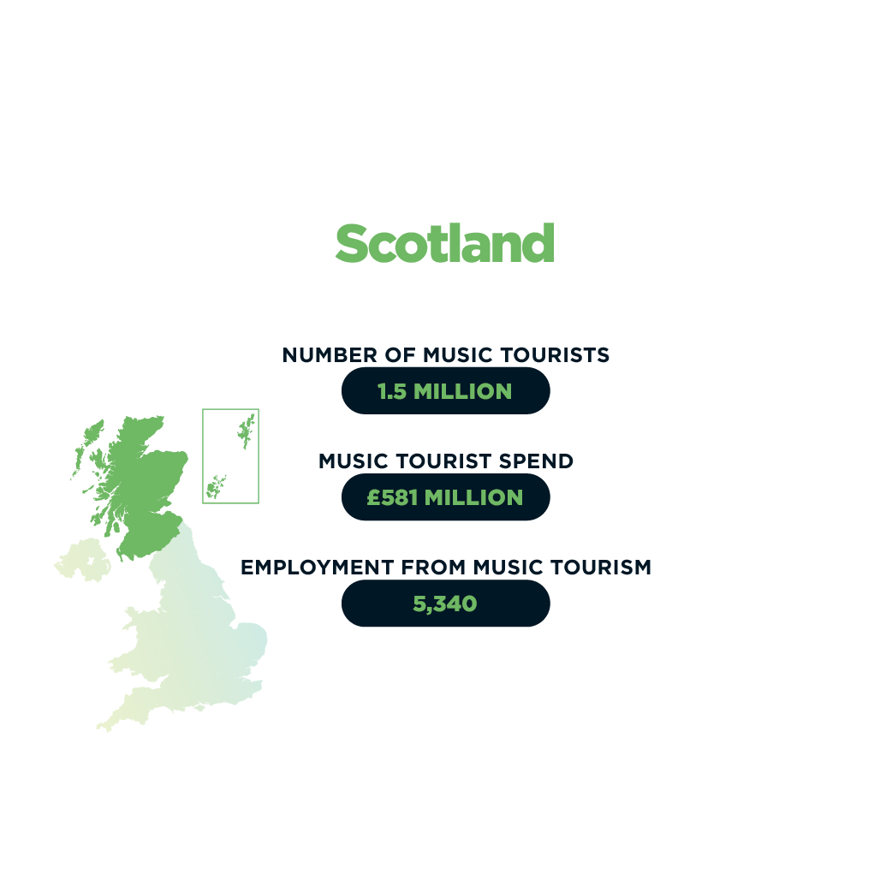
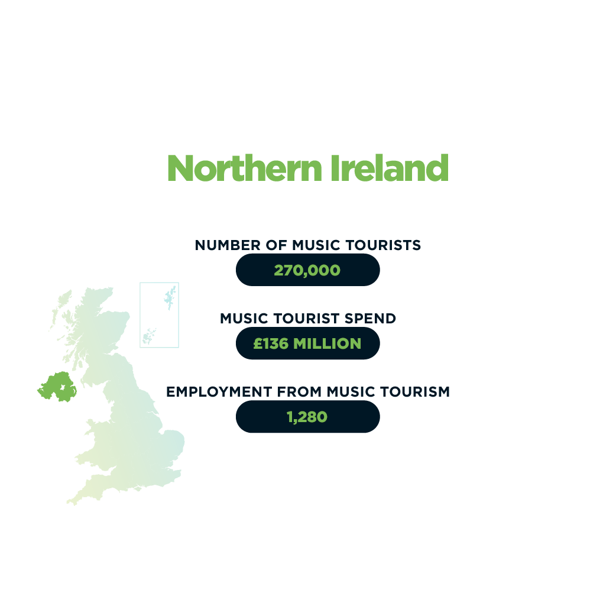

Slide 24

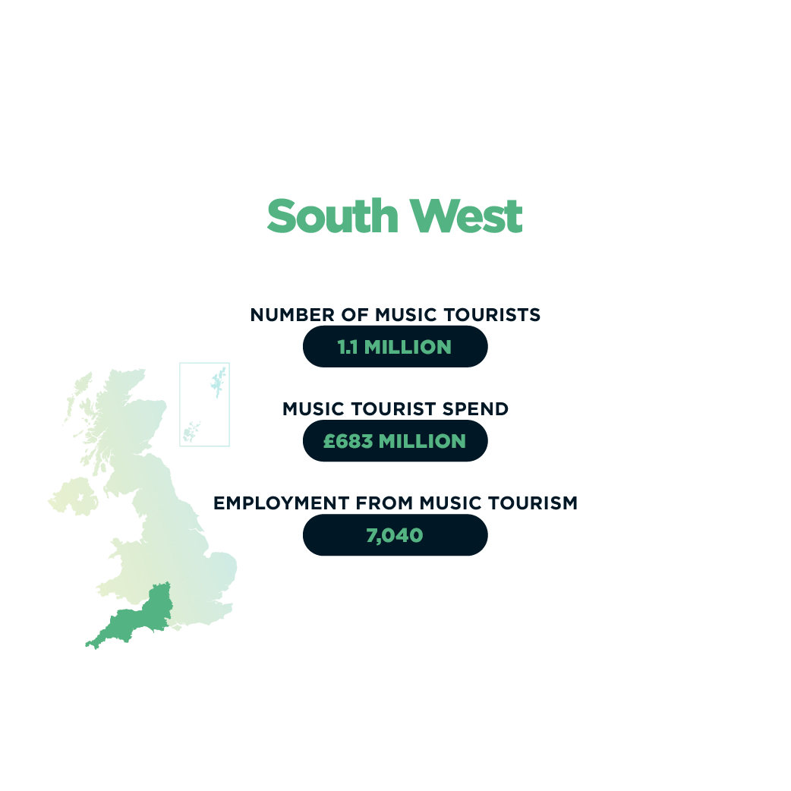

Slide 25

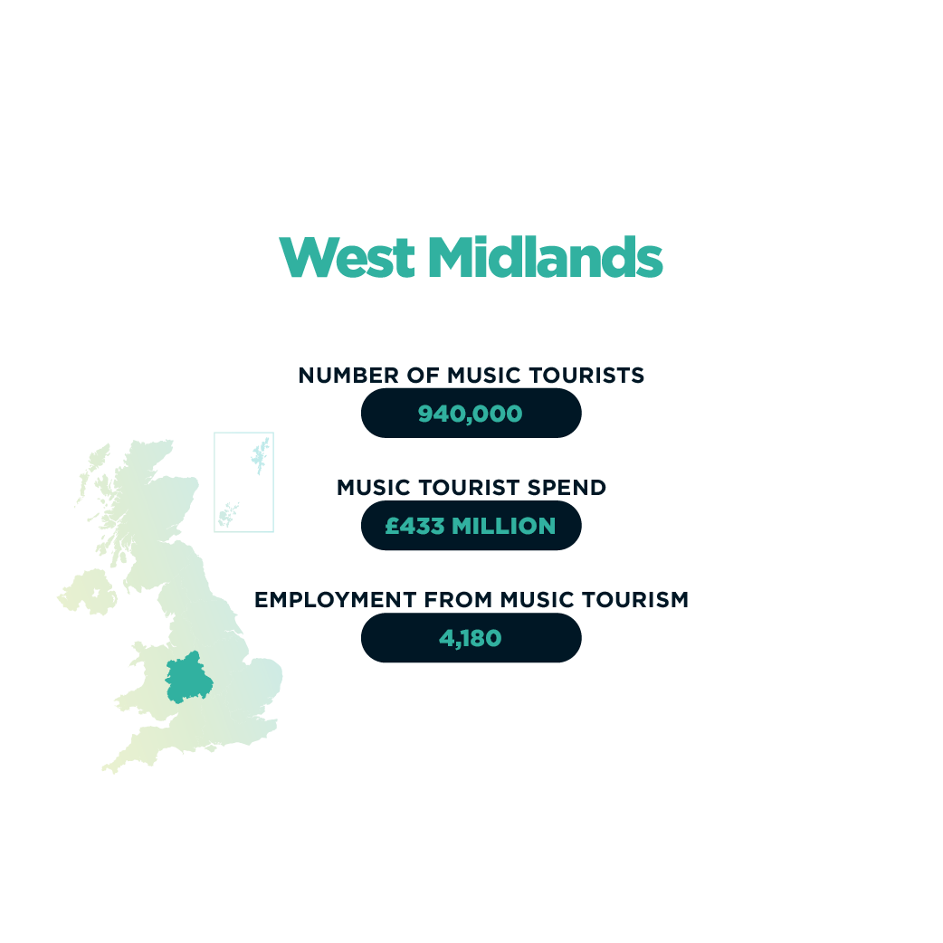

Slide 26

