Slide 1
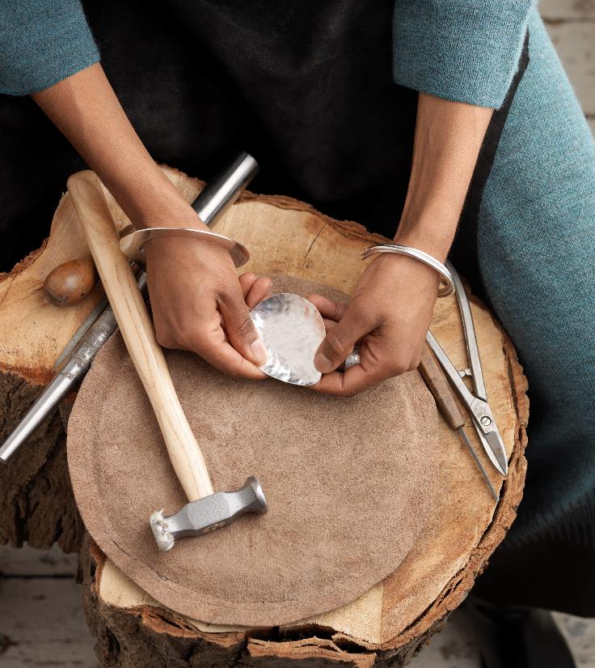
Crafts, fashion and textiles

Slide 2

Aims and objectives…
LO: To be aware of the different roles in the craft, fashion and textiles industry
AIM: To introduce students to the craft, fashion and textiles industry

Slide 3

Welcome to crafts, fashion and textiles

Slide 4
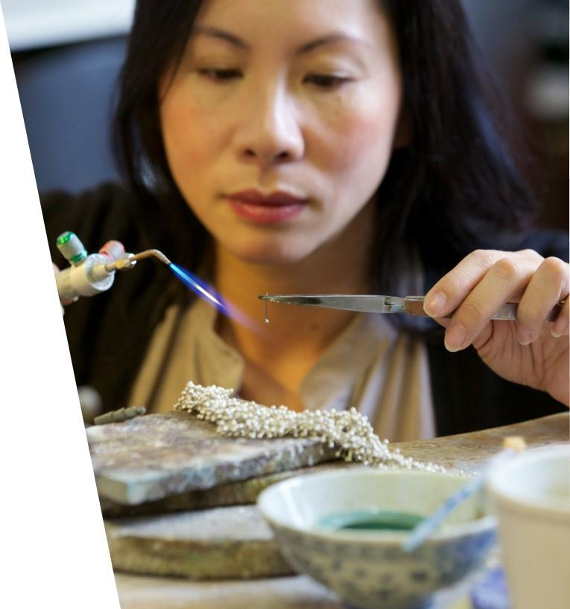
Characteristics of the craft sector
The craft industry encompasses goods that are handmade by artisans or those skilled in a particular trade.
Small businesses engaged in the craft trade include everything from art galleries to handmade textiles to culinary products.
Often, craft industry entrepreneurs operate independently and are not franchised.

Slide 5
How many different careers can you think of in crafts, fashion & textiles?
Notes:
Note: Teacher can refer students to the film and ask them to think about crafts markets, crafts beers, artisan breads, handmade Jewellery, different materials and associated trades etc.

Slide 7
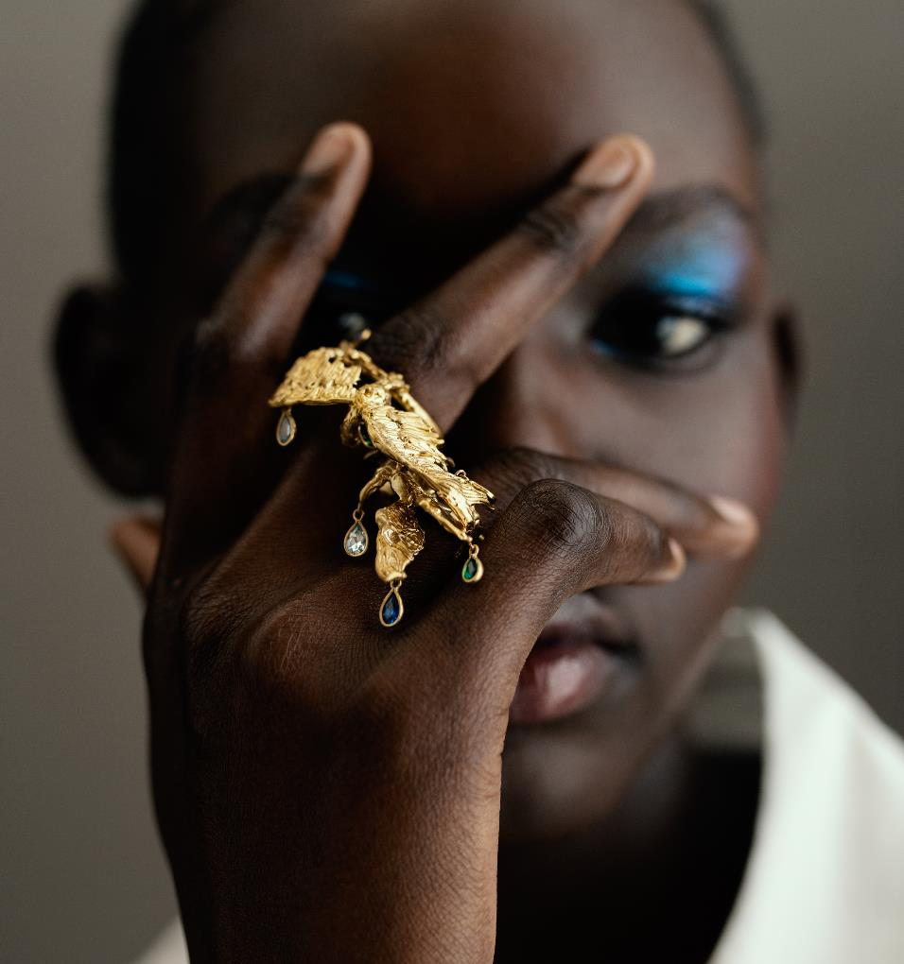
The craft industry
Made up of people who are generating an income from creating, making, designing; always honing their skills and usually doing something they love
It’s a serious business:
  Crafts contribute £3.4bn to the UK economy (2021)
  There are an estimated 11,620 UK crafts businesses, employing 149,510 people.
  Government estimates £6.9bn of exports from the UK crafts sector (2019)

Slide 8

Tour Cockpit:

Slide 9


Tour of Cockpit (Discussion – 5 minutes)
(
Cockpit is a centre for excellence in craft, bridging the gap between talent and opportunity. They are an award-winning social enterprise, home to 160 independent creative businesses in London.
Was Cockpit what you expected?
Which crafts appealed the most?
Would you like to work in craft or fashion? Why?

Slide 10
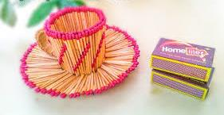
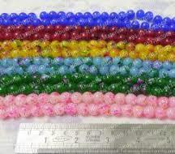
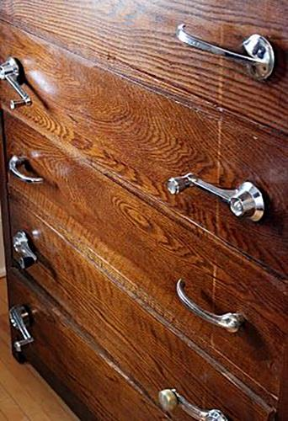
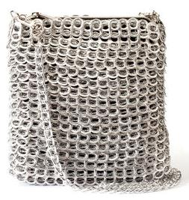
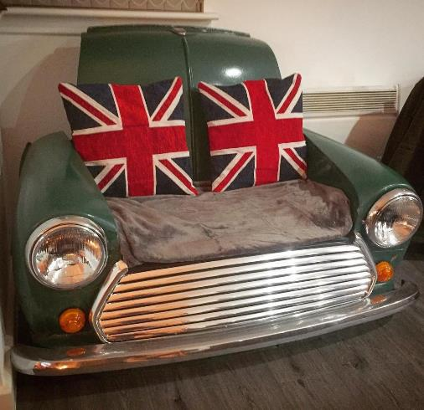

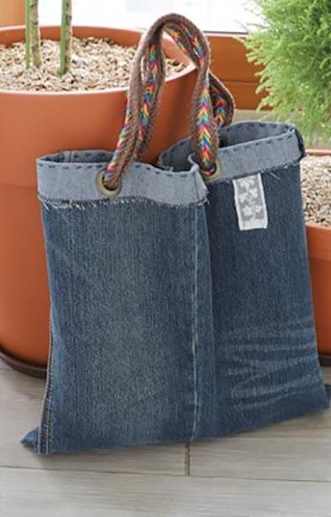
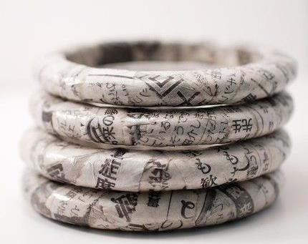
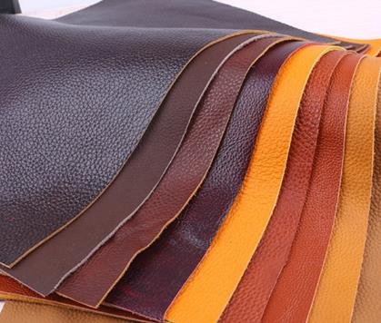
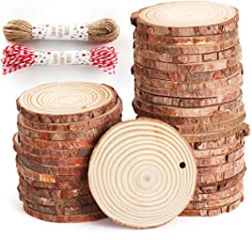
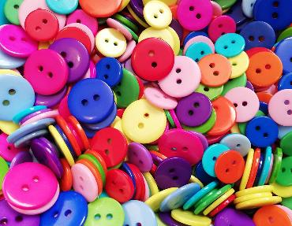
Sustainably innovative
Old car part handles
?
Ring pull bag
Vintage mini sofa
Newspaper Jewellery
Newspaper jewellery
31% of makers have changed their practice in the last three years in response to environmental concerns…
Old jean accessories

Slide 11
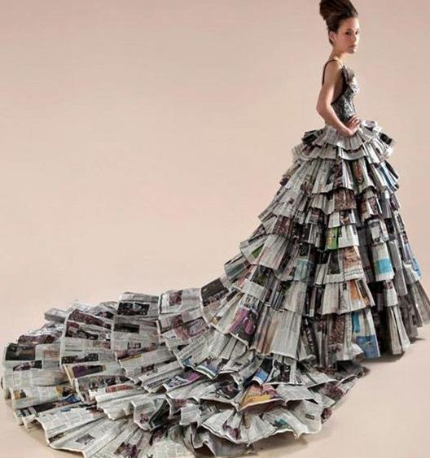
Sustainably innovative
Students to work in pairs:
Discuss possible raw materials that could be recycled, upcycled or downcycled – consider what would happen if you pair up two materials, what product could you create – be innovative, sustainable, creative and crafty!
For your product to be a craft industry idea, the product must always be made-by-hand rather than manufactured in vast quantities.
Consider what issues your product might solve or why would your customer want or need it. (see worksheet)

Slide 12
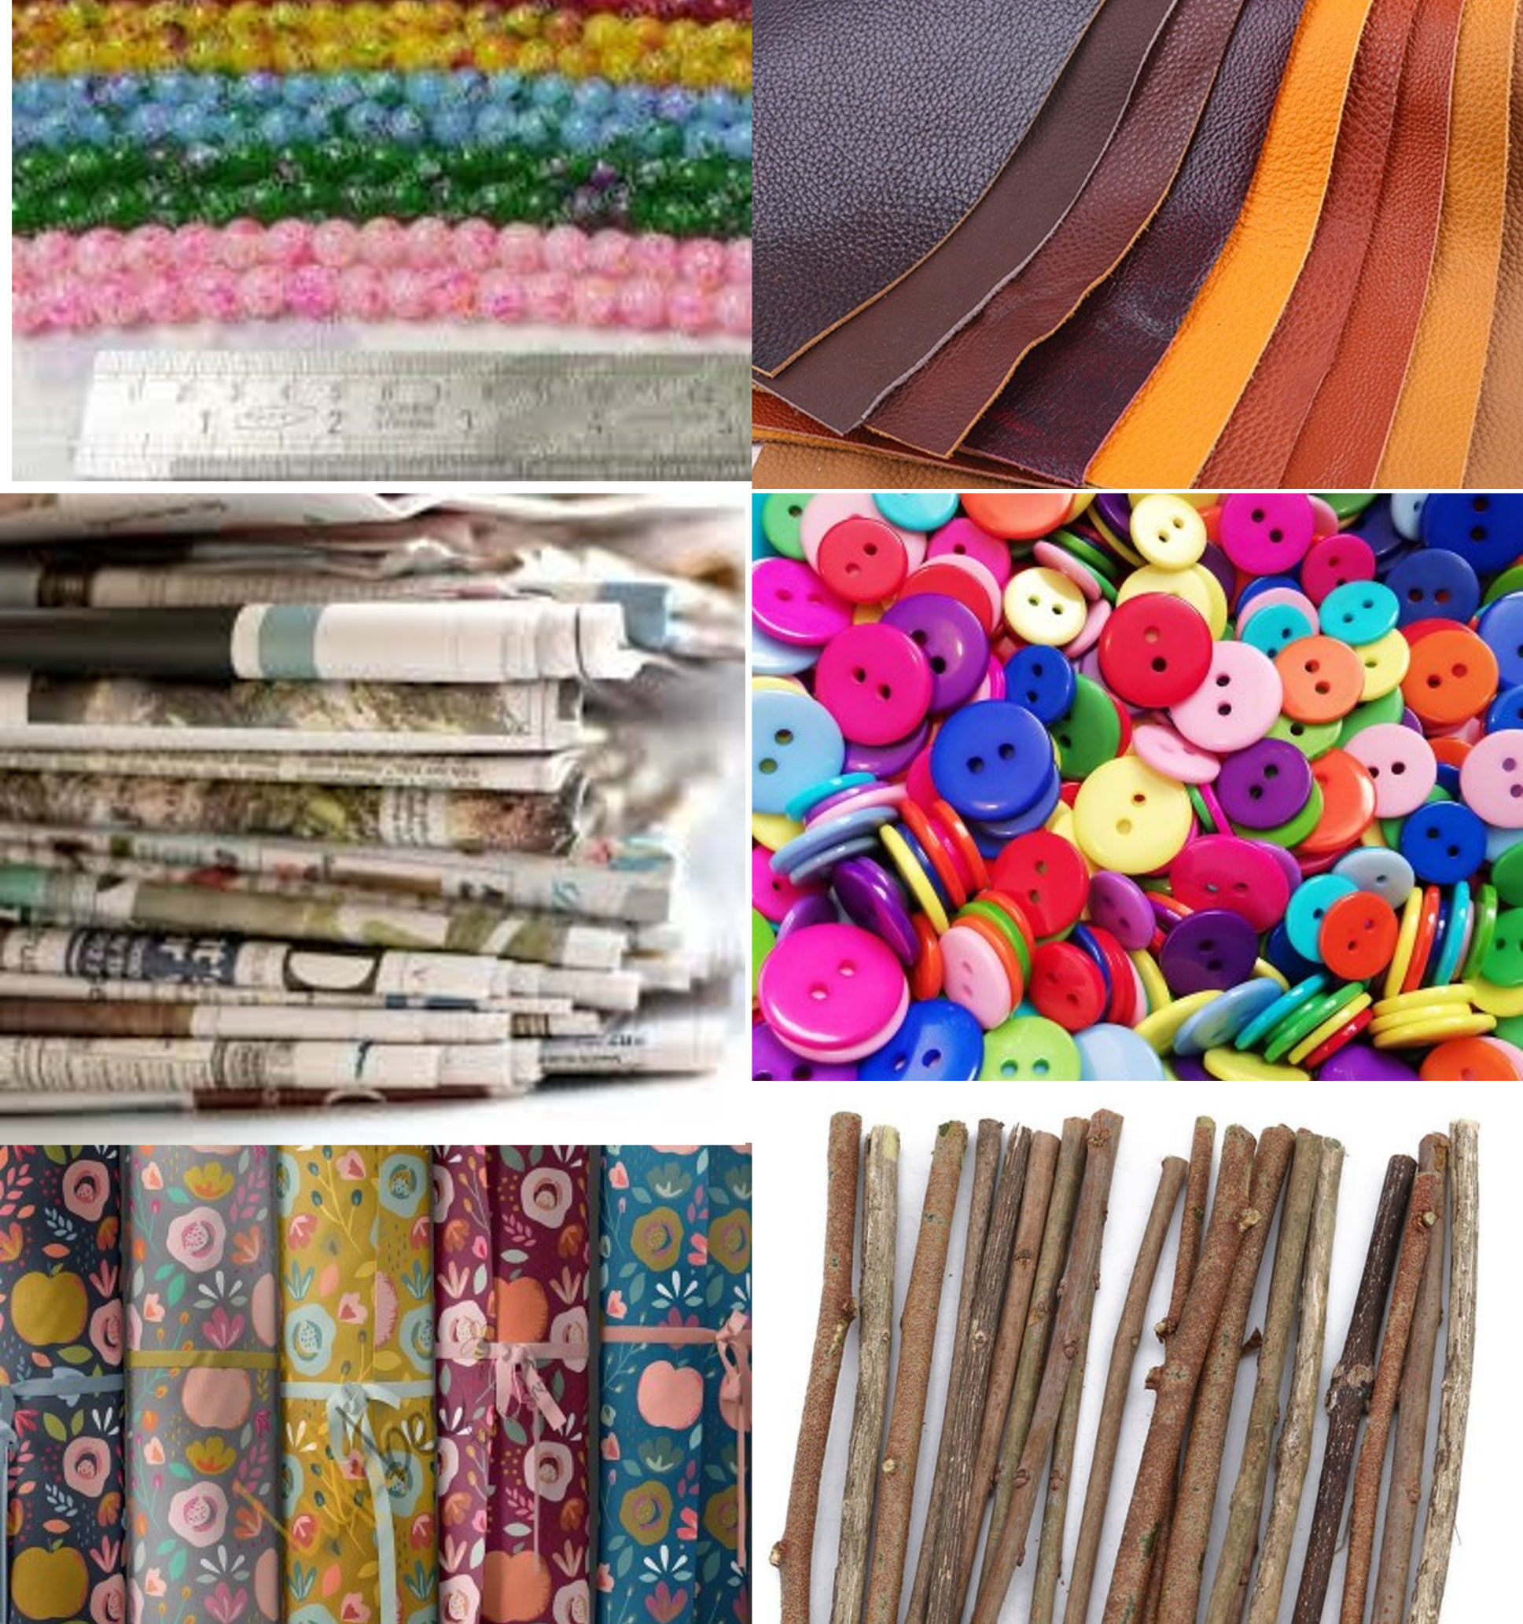
Sustainably innovative
Extension Activity:
Craft is different from manufacturing because it is making-by-hand.
What item of clothing or accessory could you make from raw materials you have to hand?
Present your creation to the class!

Slide 13
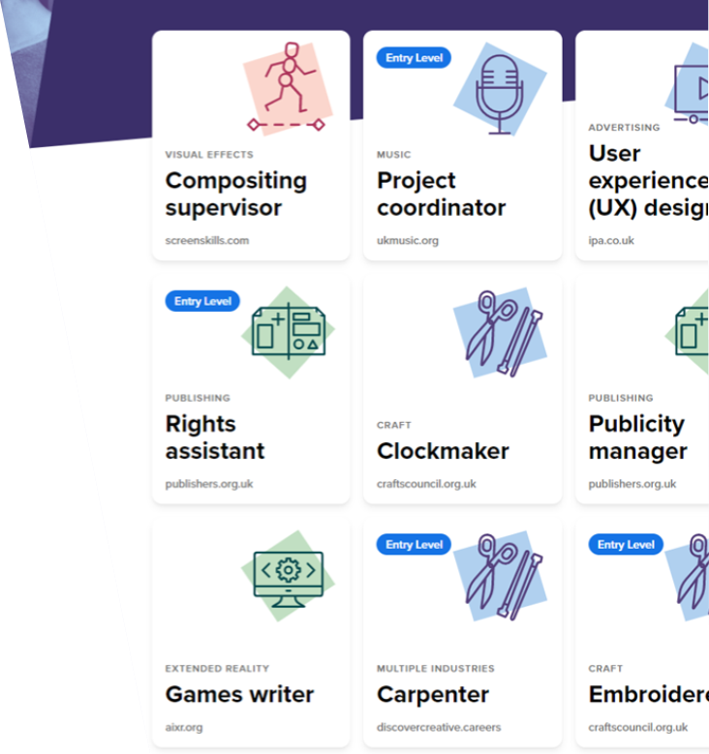
Find out more about careers
Visit www.discovercreative.careers
Find a job you have never heard of
Find a job you would like to do

