Slide 1
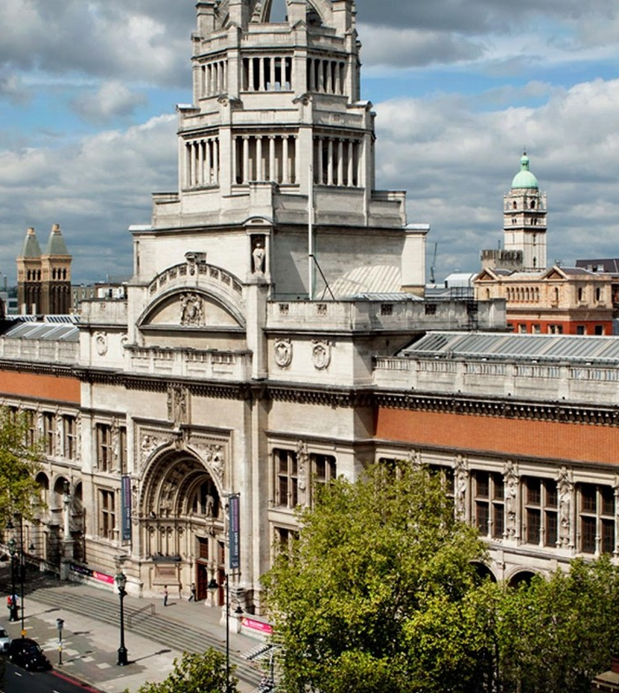
Museums, galleries and heritage

Slide 2

Aims and objectives…
LO: To demonstrate you can identify careers in museums, galleries and heritage
AIM: To bring the gallery curation experience to life by virtually discovering objects featuring in exhibitions at the V&A
To experience and solve a workplace task

Slide 3
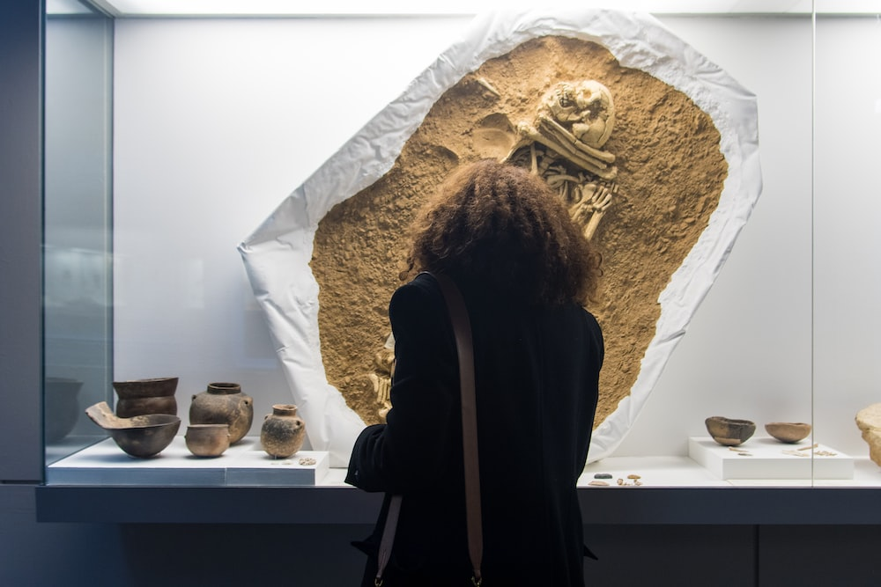
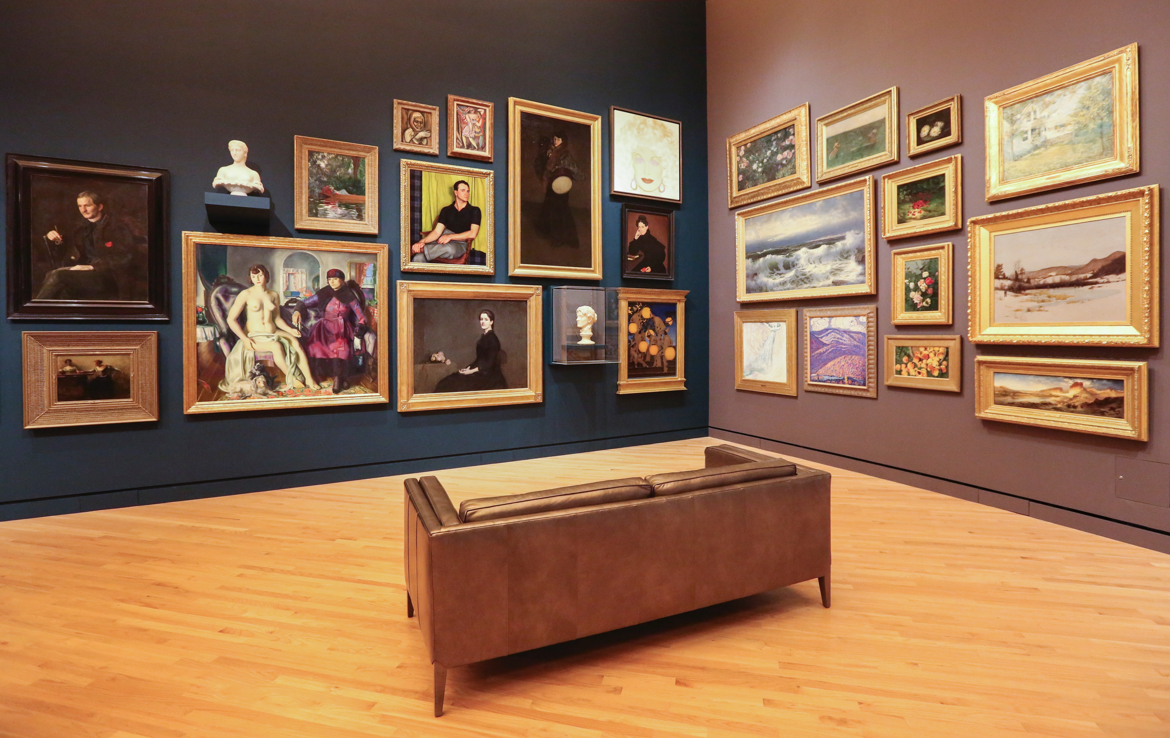
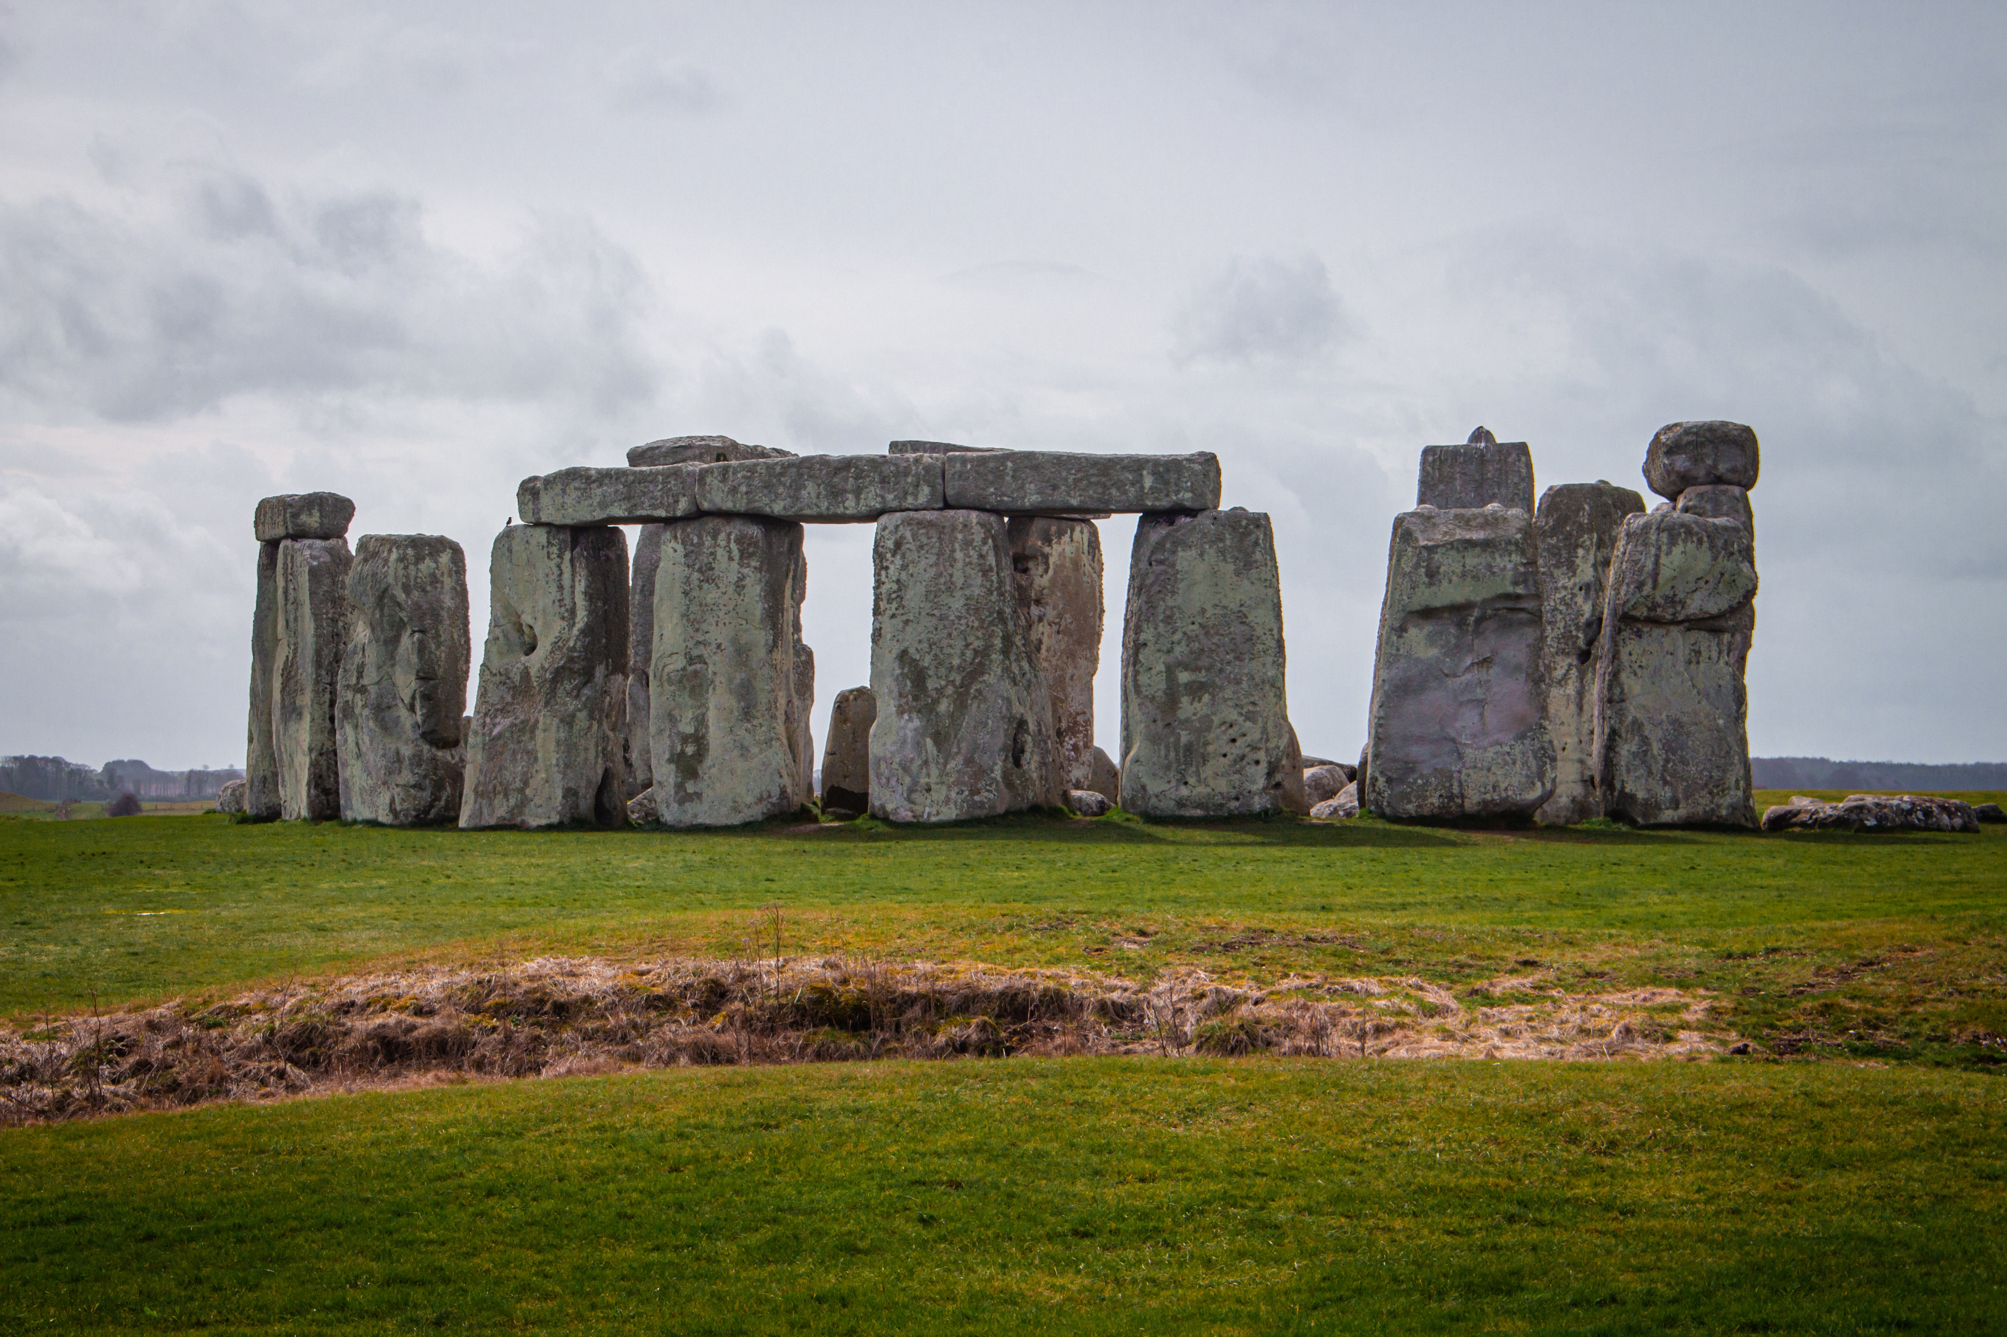
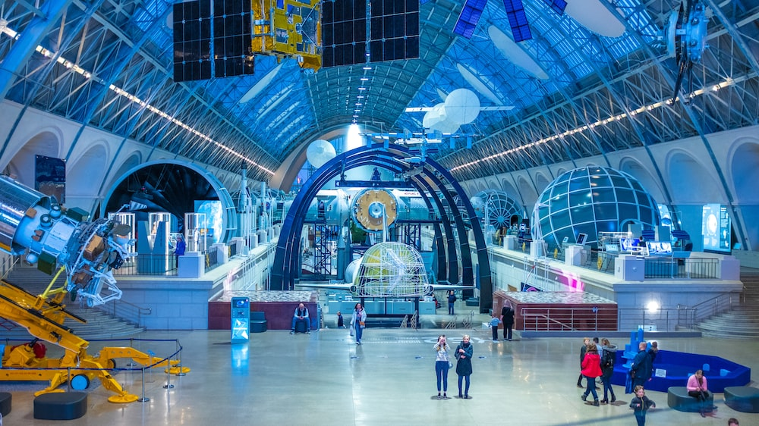
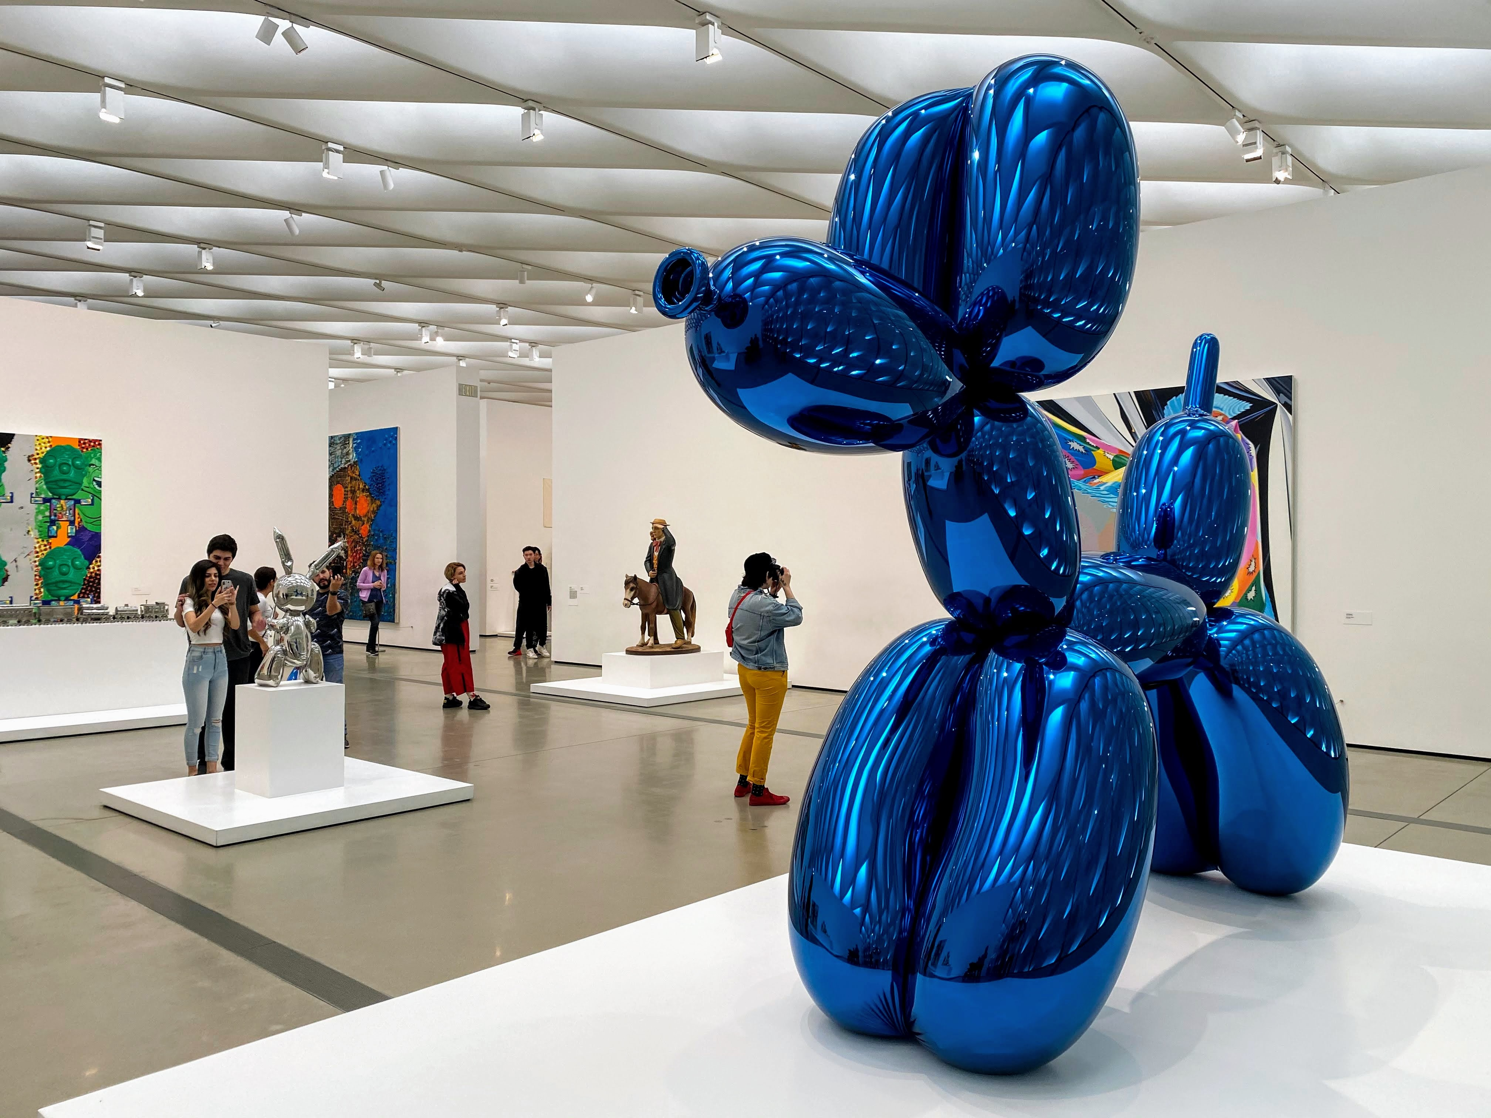
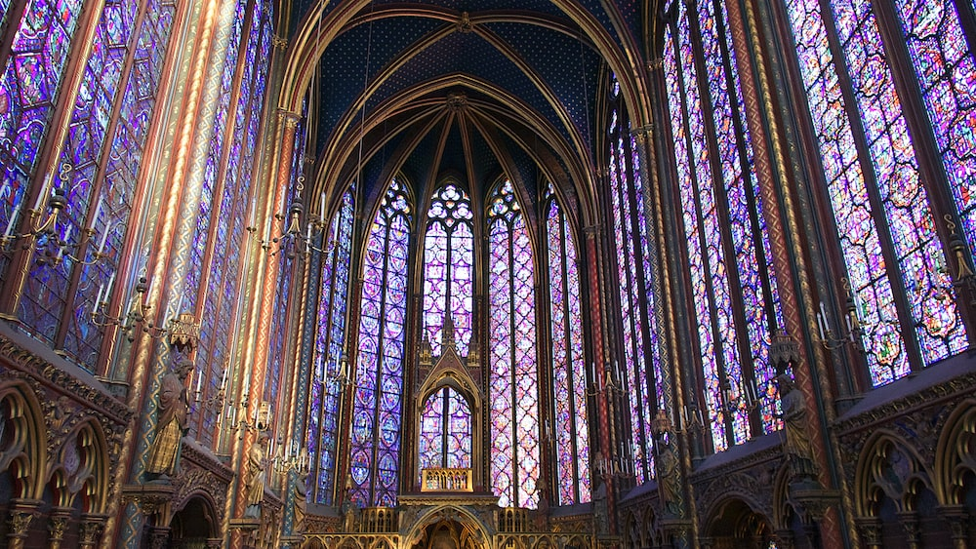
Museums, galleries and heritage sites – what’s the difference?

Slide 4












12 sectors = lots of opportunities
Advertising
and marketing
Design (product graphic, fashion)
Film TV,
video radio and photography
Animation and
VFX (visual effects)
Video games
Heritage
IT, software and computer services (‘creative tech’)
Museums, galleries and libraries
Music, performing and visual arts
Crafts
Publishing
Architecture

Slide 5
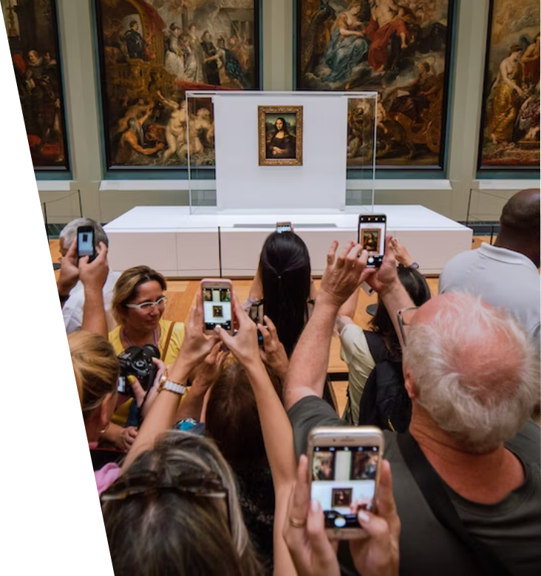
Question and Answer
Independent museums and galleries play a valuable role in their communities, contributing to a sense of place and making up an important part of the tourism economy.
What museums, galleries, heritage sites or attractions do you have near you?
Did you find any experiential or interactive activities there?
What was interesting about these places?
Could anything be improved?

Slide 6
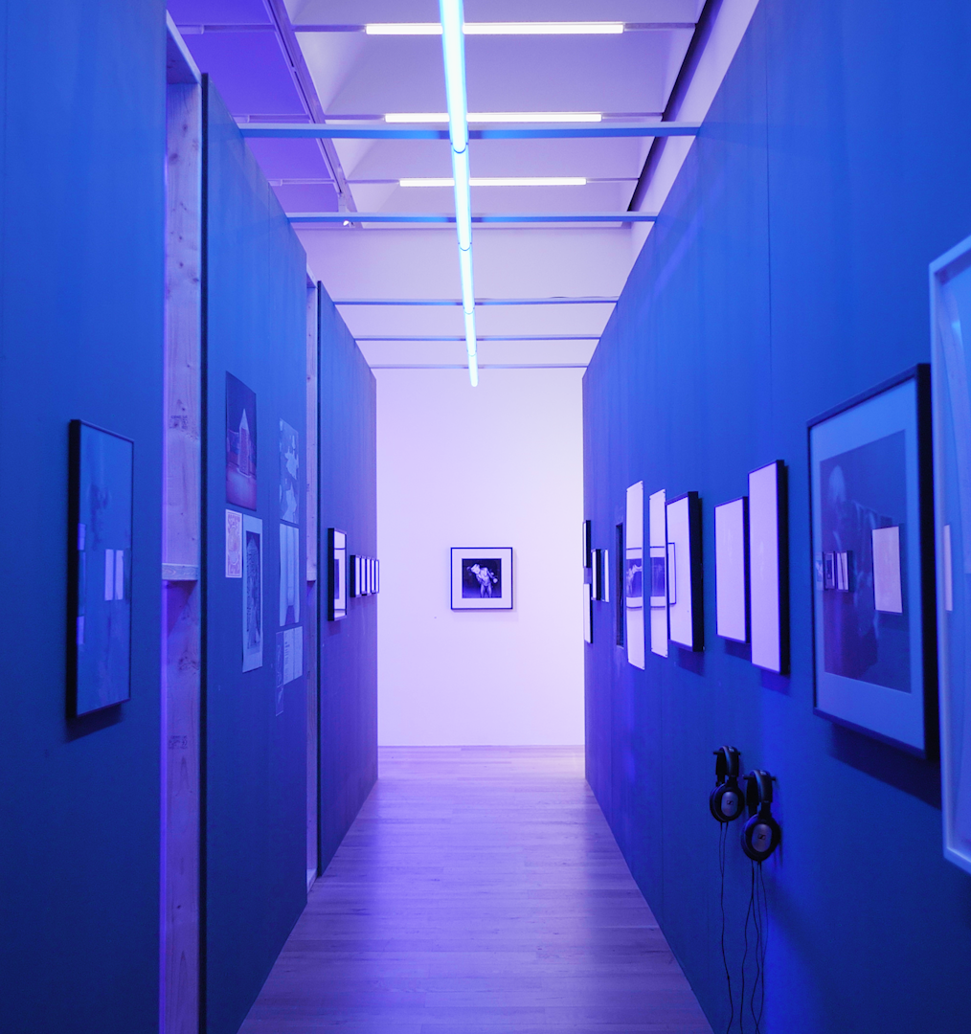

10- 15 minute task
You are asked to create an exhibition showcasing art from your school. Which art would you select and why?
Draw an example of the layout of the exhibition considering spaces you have within your school. Note below:
Who is this exhibition aimed at? How do you know?
What do you want your visitors to learn? How will you facilitate this?
How would you make your experience more interactive and sensory? What other items might you include in your exhibition?
Extension: explain why to the teacher (verbal)

Slide 7
Video: Watch and listen…
Note down 5-8 jobs you can do within the sector.
Write down examples of 2-3 jobs you’ve never heard of. Extension - can you find out what they are?

Slide 8

Discussion: Is there anything you learnt about the sector you didn’t know before?

Slide 9



National museums, galleries & heritage
National museums are run and funded directly by the central government.
They are generally larger institutions that hold collections considered to be of national importance.
It is free to access the permanent collections in all national museums, though they may still charge for temporary exhibitions.
Museum examples:
British Museum, Science Museum, National Museums in Liverpool
Gallery examples:
National Portrait Gallery, Tate (London , Liverpool, St Ives Cornwall)
Heritage examples
National Trust, National Heritage Trust, Historic Royal Palaces

Slide 10
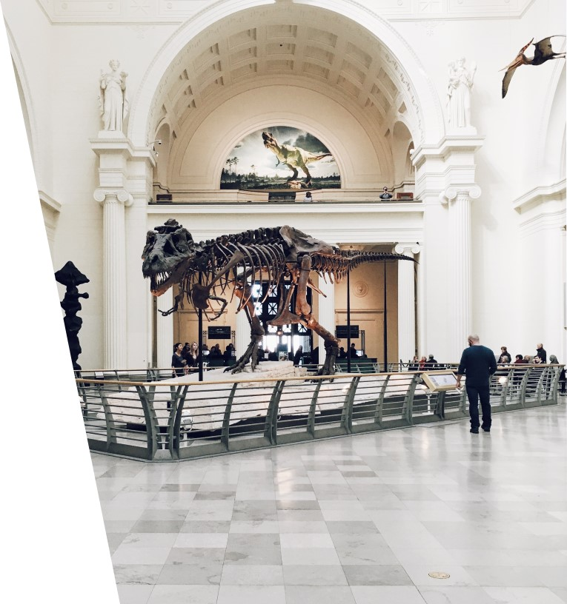
Independent museums, galleries & heritage
Independent museums are long-standing, successful social enterprises run on a business-like basis.
The UK’s 1,600 independent museums account for more than half of the UK’s museum sector and are the largest type of museum within that sector

Slide 11
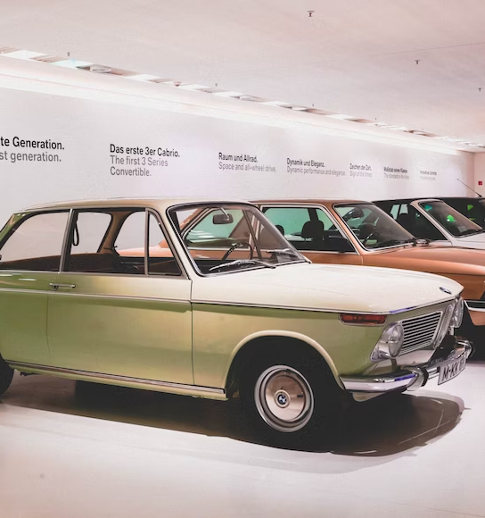
Independent museums, galleries & heritage
Museums cover a wide range of subject matter…
1/3
are more general, from major ‘civic’ museums to numerous medium size museums in county towns and over 300 small museums concerned with local and community history
2/3
deal with specialist subjects and transport - military, industrial heritage, galleries and famous persons are most popular

Slide 12
How many different careers can you think of in museums, galleries & heritage?
Use the Discover Creative Careers website to help you…

Slide 13
Careers in museums, galleries and heritage
Copyright Manager
Art Handler
Taxidermist
Curator
Digital Archivist
Fashion Historian
Art Gallery Manager
Finance Officer
Archaeologist
Fundraiser
Gallery Art Technician
Indexer
Arts Administrator
Librarian
Learning & Participation Manager
Museum Assistant
Exhibition Designer
Marketing Assistant
Retail/Customer Service
Conservator
Guides
Admissions/bookings officers
Archivist
Heritage Manager
Historian
Catering

Slide 14
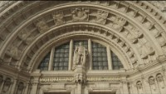
Photography Exhibition at the V&A

Slide 15
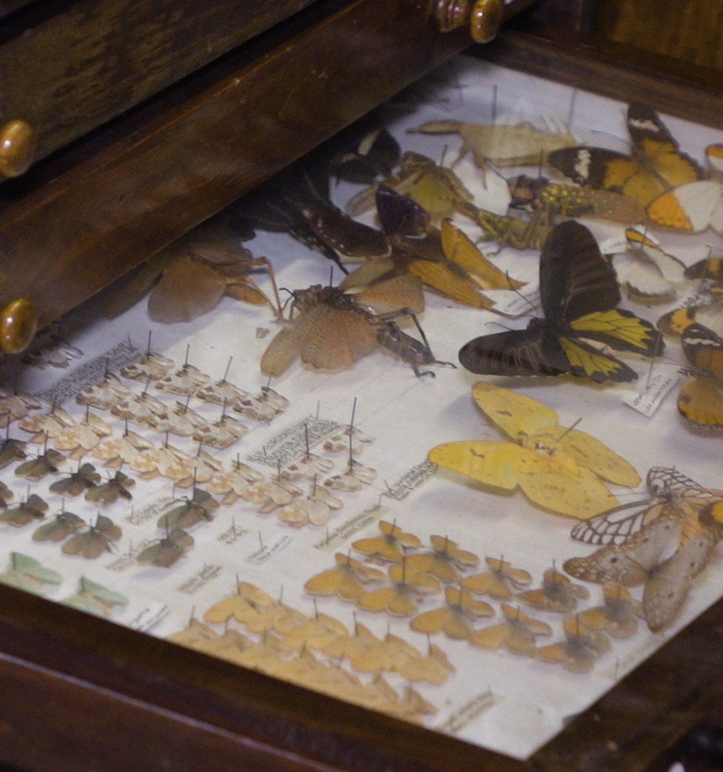
Curator – Job role
Museum curators manage collections of objects of artistic, scientific, historical and general interest. In your day-to-day duties you may:
select, buy or borrow items
organise records, catalogues and indexes
make sure exhibits are stored under the right conditions
arrange conservation and restoration
help visitors to interpret and enjoy exhibits and collections
organise publicity and fundraising
give talks

Slide 16
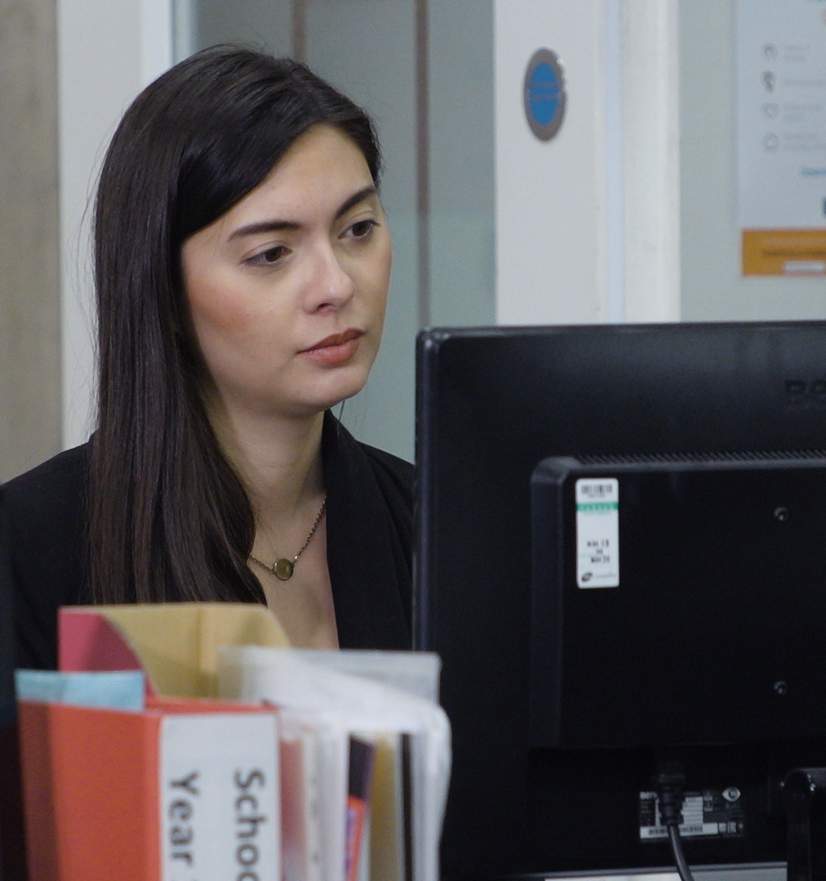
Curator – skills and knowledge
The skills and knowledge you will need include:
interest and knowledge of history
knowledge of English language
to be thorough and pay attention to detail
knowledge of the fine arts
knowledge of teaching and the ability to design courses
to be flexible and open to change
the ability to use your initiative
the ability to work well with others
to be able to carry out basic tasks on a computer or hand-held device

Slide 17
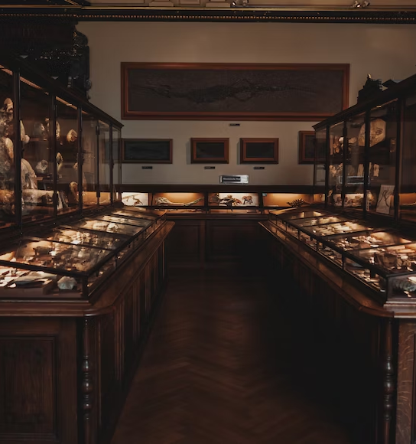
Go back to your exhibition…
EXTENSION task - 10 Minutes
Peer assessment on shared task sheets.
What would you change?
What went well and even better if?
How would you change your exhibition now from the start of the lesson?

Slide 18

Learning check
5 minutes – exit slip
How many sub-sectors of the creative industries are there? Can you name them?
What skills and qualifications do you need to work in museums, galleries and heritage?
Where do you look to find out more about careers and pathways into the creative industries?

