Slide 1


Slide 2
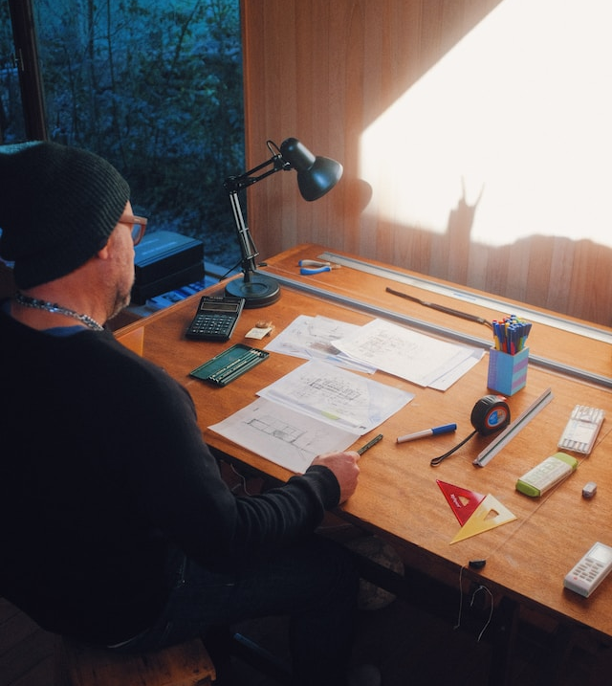
Focus on architecture
Is there a career for you?
Notes:
Today we are talking about careers in architecture, as part of our exploration on careers in the Creative Industries.

Slide 3
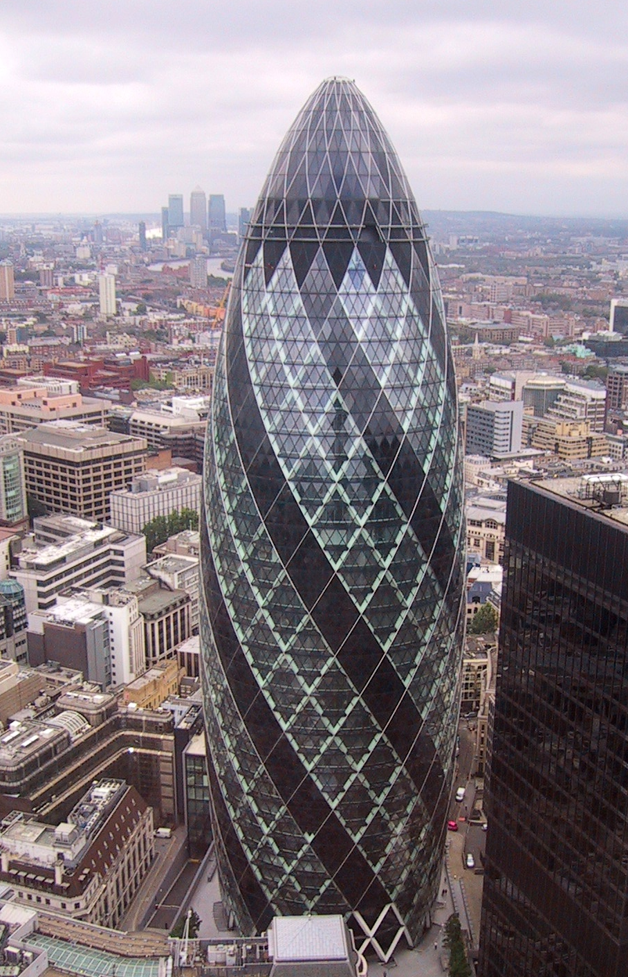
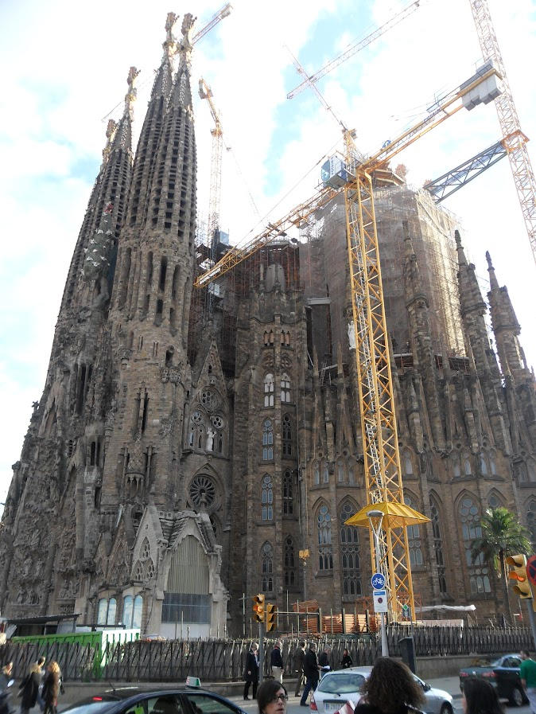
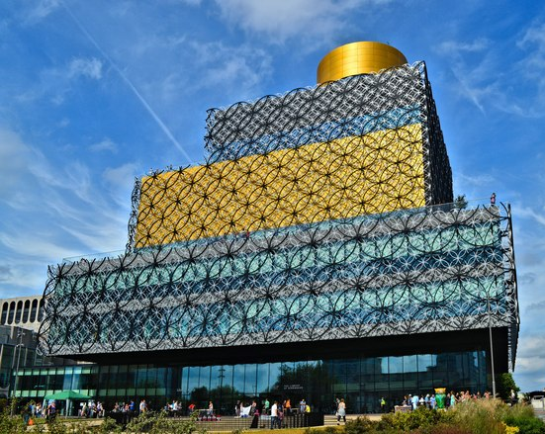
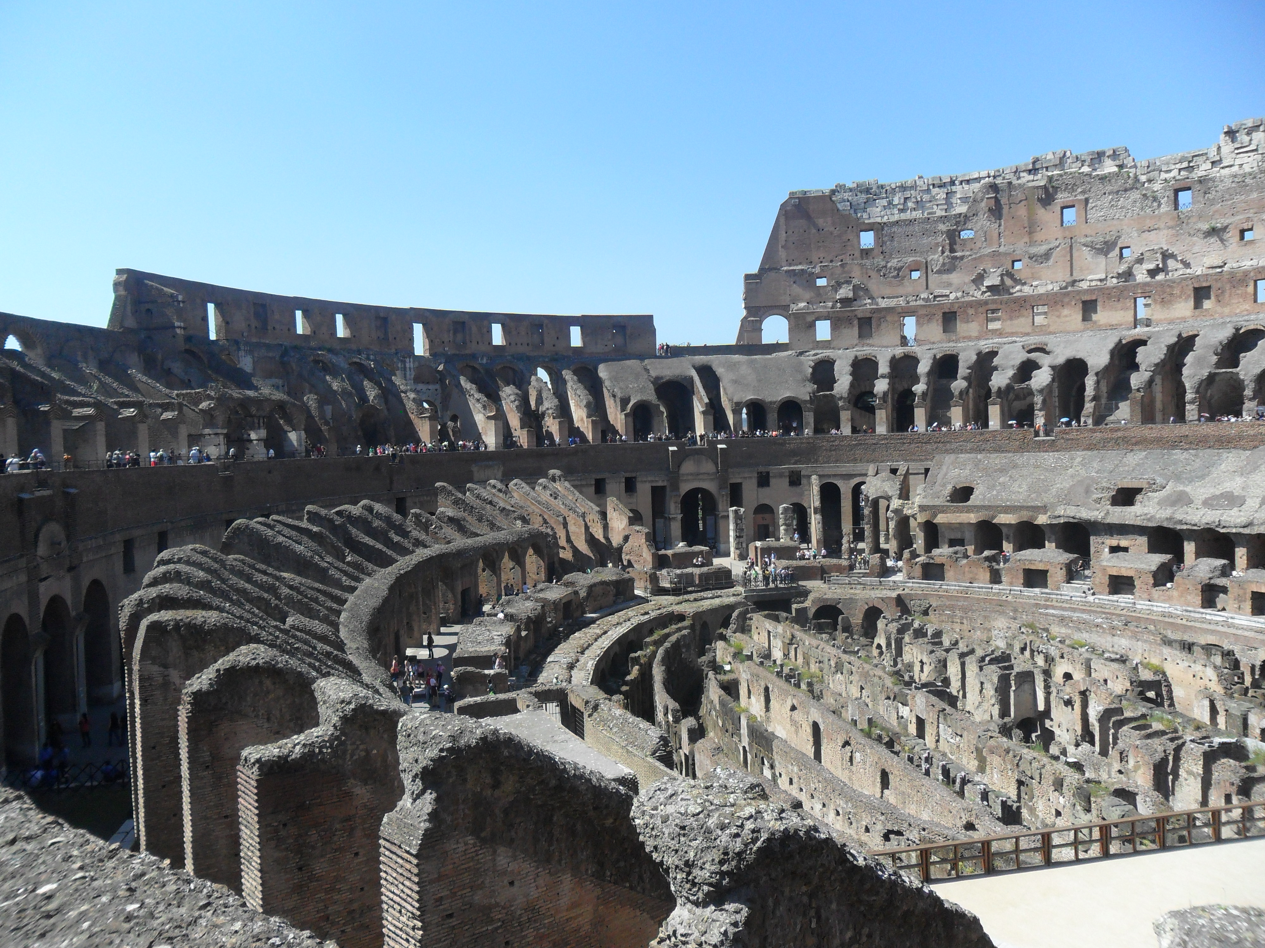
What is architecture?
Architecture means the design of building and spaces.
Do you recognise any of these buildings which have been designed?
Notes:
ASK : Can anyone tell me what architecture means or refers to?
SAY: Architecture can refer to the practice of designing buildings/spaces, or the physical appearance or style it has been designed in.
The design of buildings/structures are usually done by architects, but the design process is usually collaborative with many other professionals who work within architecture – such as structural engineers who need to ensure the design by the architects will actually stand up and be safe!
ASK: Look at these iconic buildings designed by architects. ere are some iconic buildings designed by architects. Can anyone tell me the name of the building and its location?
Answers:
Library of Birmingham, Birmingham, (designed by Mecanoo).
Familia Sagrada, Barcelona, (designed by Antonio Gaudí)
Colosseum, Rome, (designer unknown)
The Gherkin, London (designed by Norman Foster)

Slide 4

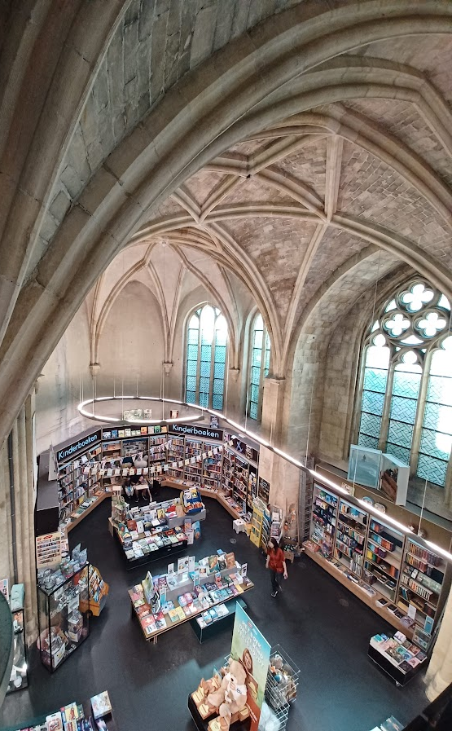
Quick brainstorm…
In pairs list as many different buildings, spaces and structures that you can think of which are designed by architects.
Which do you think are designed more frequently?
Which do you think would be most fun to design?
Notes:
Say:
Architecture is often associated with houses and skyscrapers. But there are many other types of buildings and spaces that can be designed, either from scratch or retrofitted (explain that this means an old building that is re-designed and may have is function changed- see picture).
Instruct:
Tell students that they have two minutes to work with their partner to list as many buildings and spaces they think may be designed by architects.
Discuss:
Ask students to share what they wrote down.
Answers to expect: Houses/flats/bridges/parks/pavilions/hospitals/schools/care homes/housing estates/interiors/monuments/retrofitting of old buildings/cafes/bars/libraries/green spaces/churches/town halls/sea fronts/stadiums/museums.
Discuss:
Which do students think are the most common to be designed (consider demand/need & age of existing buildings found in their area e.g. housing shortages, many schools built last century and not fit for purpose)
Which do you think would be most fun to design? (consider how much creativity they would have, if they think clients would have a lot of money).

Slide 5


Fact or myth?
Which of these statements about careers in architecture do you think are facts, and which do you think are myths?
The title ‘architect’ is legally protected in the UK
You must be good at maths and art to have a career in architecture
Qualifying as an architect takes longer than qualifying as a doctor
Being an architect is a well paid profession
Notes:
Say:
TV and films love to have characters working in architecture - such as Ted Moseby from How I met your mother and Keanu Reeve’s character from the film the Lake. However these portrayals help add to many myths about what it’s like to work in architecture. Let’s see how good you are from separating fact from fiction.
Instruct
Read each statement out and ask students to raise their hand if they think it’s a fact or a myth. Ask a student to explain their answer.
Share
Give students the correct answers and explanations.
FACT: Only architects registered with the Architect’s Registration Board (ARB) can legally call themselves an architect.
MYTH: Architecture has many roles which suit many skill sets. Creativity, teamwork and good communication skills are amongst the most important.
FACT: The minimum time it takes to qualify as an architect is seven years, doctors it takes just five
MYTH/TRUE: Architect’s salaries vary greatly depending on location and level experience, but the average salary for those who qualified in the last five years was £35k. So whether this is well paid is personal!

Slide 6
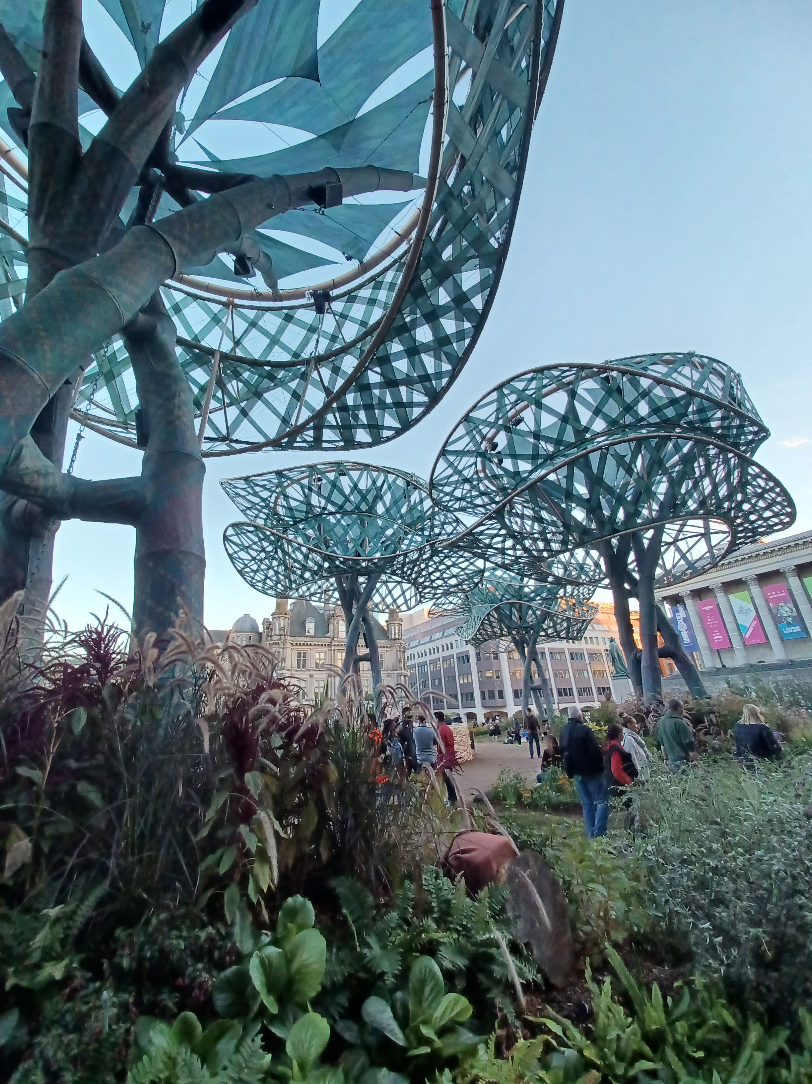

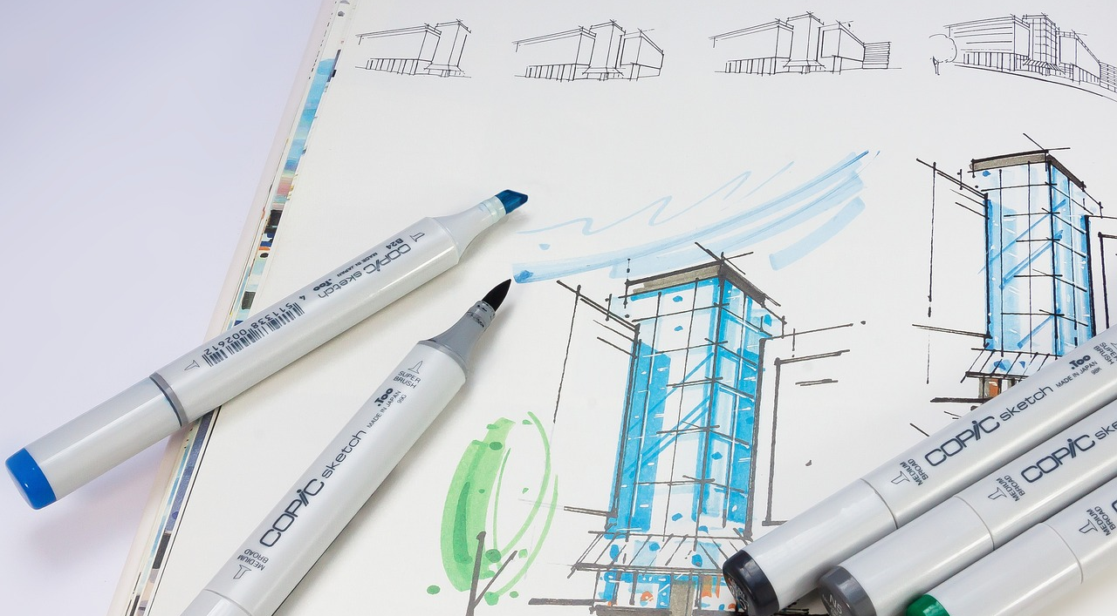
Architecture opportunities
44,000 people are employed in architecture practices
124 countries have architects registered with a recognised architecture body
In 2019 the architecture industry’s value was estimated as 3.6 billion pounds
Notes:
Say
There is no danger that jobs relating to for architecture will disappear anytime soon. Global and national issues such as the climate emergency, lack of housing, and the need for healthy and safe community spaces are only becoming more important each year, with many industries looking to better design in the built environment to solve these issues.
There are many conferences and places for architects across the world to come together and try and tackle some of the big issues through design. Being an architect is a great job if you like to meet like minded people and travel to new places!
Source: RIBA Business Benchmarking Survey 2019

Slide 7
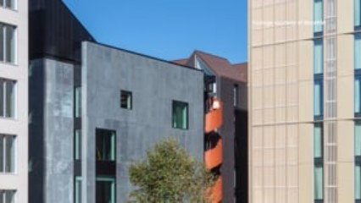
ShedKM
Notes:
Instruct
Tell students to watch the video about what it is like to work in architecture according to employees from ShedKM in Liverpool. Tell them to make a note of any skills and interests they describe.
Play the video for students.
Ask students what they think Harry & Rishita enjoy about their careers. (Hint, making useful and iconic buildings for people, feeling they’ve contributed to people’s lives, being able to see something they designed brought to life, being able to work in different places, having new challenges)
What kind of things do they design (houses, housing estates, schools, offices, cafes, flats).

Slide 8


Skills
What skills and interests do Rishita and Harry need to do their jobs?
Notes:
Discuss:
Ask students to use their notes to answer the question on the slide. Ask for people to share their thoughts, and ask as part of the discussion whether anything surprised them.
Answers they should mention.
Communication. Both stress that being able to communicate with others – whether clients, other professionals or members of your team, were essential.
Creativity. Being able to think creatively and share these ideas were important.
Curiosity/willingness to learn. Careers in architecture require a commitment to lifelong learning to keep up to date with newest trend and design legislation. Taking the time to meet others and look at the environment around you is important.
Teamwork. Design is a collaborative process, and you need to work with many different people to ensure the overall idea will work

Slide 9
What other careers are mentioned?
Project Manager
Urban Designer
Interior Designer
Studio Manager
Structural Engineer
Electrical Engineer
Notes:
Say:
In the film several other architecture professions are mentioned (n.b. you can bring them up again at 3:00mins on the video)
Instruct:
Tell students they have 10 mins to look through job descriptions on the worksheet provided and match them to the career listed on the slide.
Instruct:
Tell students to work with their partner to try and work out which career mentioned matches the description on their worksheet.

Slide 10
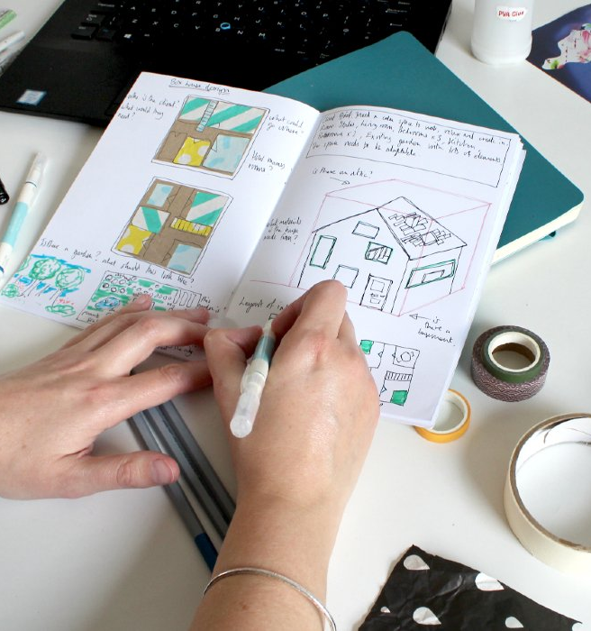
Architecture Challenge
You are following ShedKM’s lead and setting up your own design team!
Get into groups of four and read the design brief that has been supplied by a client.
You have 20 minutes to create a design which meets the brief.
You will have two minutes to present your design to the rest of the class and explain why it is such a good design – this is called a pitch
It is up to you how you split the task/use the time, but everybody must say something in the pitch
Notes:
Instruct:
Ask students to look at the client brief and mood board provided for their group of four.
Say:
Tell students that they must work as a team to create a drawing which shows a design that the client would be happy with. They must try and make it as appealing as possible, as they will be competing against the other groups to win the client. They will be judged on how closely they meet the criteria, how creative they are, and how convincing they are in the pitch they present. Everyone must contribute and say something, but it is up to them how they split tasks and come up with the final design.
Prompt:
Ask them the following types of questions to help them get started.
What are the main characteristics of the buildings in the mood board? How old do you think they are? What colour may complement or be striking against the red? What type of security would be appropriate (e.g. lockable doors, security, fencing to separate cars from pedestrians, lots of windows/tinted windows. How are you going to agree what the design should look like?

Slide 11

TASK 2
Create a floor plan for the ground floor of your youth centre to accompany your design.
Think about:
What rooms/spaces are needed?
Is it open plan or lots of separate rooms? (consider noise and how different activities would work in the same space)
What type of facilities (e.g. toilets) or storage might be needed?
Will there be corridors and doors?
Where will the stairs/lift to the upper floor go?
Notes:
Prompt:
Do you think boys and girls toilets should be separate? What about staff? What types of activity work well in open plan spaces? What might a reception need? Should there be a place to eat? Would any rooms/spaces work better on the first floor and not be included? Should windows not be in any rooms? Where might the fire exits be? How easy would it be for those in wheelchairs to move around? What would make a welcoming entrance?

Slide 12

TASK 3
Your client has added that you must now make your design environmentally friendly.
Think about:
Are the materials you use natural or manmade?
Can you include renewable energy?
Can you create habitats to attract animals and insects?
Can your design utilise rain or natural water sources?
Can you include things like bike parking or electrical charging points?
Notes:
Prompt:
Do you think brick or concrete is better for the environment (n.b. brick uses natural materials, concrete does not). Could you have compost or recycling facilities? Do you think solar panels or wind turbines might work? Would the inclusion of bug hotes or wilflowers help? What about trees? How might a southerly orientation for the building help (keeps the room warm as sun will shine into the rooms for longer).

Slide 13
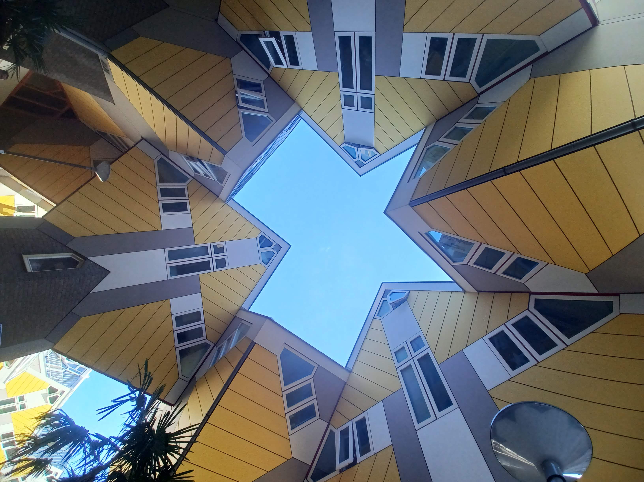
Final Thoughts:
Can you name one thing you have learnt about a career in architecture?
Do you think you have skills needed to work in this field?
Notes:
Today we are talking about careers in architecture, as part of our exploration on careers in the Creative Industries.

