Slide 1

Performing Arts

Slide 2

Aims and objectives…
LO: To demonstrate you can identify careers in performing arts.
LO: To understand where to find more information on careers in performing arts.
AIM: To virtually visit a workplace and to experience and solve a set design task.

Slide 3












12 sectors = lots of opportunities
Advertising
and marketing
Design (product graphic, fashion)
Film TV,
video radio and photography
Animation and
VFX (visual effects)
Video games
Heritage
IT, software and computer services (‘creative tech’)
Museums, galleries and libraries
Music, performing and visual arts
Crafts
Publishing
Architecture

Slide 4
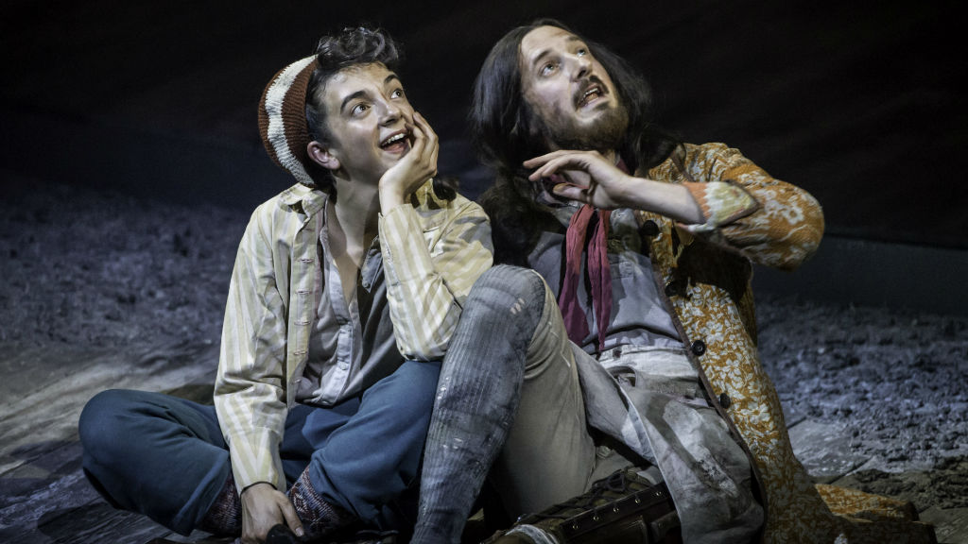

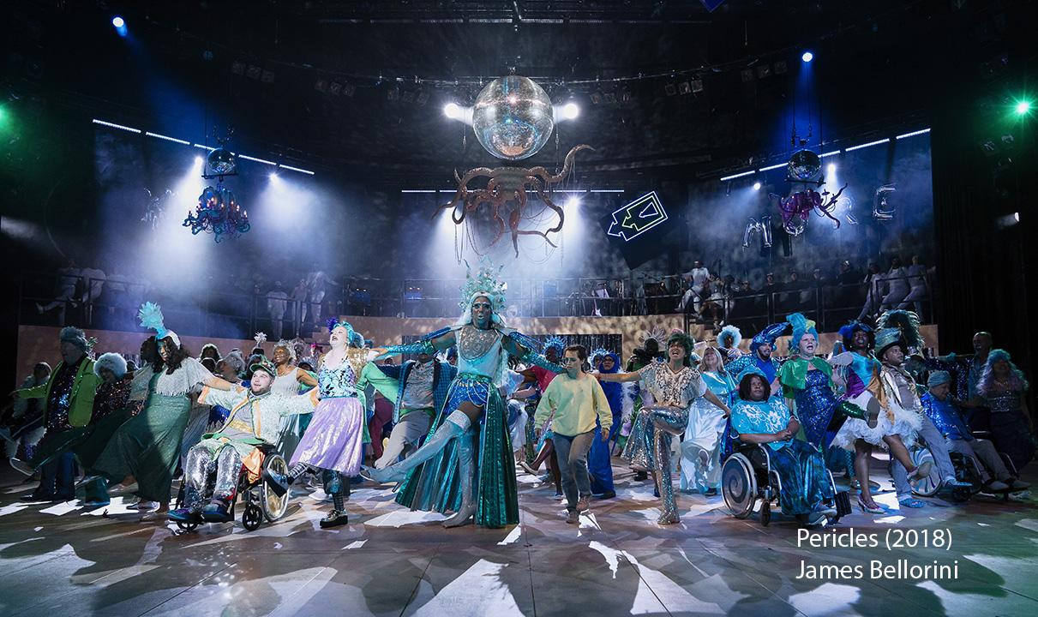
The Performing Arts:
Forms of creative activity that are
performed in front of an audience,
such as drama, music, and dance.

Slide 5
How many different careers can you think of in performing arts?

Slide 6

Take a look at the sector
(15 mins)

Slide 7

Careers in performing arts
Artist/performer
Electrician
Sound technician
Roadie
Tour manager
Artistic director
Finance Officer
Lighting director
Production manager
Front of house
Musician
Playwright
Scenic automator
Backstage crew member
Finance officer
Stage manager
Marketing Assistant
Set designer
Make-up artist
Admissions/bookings officers
Musical director
Producer
Catering
Prop maker
Carpenter
Theatre manager
Usher
Wardrobe assistant
Choreographer

Slide 8
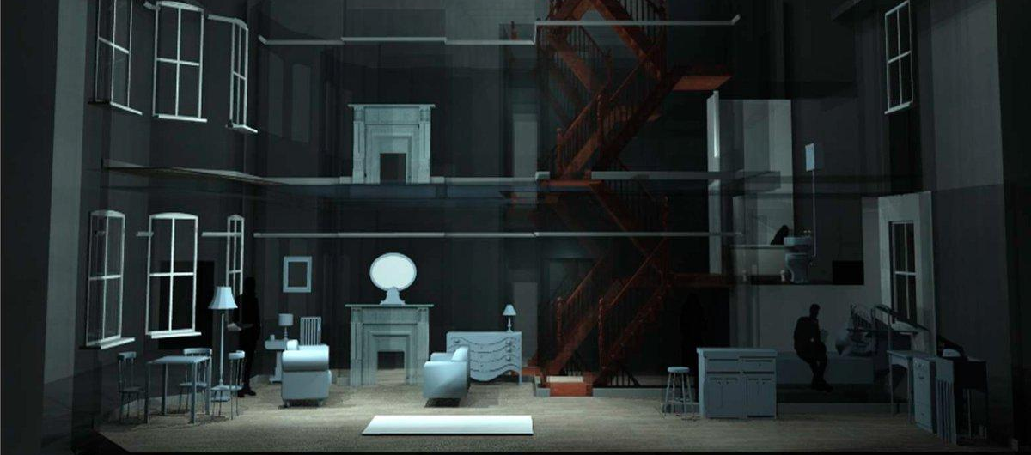
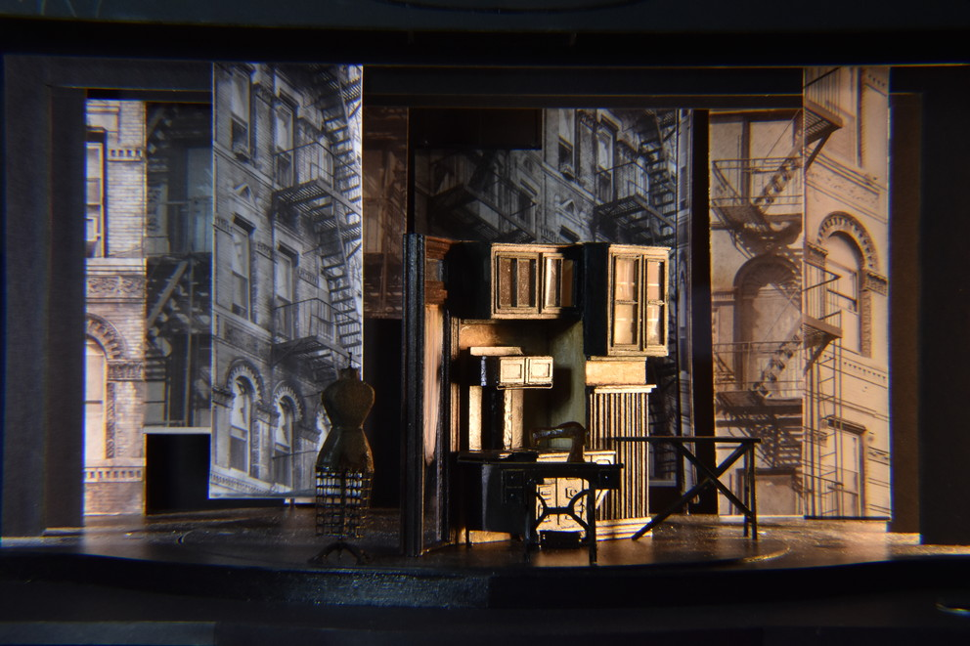
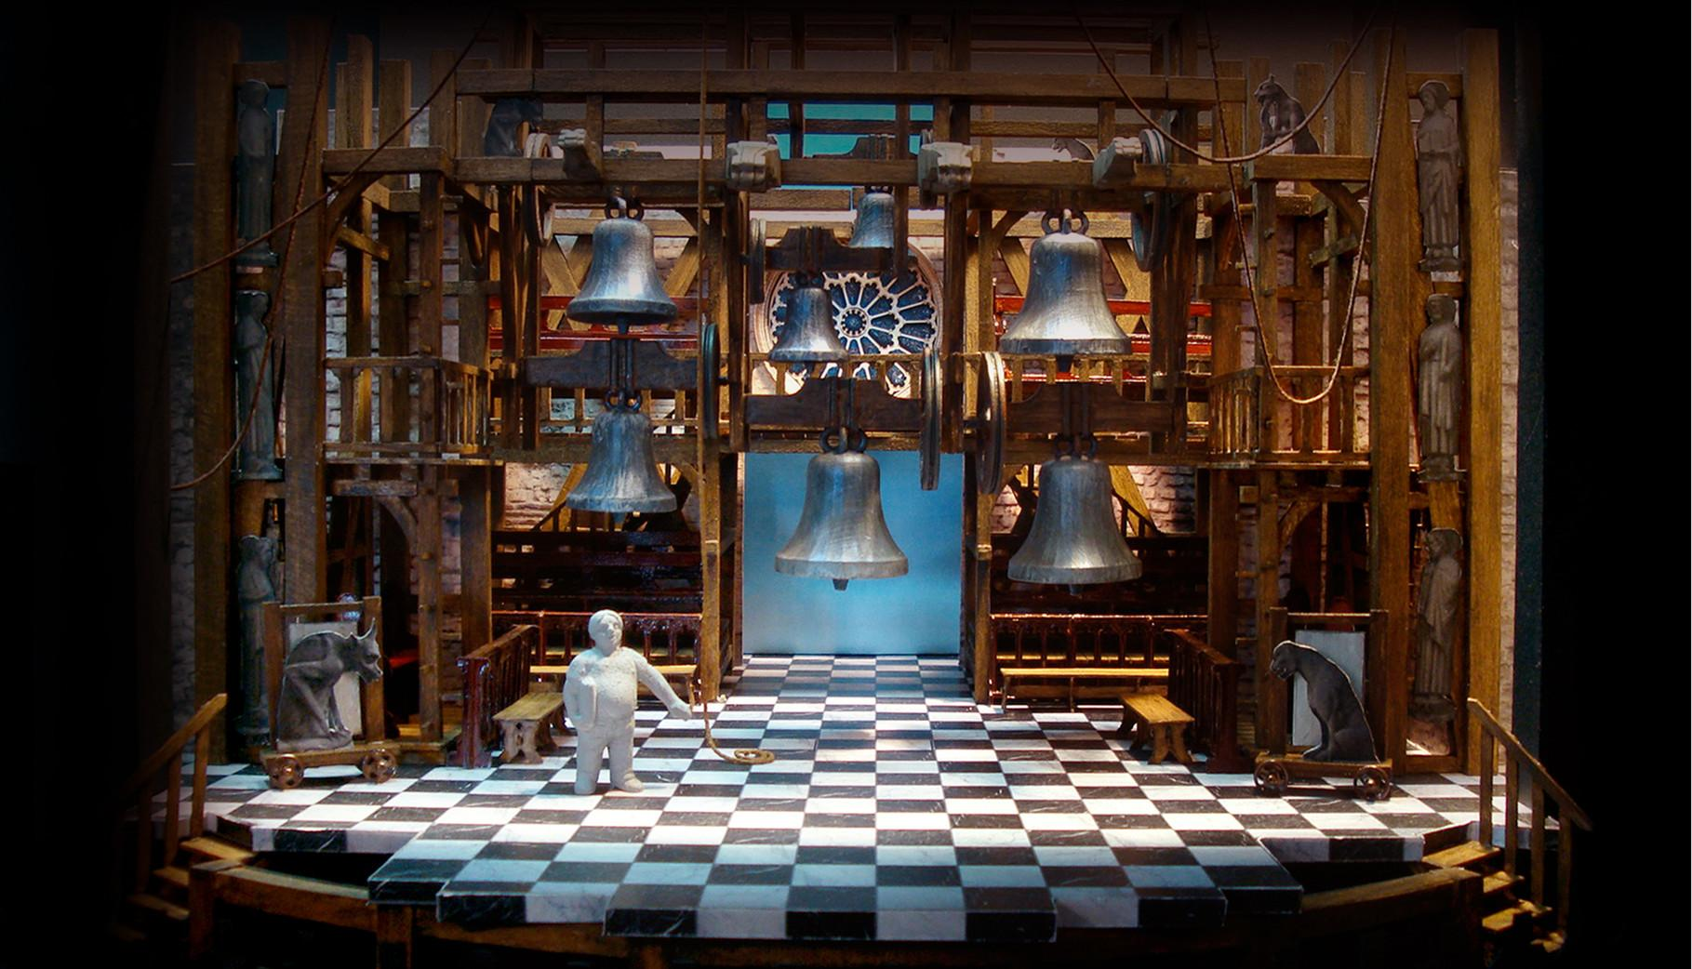

Focus on Set Designer
The Set Designer gets to interpret the story and create the world of the play.
This is done by choosing shapes, colours and textures that tell the audience where they are and how they feel.
A model, a scaled down version of the set design is made. Usually 1:25, so model is 25 times smaller than it would be on stage. This is used to show all the other departments working on the show what will be on stage and helps everyone to visualise the world and plan all the other work needed to create it.

Slide 9
Video
here is the link: https://discovercreative.careers/video-programme/performing-arts/royal-opera-house/

Slide 10
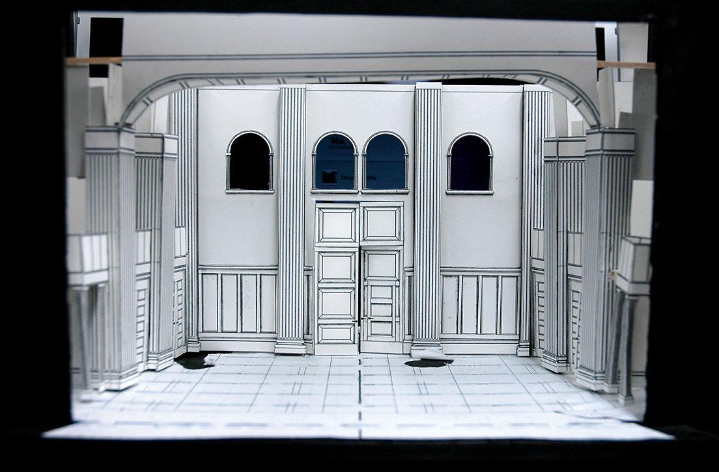

(Activity)
Focus on Set Designer
Before the final model is created, a model box (the theatre space itself rather than the model pieces of set) is a place of play and experiment.
Set Designers do something called ‘Sketch Modelling’ where they play with shape and texture and form by making shapes made of basic materials and moving them around in the space.

Slide 11
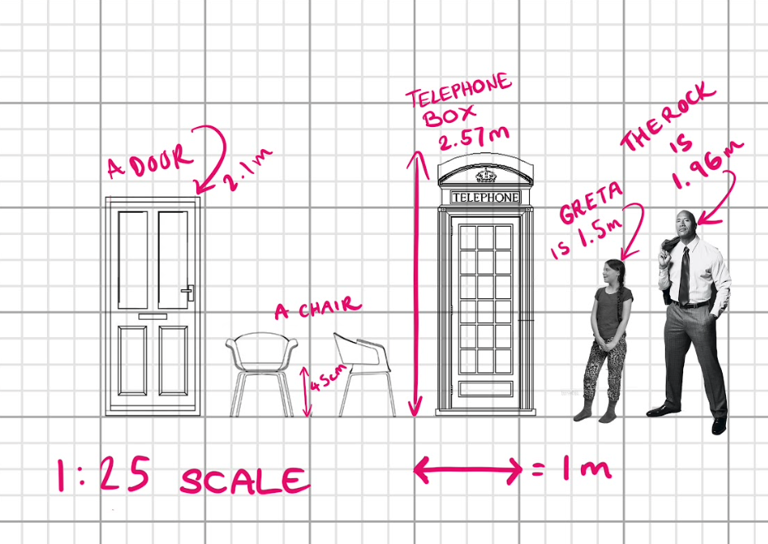
Task
Notes:
10 Minutes - groups of two
Students have the chance to evaluate A3 print out of scaled objects to be used in a set design. Students should annotate these sheets with objects noting down where they may be positioned on a set. For instance ‘foreground’ or ‘background’ with justifications of why they would be placed in this way.
Extension - can any of you consider the texture of the objects or the surrounding spaces? Can you make any further notes justifying why.
Focus on the set teacher slide - back to the teacher. Hands up - did any of you manage to annotate texture, space, etc? (5 mins)

Slide 12
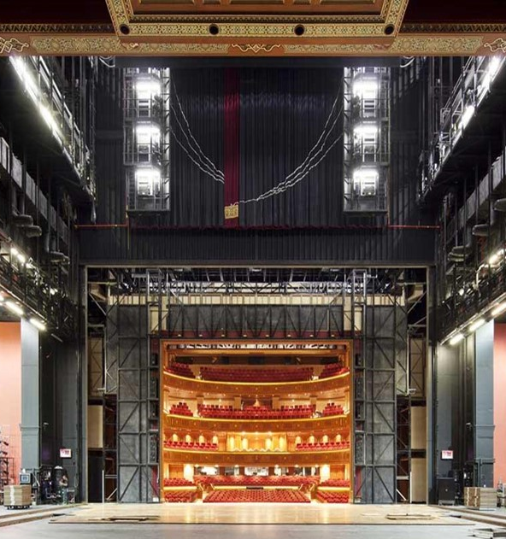
Set Design Task (Activity)
10 Minutes
You are designing a set for a play based within the school about students. The play is about a student who has dreams of following his/her favourite musical artist on tour.
Note down: poses of actors, shape of the set, position of actors, textures and materials needed on the set for a dream sequence where the student is in a typical classroom environment.

Slide 13
The National Theatre – Set Design Task
10-15 Minutes
Design a set for dream sequence using an A3 sheet of paper provided.
Extension - Make justifications for your design using the reflection sheet at the back.

Slide 14
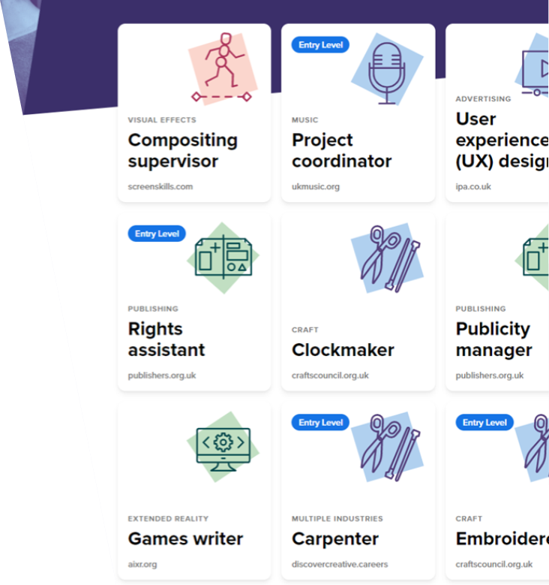
Find out more about careers
Visit www.discovercreative.careers
Find ‘set designer’
Find a job you have never heard of
Find a job you would like to do

Slide 15

Learning check
How many sub-sectors of the creative industries are there? Can you name them?
What did you learn about set design today?
Where do you look to find out more about careers and pathways into the creative industries?

