Slide 1


Slide 2

Focus on
Radio and Podcasts
Is there a career for you?
Notes:
Image from: Microsoft 365 royalty free Image Gallery

Slide 3
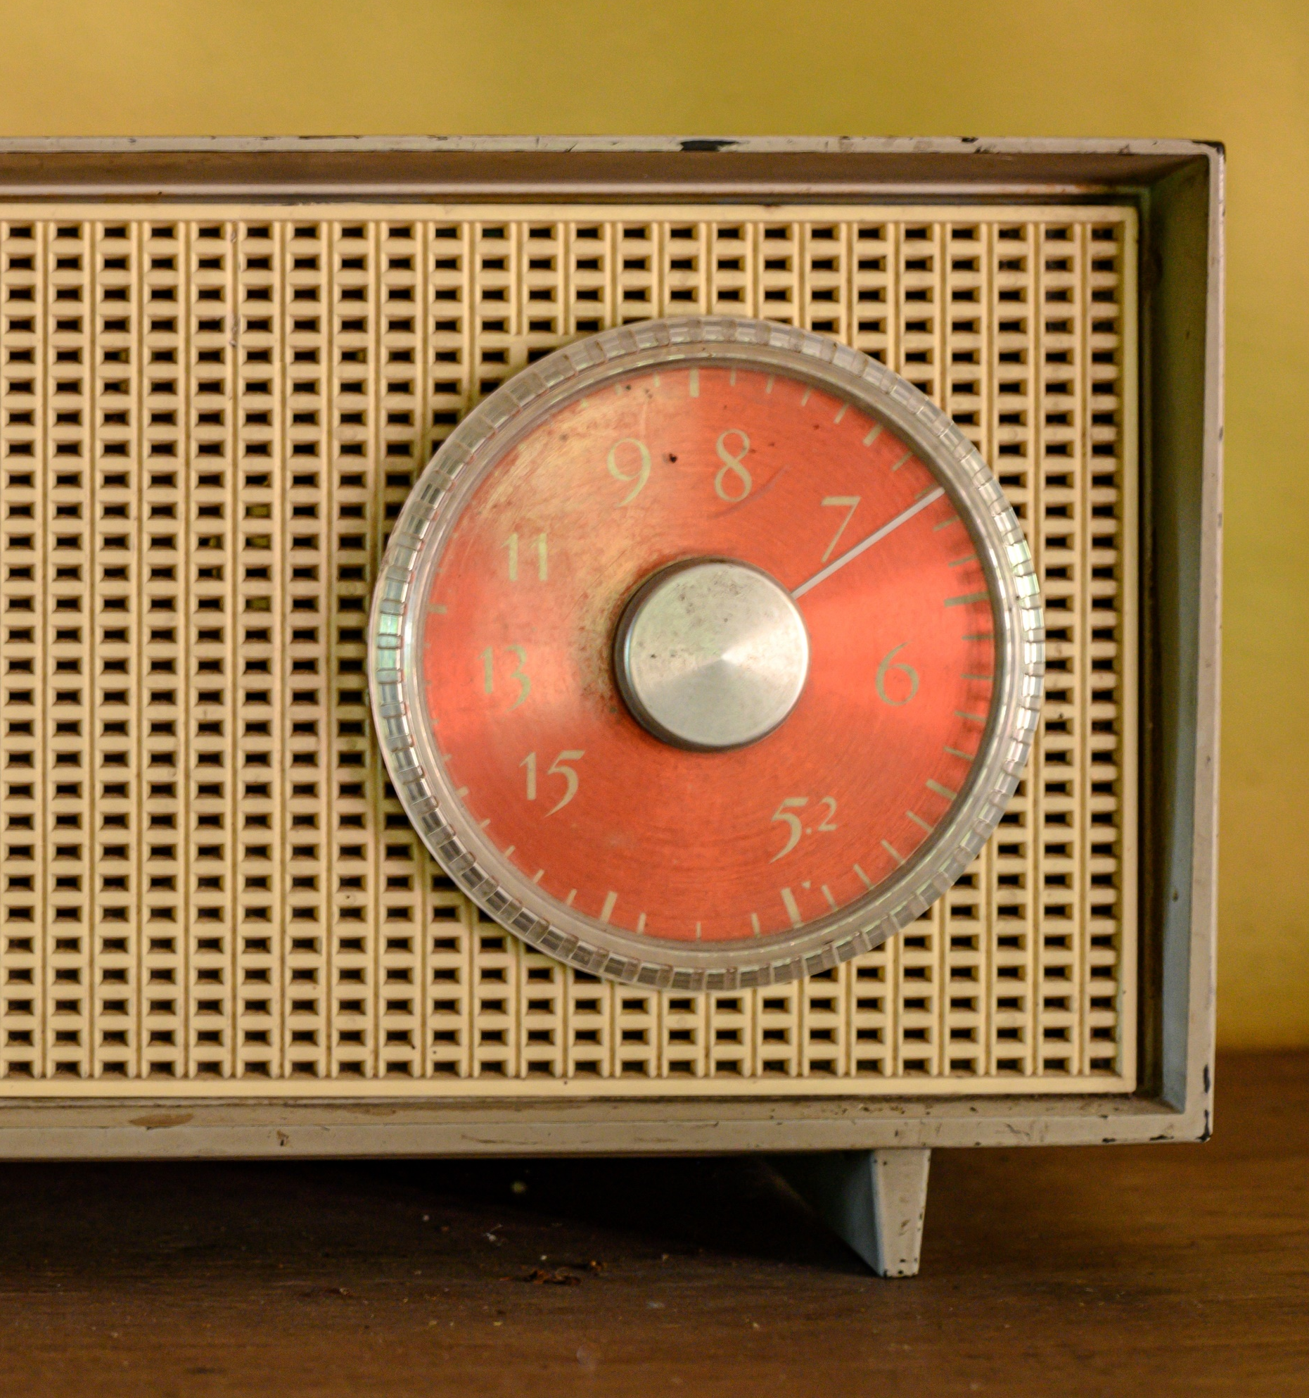

Heard it on the radio
Do you ever listen to the radio?
Do your parents?
Where do you, or they, listen to it?
Icebreaker
Working with a partner, brainstorm a list of all the different things you can listen to on the radio.
Notes:
Image from: Microsoft 365 royalty free Image Gallery
Research sources:
https://music.britishcouncil.org/sites/default/files/UoW-MusicTank-Sounding-Out-Radio-Research-British-Council.pdf
https://downloads.bbc.co.uk/rd/pubs/whp/whp-pdf-files/Better-Radio-Experiences-Research-Report-180720.pdf

Slide 4

What is a podcast?
Did you know?
The word podcast is made up of two words. ‘Pod’ from Apple’s iPod and ‘cast’ from ‘broadcast’.
A podcast is a digital audio file that can be downloaded to a personal device.
A podcast is like a radio show but, instead of being broadcast live, it is pre-recorded.
Podcasts are often released as a series of episodes and can be based on any topic.
Notes:
Image from: Microsoft 365 royalty free Image Gallery

Slide 5


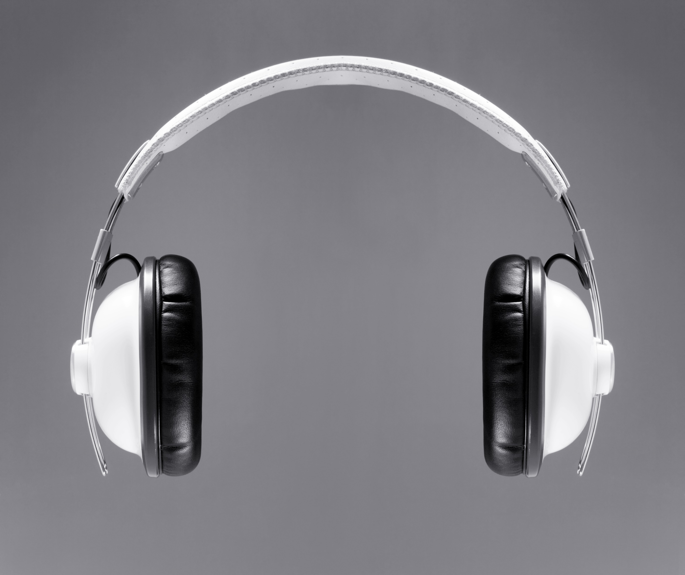
Surrounded by sound
21,000 people were employed in radio broadcasting in the UK in 2022, up from 13,000 in 2019.
There are around 600 licensed national and local radio stations in the UK and 300 community stations.
An estimated 21.2 million people listened to podcasts in the UK in 2022 and numbers are rising every year.
Notes:
Images from: Microsoft 365 royalty free Image Gallery
Statistics sources:
https://medialandscapes.org/country/united-kingdom/media/radio
https://www.statista.com/statistics/383593/radio-broadcasting-employment-in-the-united-kingdom-uk/
https://www.statista.com/topics/6908/podcasts-in-the-uk/

Slide 6
Audio Always
Design note: please embed Audio Always video:
https://discovercreative.careers/video-programme/radio-podcasts/audio-always/

Slide 7


Ways into radio
Talk about these questions with a partner
What different ways are there of getting into working in radio?
Do you need to live in London?
Do you think working in radio would be fun? If so, why?
Notes:
Image from: Microsoft 365 royalty free Image Gallery

Slide 8
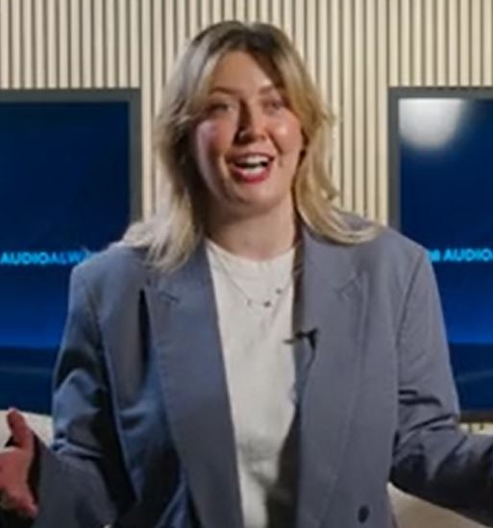
It comes naturally
‘Just having basic skills that you may not even value because [they] come so naturally to you.’
Lillie-Mae Stubbs, producer at Audio Always.
Some skills don’t need to be taught.
They are personal qualities that help you to do well at school and at work.
They are sometimes called soft skills and can be developed with practice and experience.
Notes:
Image from: Always Audio video

Slide 9
Do you already have the skills?
The role of broadcast assistant is an entry level job at a radio station.
What do they do?
Support assistant producers, producers, presenters and programmes.
What skills do they need?
team player
willing to learn
trustworthy
good communicator
flexible
calm under pressure
positive attitude
reliable
good time management
creative

Slide 10

Feedback: Activities 1 & 2
What skills come naturally to you?
How does school help you to develop others?
Notes:
Image from: Microsoft 365 royalty free Image Gallery

Slide 11





Top of the pods
Podcasts can be on any topic, or genre.
A survey in 2022 found that comedy was the most popular podcast genre for all listeners in the UK.
What do you think was the second most popular podcast genre with these different groups?
1. Men
A true crime
B football
2. Women
A true crime
B health and wellbeing
3. 16–24 year-olds
A lifestyle
B entertainment
4. 25-34 year-olds
A football
B travel
Notes:
Survey results:
https://www.statista.com/topics/6908/podcasts-in-the-uk/#topicOverview

Slide 12




Top of the pods 2
5. 35-44 year-olds
A entertainment
B science and technology
6. 45-54 year-olds
A food and drink
B news and current affairs
7. Over 55 year-olds
A news and current affairs
B history
Notes:
Image from: Microsoft 365 royalty free Image Gallery
Survey results:
https://www.statista.com/topics/6908/podcasts-in-the-uk/#topicOverview

Slide 13

Feedback: Activities 3 & 4
What order did you put the tasks in?
Do you all agree on this order?
What skills do you think a podcast producer needs?
What ideas did you have for an entertainment podcast?
Notes:
Image from: Microsoft 365 royalty free Image Gallery

Slide 14






Pick of the podcasts
Working as a group, think of an idea for a podcast that is relevant to people your own age. It needs to be on a topic that you all know about and are interested in.
Start with a question that the podcast will explore.
For example:
Which football teams are in the running to win the next world cup?
What kind of music do young people listen to?
What’s great about living in our local area?

Slide 15

Pick of the podcasts
Plan how you will present your idea to the rest of the class in a lively and interesting way.
You could do this in the form of a 2-minute ‘taster’ of your podcast.
One of you can take the role of the presenter and the others the roles of guests.
Notes:
Image from: Microsoft 365 royalty free Image Gallery

Slide 16
Extension Activity 1:
Podcast trailer plan
A podcast trailer is a short audio clip designed to persuade people to listen to a podcast.
You are a podcast producer and presenter. Use the worksheet to plan a trailer for your latest podcast.
The podcast might be:
about something you are interested in or an issue that you care strongly about.
something that concerns your school or local community.

Slide 17
Extension Activity 2:
Podcast script plan
You are a podcast producer and presenter.
Use the worksheet to write a plan for a new podcast script.
It might be:
about something you are interested in or an issue that you care strongly about.
on a topic that you already know a lot about or one that you’d like to research.

Slide 18
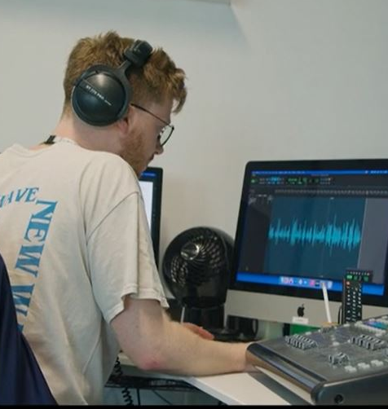
Reflection
Can you name one job in radio that you didn’t know about before today?
Do you think a career in radio broadcasting could be for you?
What school subjects help you develop the skills you would need?
Notes:
Image from Quercus Books video

Slide 19
Getting started
If you think a career in radio or podcasting could be for you:
Sign up for work experience at your local radio station.
Find out about community radio stations in your area, or ones in local hospitals or colleges. Ask if you can volunteer – even if it’s just making the coffee to begin with!
Contact the producers/presenters of a podcast you enjoy to see if you can interview them, or if they offer any work experience placements.
Make your own mini-podcast on a topic you’re passionate about (there are free podcast creation apps available for mobile devices and laptops). Share it first with your class or school but then consider uploading it to a podcast platform (such as Acast or Podbean).
Find out more at
https://www.radioacademy.org/careers/roles/
https://discovercreative.careers/explore/

Slide 20
There’s a career for you in the creative industries

