Slide 1
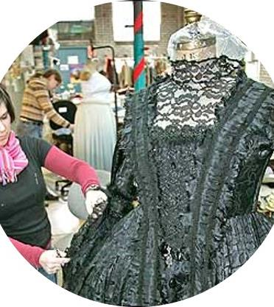
The Creative Industries
Is there a career for you?

Slide 2
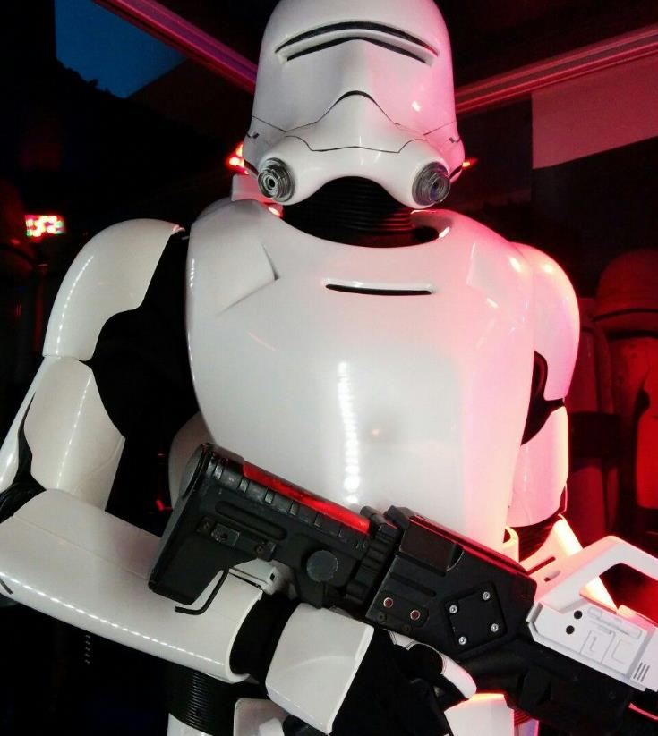
Careers in Crafts, Fashion and Textiles

Slide 3

Opportunities in the Creative Industries
3m+ people work in creative industries – 1 in 11 jobs across the UK
87% of creative jobs are at low or no risk of automation

Slide 4
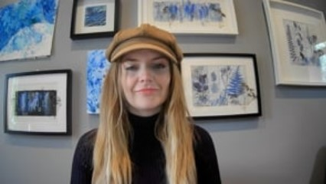
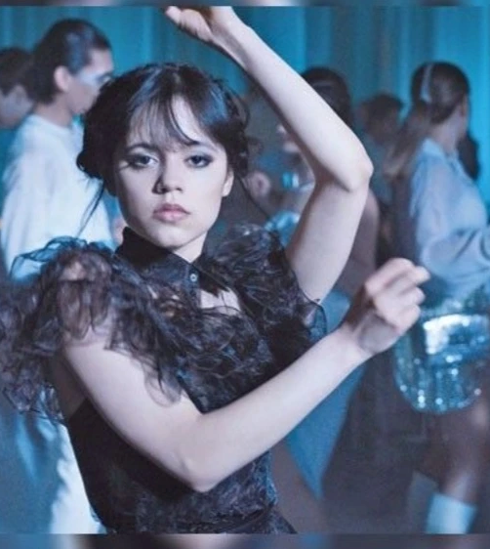

Meet costume designer, Alice Buckingham
Textiles Skills Centre - YouTube

Slide 5
The role of a Costume designer
Costume designers are responsible for the overall look of the clothes and costumes in theatre, film or television productions. They research and design costumes ideas, and lead a team that may include a design assistant, wardrobe supervisor, wardrobe assistants and costume.
They would also Study scripts, discuss ideas with the production designer, director, and make-up, set and lighting designers
Create costume ideas to fit the production’s design concept and budget
Research suitable costume styles, fabrics and designs
Sketch costume designs
Work closely with a team of costume makers, who would turn your sketches into
wearable garments.

Slide 6
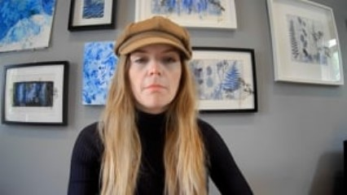
Alice’s job encompasses the knowledge of lots of other roles in the film, TV & theatre industry

Slide 7
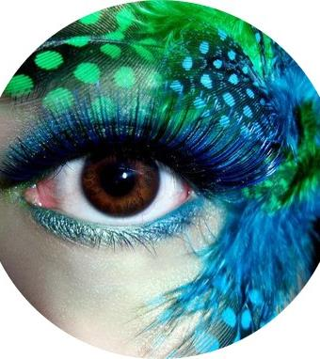
Alice has to be aware and have knowledge of many other aspects while buying or designing costumes
The Creative Director’s vision
Costume Research
Costume Maker & Pattern Cutters
Wardrobe Supervisor & Wardrobe Assistant
Make Up Artist
Prop Maker & Set Designer and Maker
The Film Crew & Lighting

Slide 8
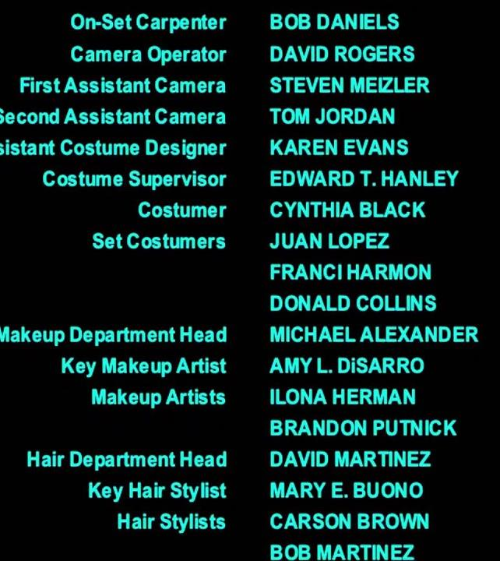
Discuss in your groups-
How many of these roles have you heard of?
Have you seen these roles on the credits after a movie?
What role could you see yourself doing and why?

Slide 9
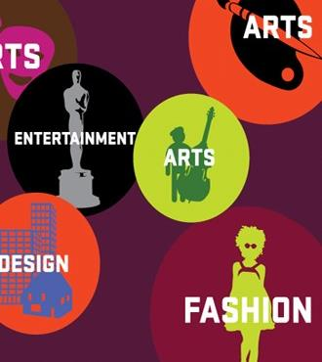

Employability Skills

Slide 10
Employability Skills
VERBAL COMMUNICATION: Being able to express your ideas clearly and confidently in speech
TEAMWORK: Working confidently within a group
ANALYSING & INVESTIGATING: Gathering information and Problem solving.
INITIATIVE & SELF MOTIVATION: Being able to act on initiative, identify opportunities & proactive in putting forward ideas & solutions
DRIVE: Determination to get things done. Make things happen & constantly looking for better ways of doing things.
PLANNING & ORGANISING: Being able to plan activities & carry them through effectively
FLEXIBILITY: Adapt successfully to changing situations & environments
TIME MANAGEMENT: Manage time effectively, prioritising tasks, able to work to deadlines

Slide 11

Discuss in your groups-
Do you recognise these skills in you?
Can you name times you use these skills?
Which are most important?
Do you think they are important for a career in Crafts, Fashion & Textiles?

Slide 12
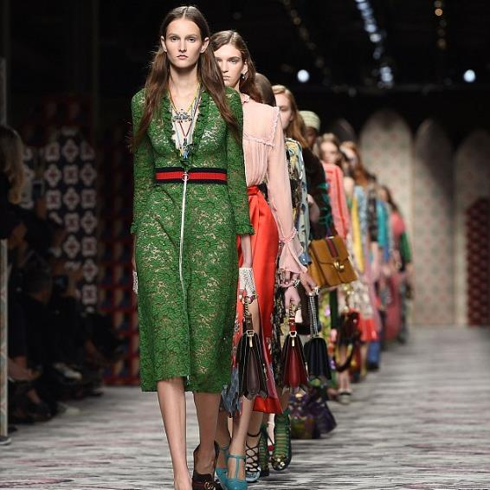
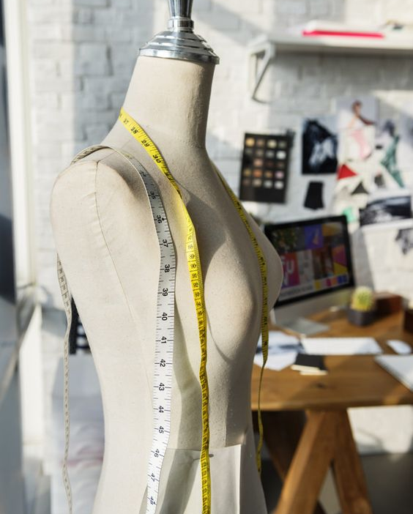

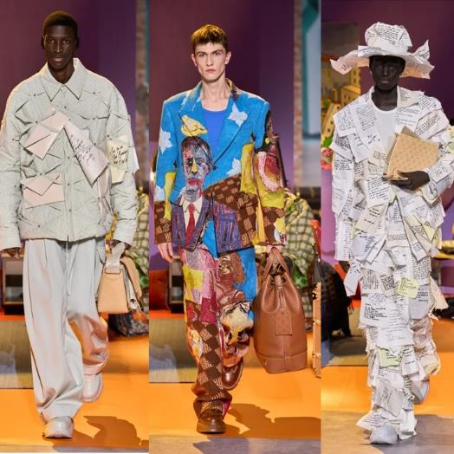

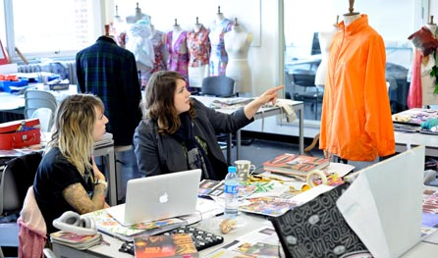
Learning check
In pairs and using the guides provided – discuss what skills you enjoy using.
Are you good at those things?
Does your partner agree?

Slide 13

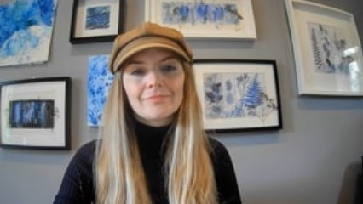
Transferable skills

Slide 14
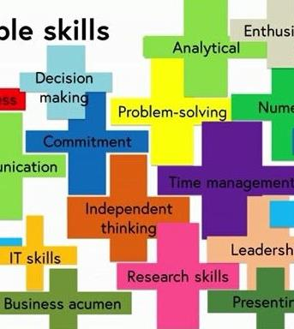
Transferable skills
CREATIVITY: Generating and applying new ideas and solutions
NEGOTIATING: Able to discuss and reach agreement.
LEADERSHIP: Able to motivate and direct others
STRESS TOLERANCE: Maintains effective performance under pressure
INDEPENDENCE: Accepts responsibility for views & actions and able to work under their own direction & initiative.
ACTION PLANNING: Able to decide what steps are needed to achieve particular goals and then implement these.
DECISION-MAKING: Determining the best course of action. Evaluates options based on logic & fact & presents solutions

Slide 15
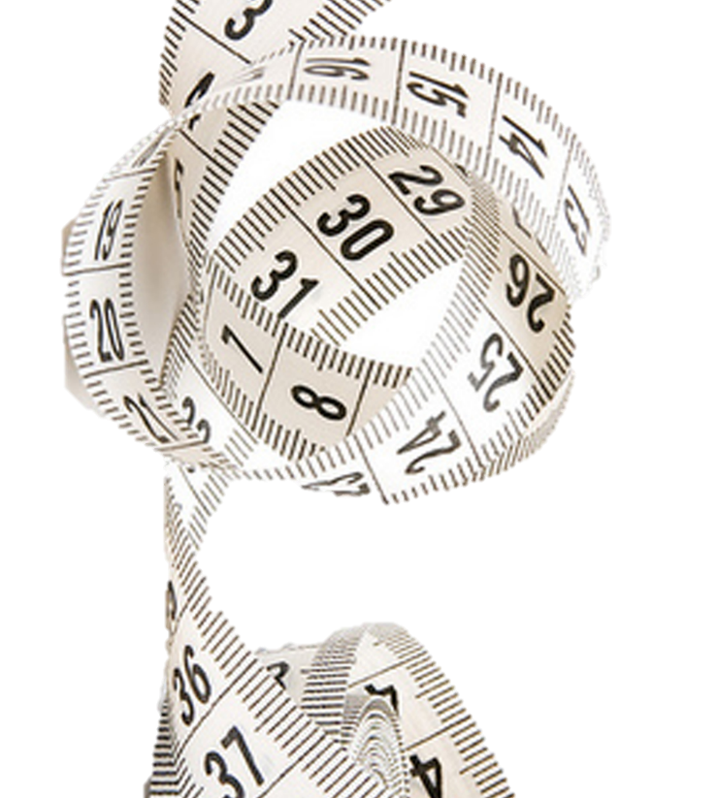
In your groups
Task 1
Matching cards: match the skill to the subject
What skills am I learning in school?
Within what subjects?
How and where can I use them?

Slide 16
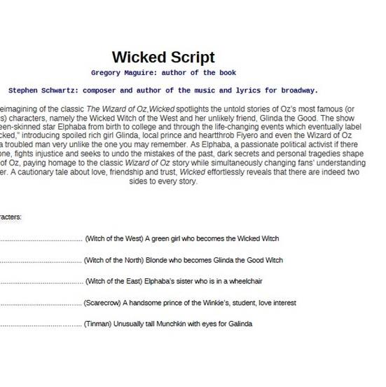
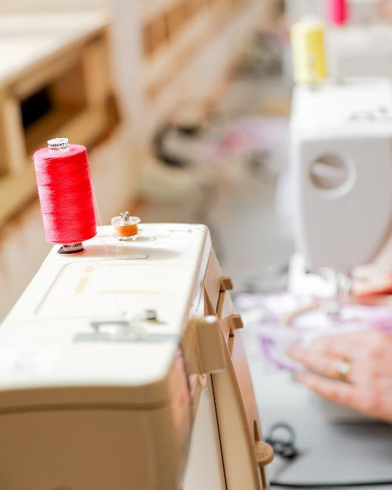

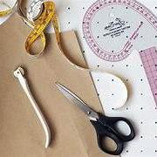
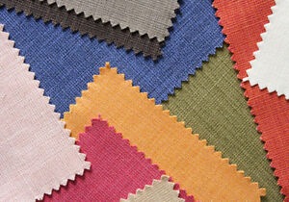
Learning check
What skills does a costume designer learn in school?
English-communication, reading scripts, analysis
Maths-budgeting for a character, calculating costs
History-research, political and historical movements, cultural understanding
Fashion & Textiles-knowledge of fabrics, garments, patterns,
IT-emails, excel spreadsheets
Performing Arts-confidence
Psychology-understanding people, understanding characters and emotions

Slide 17
How can you use this understanding about your skills?
Learning check
Getting feedback on skills from others
Job applications and Further Education entry forms
Looking at Further Education courses you can do
Understanding how all the subjects you study are important
Can you think of other ways?
Identifying skills gaps you’d like
to fill
Writing your skills on your CV
Matching your skills to your career
FREE RESOURCE: Cross Curricular Learning - Textiles Skills Centre

Slide 18

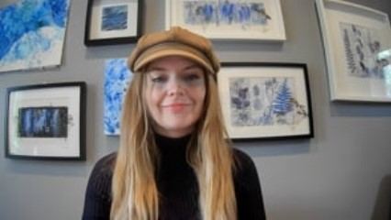
Alice Introduces the Costume Activities

Slide 19

Activities
Creating a Styling Mood board
Costume Design Illustration
Fabric & Pattern Research
Drawn/Cut & Paste Illustration
Create a styling board, combining all the research and present to the director

Slide 20
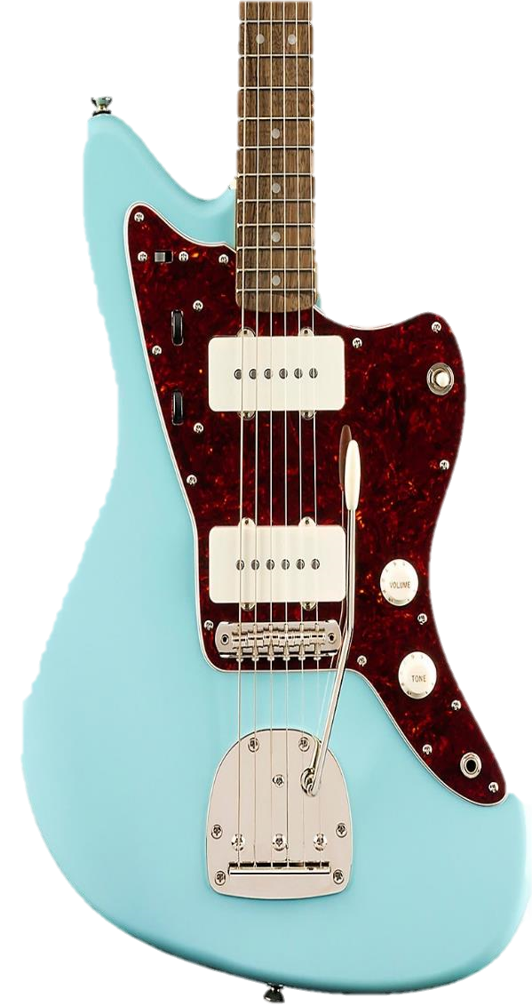
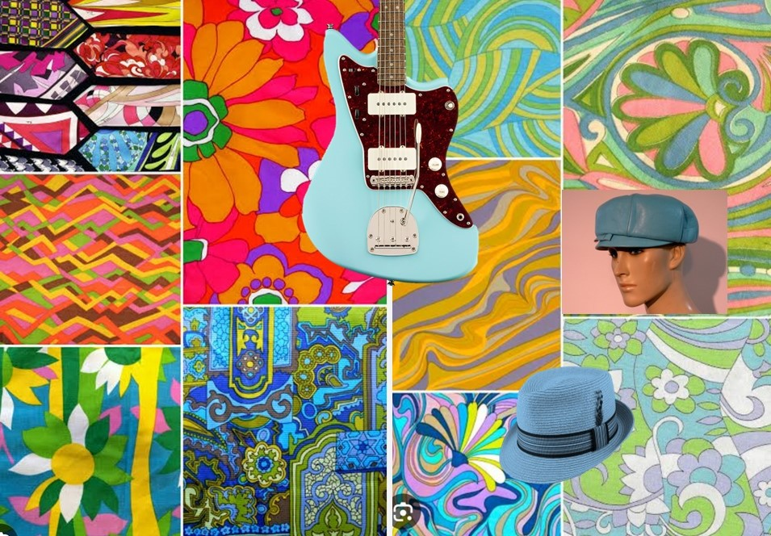

To Create a Styling-Mood board
Activity 1
Research Fashion of the 60’s and 70’s
For a musical set in America
What skills do you need for this activity?
Produce a mood board
This could be produced by AI, these were!

Slide 21
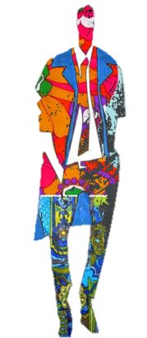
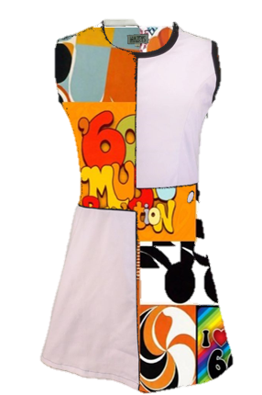
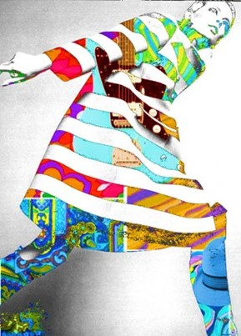
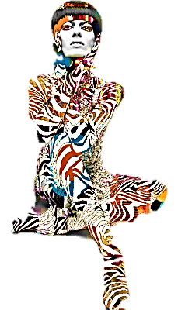
Costume Design Illustration
Activity 2
What skills do you need for this activity?
The character likes wearing hats and really likes the colour orange
The design is for the main character
You can choose the activity you want to do based on what skills suit you best
The character is 5 foot 8 inches and plays the guitar
it is set in the late 60’s, early 70’s in America
You are now working on a film for Netflix. It’s a musical

Slide 22
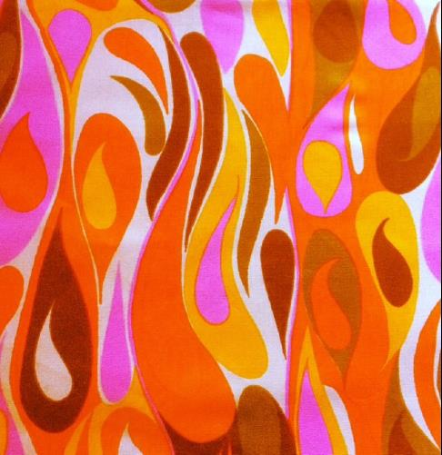

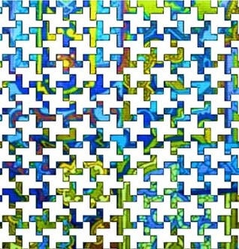
Fabric & Pattern Research
Activity 3
What type of prints were popular in the 60’s & 70’s
,
Make your own original designs in IT
Who were the foremost textile designers of the 60’s & 70’s
Fabric Research:-What fabrics can be used for hats?
What types of fabrics were most commonly used in the 60’ & 70’s

Slide 23
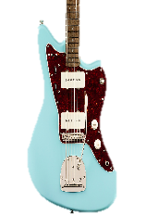
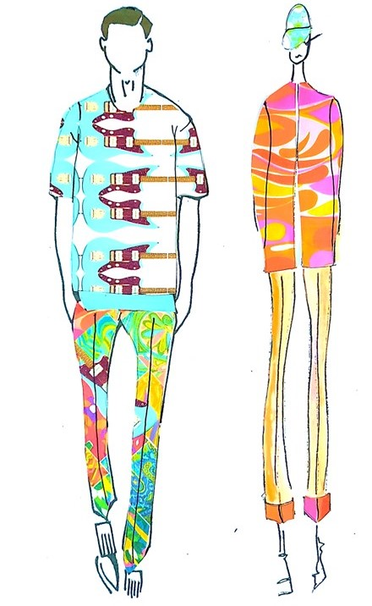
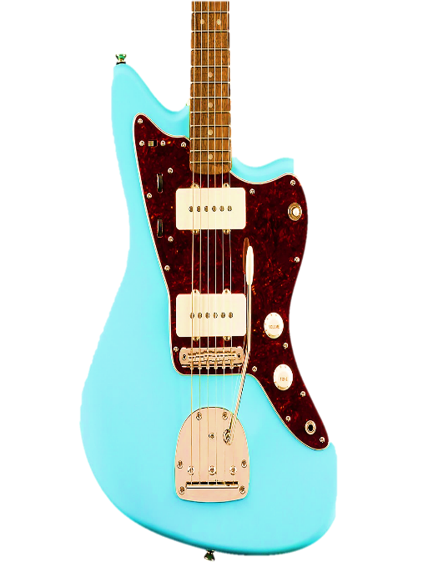
Cut & Paste illustration

Slide 24
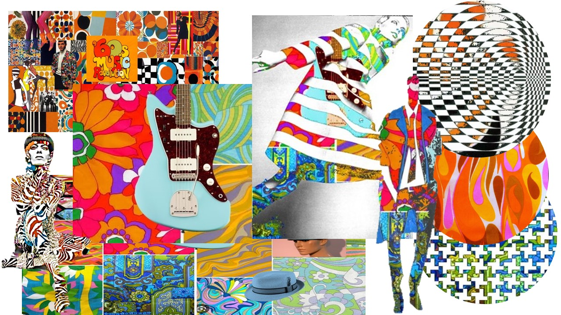
Extension: Teamwork & communication
Teamwork: Create a styling board combining all your research
Communication: Present this styling board to the director

Slide 25

There’s a career for you in the creative industries
Can you name some of the skills you used for your activity?
Home - Textiles Skills Centre

