Slide 1


Slide 2

Focus on
Design
Is there a career for you?
Notes:
Image from: Microsoft 365 royalty free Image Gallery

Slide 3


What is a designer?
A designer is a person who plans the form or structure of something before it is made, by preparing drawings or plans.
Designers use their creativity to make things that are both functional and attractive.
A designer creates new or improved products, structures or systems.
Word power
system: a collection of things that work together to perform a task. For example, computer hardware and software.
Notes:
Image from: Microsoft 365 royalty free Image Gallery

Slide 4
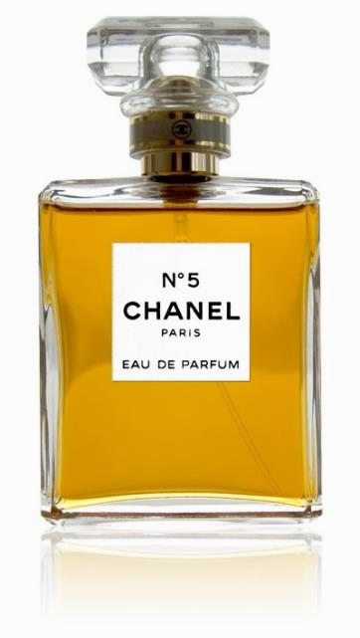
Design classics quiz
What year was this perfume bottle designed in?
A 1921
B 1956
A 1921
The Chanel No. 5 perfume bottle was designed by French fashion designer Gabrielle ‘Coco’ Chanel.
Notes:
Image: public domain

Slide 5
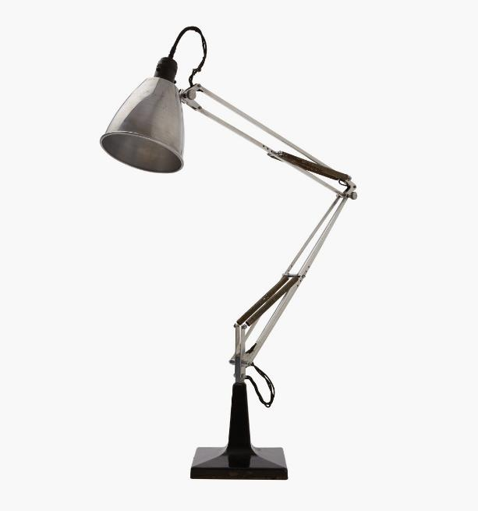
Design classics quiz
What is this type of lamp called?
A gooseneck
B anglepoise
B anglepoise
The anglepoise lamp was designed by British car suspension designer George Carwardine in 1931.
Notes:
Image: Wikimedia commons

Slide 6
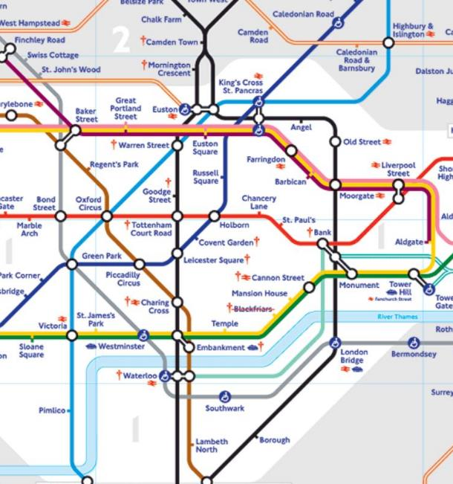
Design classics quiz
What inspired this map of London’s tube network?
A an electrical circuit board
B a drawing of blood circulation
A an electrical circuit board
The London Underground map was designed by British electrical draughtsman Harry Beck in 1933.
Word power A draughtsman or woman creates detailed technical drawings.
Notes:
Image: public domain

Slide 7
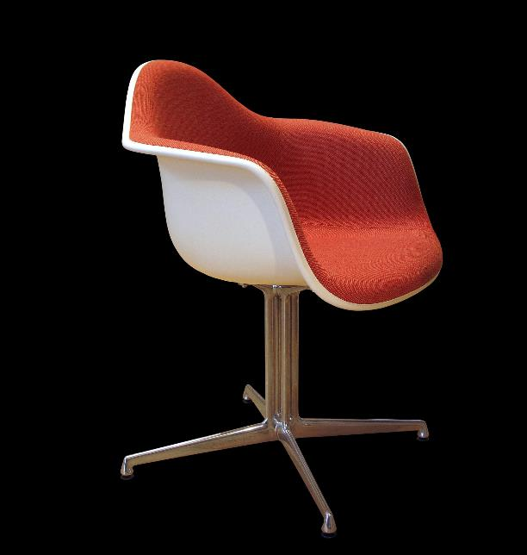
Design classics quiz
What year was this chair first sold to the public?
A 1950
B 1970
A 1950
The chair was created by product designers Charles and Ray-Bernice (Ray) Eames, an American married couple.
Notes:
Image: Wikimedia commns

Slide 8
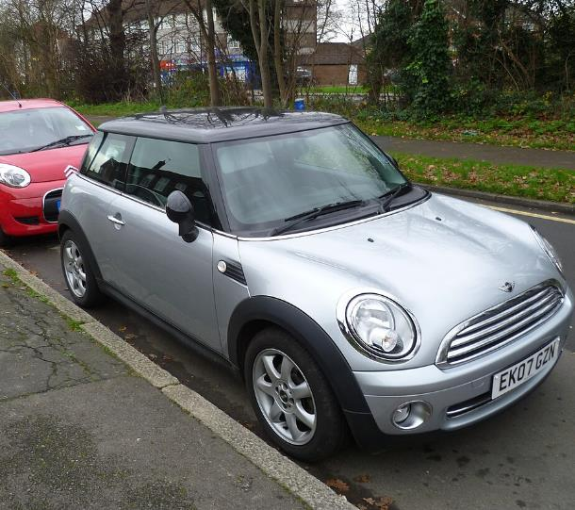
Design classics quiz
What was the main reason for the creation of the mini?
A a shortage of metal
B a fuel shortage
B a fuel shortage
The British-Greek car designer Alexander (Alec) Issigonis created the mini in 1959.
Notes:
Image: Wikimedia commons

Slide 9
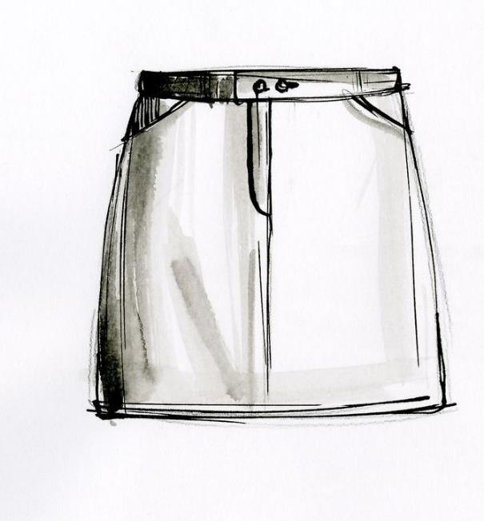
Design classics quiz
Which fashion designer made the miniskirt popular?
A Mary Quant
B Vivienne Westwood
A Mary Quant
Mary Quant was a British designer, often credited with making the miniskirt popular in the 1960s.
Notes:
Image: Wikimedia commons

Slide 10
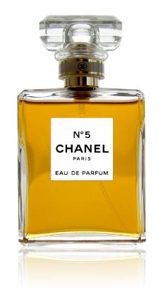
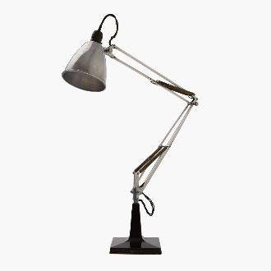
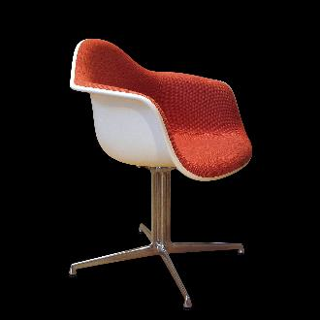
What makes a design classic?

Slide 11
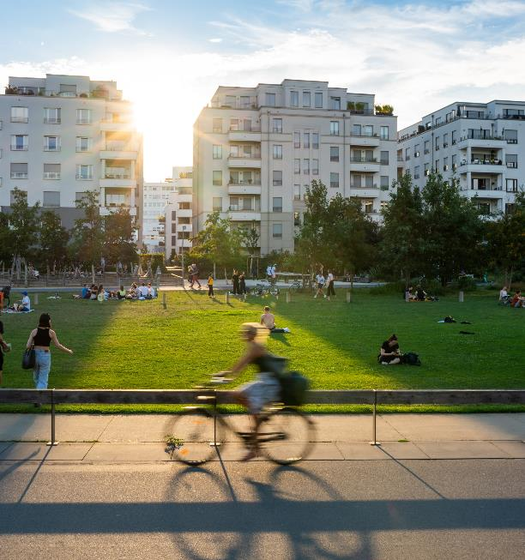
Designers create everything from the smallest objects to train stations, wind turbines, flood defences and cities.
Working with a partner:
Make a list of as many careers as you can think of with the word ‘designer’ in the job title.
Notes:
Image: Microsoft 365 royalty free Image Gallery

Slide 12
Did you include these careers in your list?
web
designer
garden designer
fashion designer
logo
designer
video game designer
exhibition designer
interior designer
set designer
textile designer

Slide 13
Focus on: Product designers
What do they do?
Product designers create new products and improve existing ones. They design most things we use in our everyday lives.
What are they good at?
Product designers are creative and imaginative. They have strong ICT skills, pay attention to detail and can find solutions to problems.
What knowledge do they need?
They need an understanding of different materials and production methods, and good technical and scientific knowledge.
Notes:
Image: Wikimedia commons

Slide 14

Product designers: day-to-day tasks
meetings with clients to discuss what they want
investigating how existing products work
developing ideas and making initial sketches or plans
deciding on suitable materials
using computer design software to produce detailed plans called blueprints
making samples or working models, known as prototypes
testing and refining designs
Notes:
Image: Microsoft 365 royalty free Image Gallery

Slide 15

Better by design
Do you think you’ve got what it takes to be a product designer? Or to have a different design career?
Test your design skills and knowledge by completing Activities 1 and 2 on your worksheets.

Slide 16

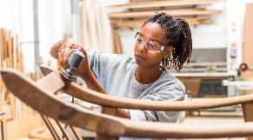
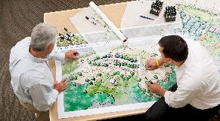
The value of design
1.97 million people work in the design industry in the UK.
An additional 2.5 million people use design skills in their jobs.
In 2019 alone, the design industry contributed £97.4 billion to the UK economy.
Notes:
Statistics source: wdo.org/mapping-the-uks-design-economy
Images: Microsoft 365 royalty free Image Gallery

Slide 17

An eye for colour
Many designers need an understanding of colour theory.
Colour theory is the study of how colours work together and how people react to them. It's like a toolbox for artists, designers and creators to help them choose the right colours for their projects.
Find out about the basics of colour theory and put them into practice by completing Activity 3.
Notes:
Image: Microsoft 365 royalty free Image Gallery

Slide 18
Focus on: Graphic designers
What do they do?
A graphic designer creates images that communicate a message to people, either by hand or using computer software.
What are they good at?
They are artistic and imaginative. They have a good eye for detail, are flexible and open to change, and have excellent communication skills.
What knowledge do they need?
An understanding of colour theory, a knowledge of different fonts and the ability to use software such as Adobe Photoshop.

Slide 19

Graphic designers: day-to-day tasks
meetings with clients to discuss what they want
working out budgets and deadlines
researching projects and target audiences
producing drafts by hand or preparing designs using specialist software
making presentations to clients for feedback and approval
keeping up to date with design trends and developments in software tools
Notes:
Image: Microsoft 365 royalty free Image Gallery

Slide 20

Design team challenge
You are a team of graphic designers.
Your design brief is to create six signs, one for each of six different galleries in a toy museum.
Use the Design team challenge worksheets to find out more.
Plan and draft your designs to present to the client.
Notes:
Image: Microsoft 365 royalty free Image Gallery

Slide 21

Client presentation
Present your designs to the rest of the class as if they are the client.
Remember to speak clearly and confidently!
Notes:
Image: Microsoft 365 royalty free Image Gallery

Slide 22



Grand designs
Architects design new buildings and the spaces around them and restore and conserve existing buildings.
Landscape architects plan, design and manage the landscapes we live and work in.
Naval architects design, construct, refit and repair marine vessels and offshore structures.

Slide 23

Extension Activity 1:
Designed for play
Playground architects plan, design, and oversee the construction of children’s playgrounds.
You are a playground architect.
Your brief is to plan and design a small outdoor play area at the toy museum for pre-school children.
Notes:
Image from: Microsoft 365 royalty free Image Gallery

Slide 24
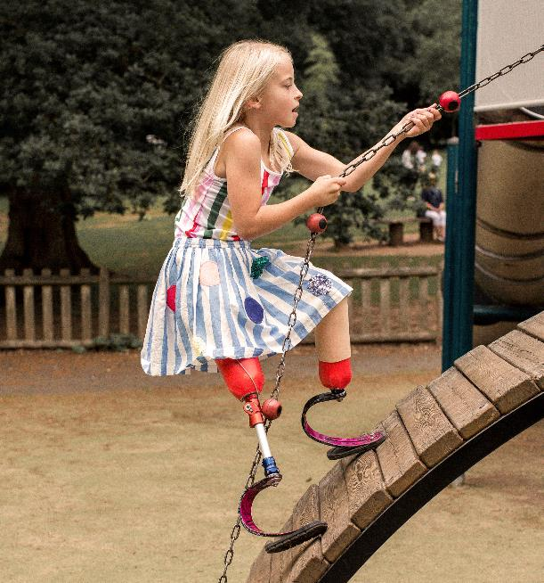
Extension Activity 2:
Design a playground
Playground architects plan, design, and oversee the construction of children’s playgrounds.
You are a playground architect.
Your brief is to plan and design a playground at the toy museum.
Notes:
Image from: Microsoft 365 royalty free Image Gallery

Slide 25
Opportunities for all
You don’t have to be creative or imaginative to work for a design company.
These jobs need different skills and knowledge.
marketing assistant
project manager
account manager
advertising manager
office manager
finance officer

Slide 26
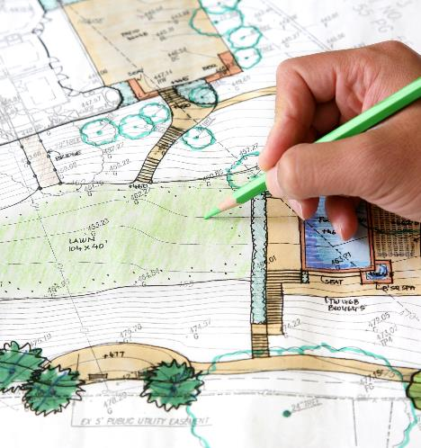

Reflection
Can you name one career in design that you hadn’t heard of before today?
Does anyone think they would like to work as designer?
If so, which career interests you the most?
Notes:
Image from: Microsoft 365 royalty free Image Gallery

Slide 27

Ways in
You can get into a career in design through:
an apprenticeship. These are often a mix of on-the-job training and classroom study at a college or university.
applying directly for a job. For example, as a junior design assistant or web support assistant.
a university or college degree or diploma. For example, in web design and development, graphic design, interior design, garden design, product design or engineering.
Notes:
Image from: Microsoft 365 royalty free Image Gallery

Slide 28
Getting started
If you think a career in design could be for you, you could:
Enter design competitions and exhibitions.
Start creating a portfolio of your design work that shows your creative ideas and skills. Universities, colleges and employers will often want to see one.
Find out if any local design companies have work experience schemes.
See if you can get a summer holiday job related to your chosen field. For example, in a garden centre or an interiors shop.
Volunteer for a local community group or charity. You could create digital posters or flyers for them, for instance, or work in a community garden.
Join a local amateur dramatic group and help create costumes, sets and props.
Find out more at
https://discovercreative.careers/explore/
https://nationalcareers.service.gov.uk/job-profiles

Slide 29
There’s a career for you in the creative industries

