Slide 1


Slide 2

Introduction to the archive sector
Notes:
Image by Annie Spratt on Unsplash

Slide 3
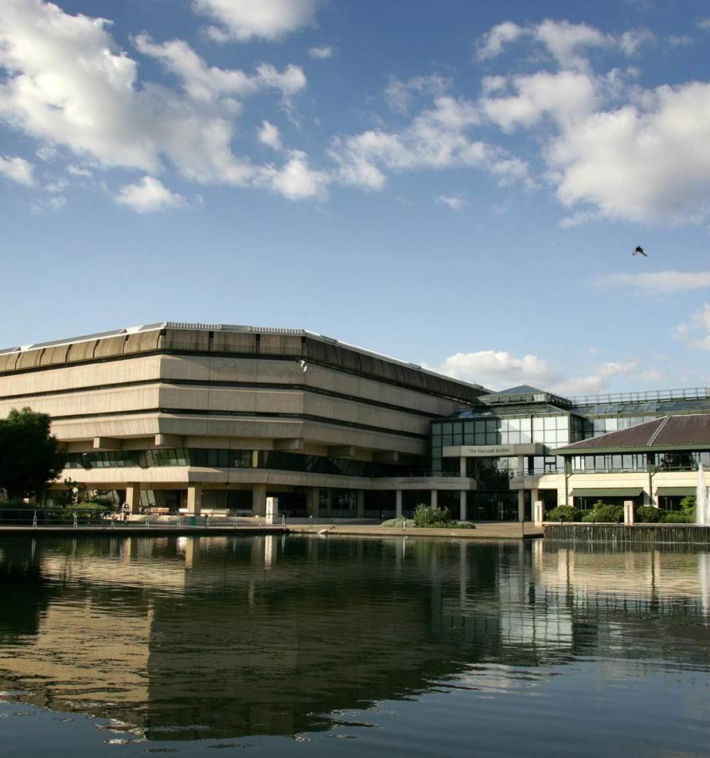
First things first!
Have you ever heard of an archive before?
Put your left hand up for ‘yes’
Put your right hand up for ‘no’
Put both hands straight up for ‘not sure!’
Can anyone explain what an archive is?
Notes:
Image taken from: https://www.nationalarchives.gov.uk/education/families/time-travel-tv/introduction/the-national-archives-building/

Slide 4
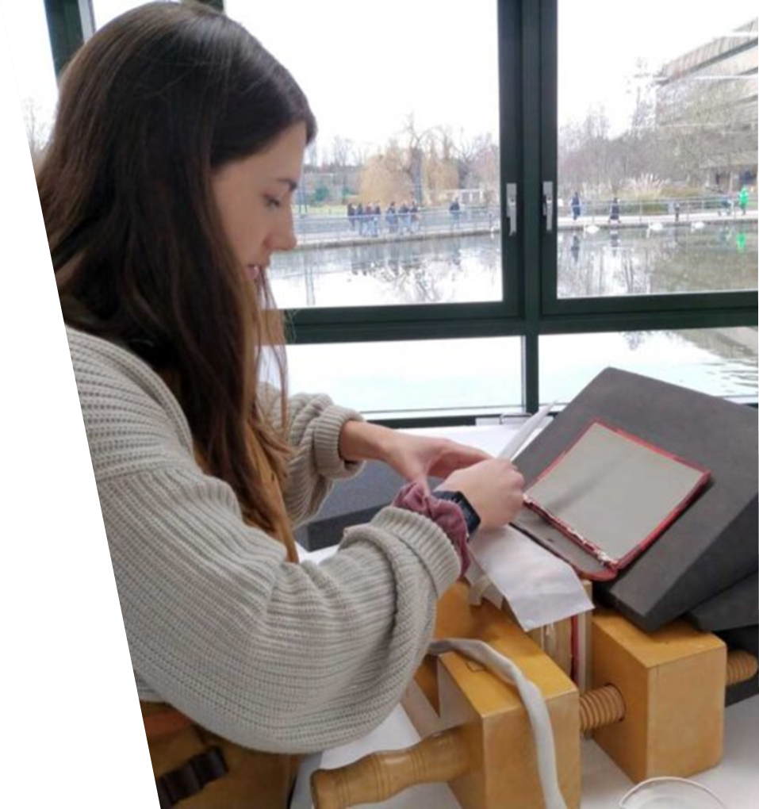
First things first!
Archives collect and look after information from the past.
They tell the stories of people, communities and places from centuries ago, to right now!
Think of an example – can anyone think of an important moment in time which you have lived through which future generations might be interested in finding out more about?
Notes:
Image taken from: https://blog.nationalarchives.gov.uk/introduction-to-conservation-for-digitisation/

Slide 5
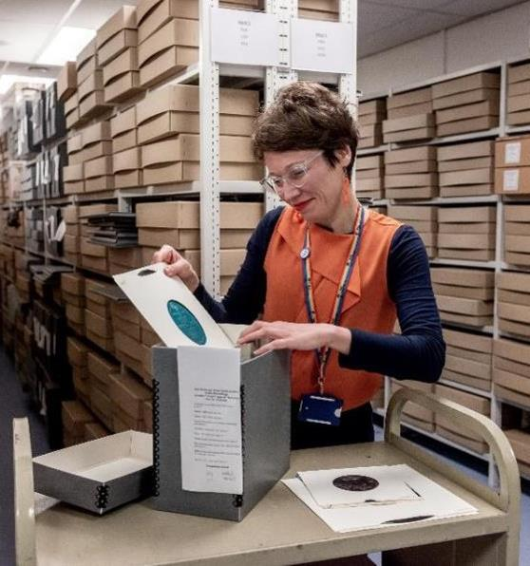
Collections
Lots of different organisations have archival collections – local councils, charities, schools, universities, religious buildings and businesses. They tell the stories of people, communities and places from centuries ago, to right now!
Each of these collections are made up of individual records or documents which are kept in special room called a repository.
A record or document is one individual piece of a collection
Notes:
Image taken from: https://www.nationalarchives.gov.uk/education/families/time-travel-tv/introduction/inside-a-repository/
Image: Salford University Archive ©The National Archives

Slide 6
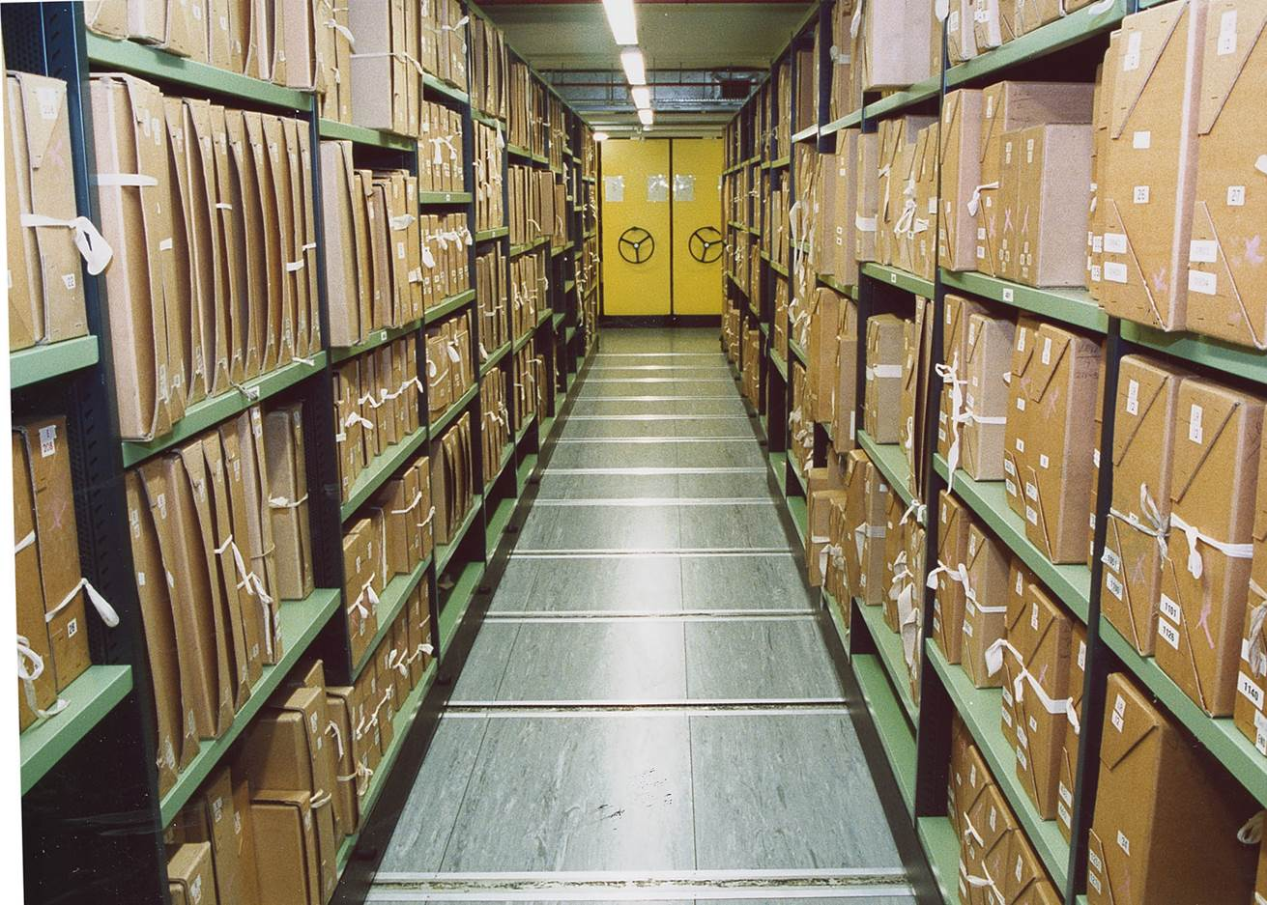
Quick quiz!
Some archival collections are quite small, others are much larger! You can find archives in universities, schools, businesses, religious buildings, historic houses and at your local library or history centre
The National Archives is a government archive and is the biggest archive in the UK.
This is a picture of one of the stacks or archive shelves in one of its secure rooms called a repository.
Take a few seconds to have a look…
Notes:
Image taken from: https://www.nationalarchives.gov.uk/education/families/time-travel-tv/introduction/inside-a-repository/

Slide 7
Time for a vote!
If this is just one stack inside one of the repositories, how many documents do you think are held there altogether?
A) 12,000
B) 120,000
C) 1,200,000
D) 12,000,000
Correct answer = D
And like many archives, the collection keeps growing!
Notes:
Image taken from: https://www.nationalarchives.gov.uk/education/families/time-travel-tv/introduction/inside-a-repository/

Slide 8
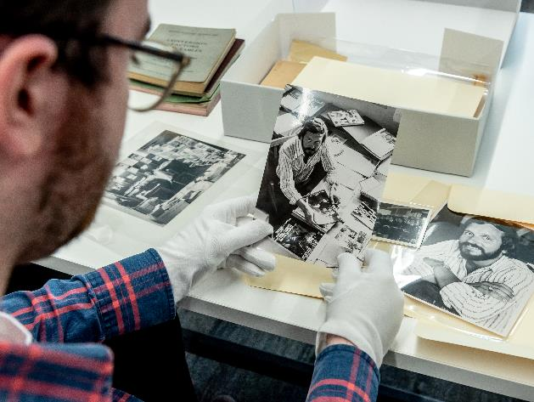
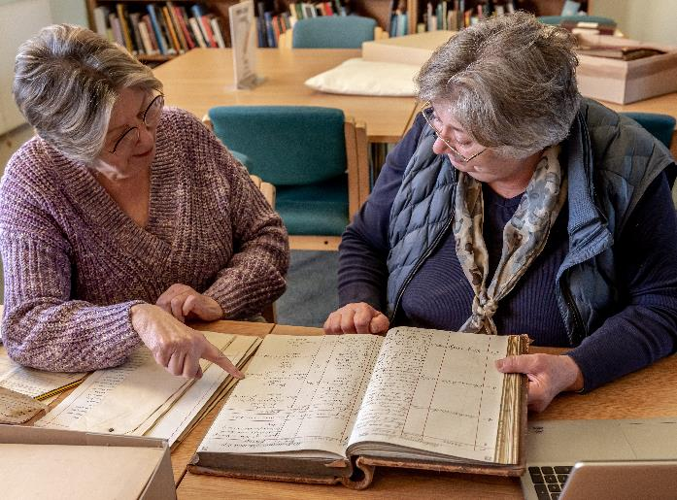
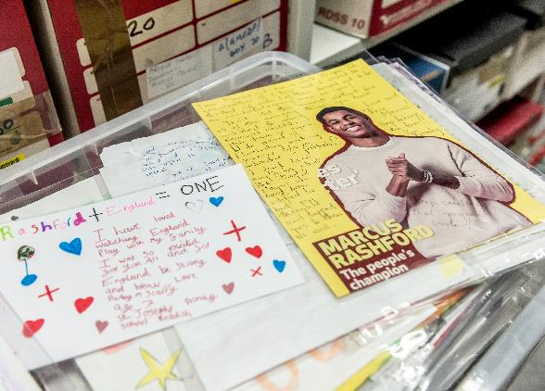
What kind of information is kept in an archive?
Archival collections are made up of many different types of documents…
Notes:
Image: Salford University Archive ©The National Archives
Image: Edge Hill University Archive ©The National Archives
Image: Manchester Central Library and Archives ©The National Archives

Slide 9

In Pairs - Task
You have two minutes!
Make a list of the different types of documents you think an archive might look after.
For example: 1. Letters
2.
3.
How many times can you go round the class with each pair calling out an answer before you run out of ideas?
Notes:
Image taken from: Stock images included free in Microsoft 365 package

Slide 10
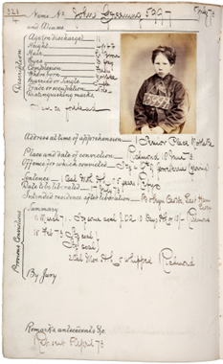
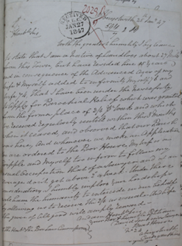
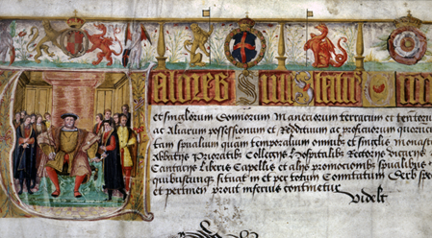
Lots of good suggestions!
Often collections are made up of things that have been written down or drawn, but in fact there are numerous ways in which information has been recorded in the past, and more recent collections include photographs, videos, emails and websites.
What makes an archive so special is that each of its documents is a primary source, capturing a view of a particular moment in time for future generations. They help us build up a picture of the past that we might otherwise never have known about!
Notes:
Images taken from The National Archives: E 344/22, PCOM 2/291/323 and MH 12/15797

Slide 11

What does this mean for me?
Well, with all this information to look after, there are lots of opportunities within the archival sector.
There are over 2000 archives across the UK to work in.
What does that look like?
How many students are in your school?
How many schools of your size would you need to put one student inside every archive in the UK?
Notes:
Image taken from: Stock images included free in Microsoft 365 package
Estimated number taken from: https://cdn.nationalarchives.gov.uk/documents/archive-sector-workforce-strategy.pdf

Slide 12

Some of the roles available in the archive sector
Archivist roles
Conservation roles
Record Management roles
Marketing and Press roles
Community Engagement roles
Volunteer management roles
Learning roles
Cataloguing roles
Digitisation roles
Visitor Experience roles
Find out more!
With a partner, you have 10 mins to complete the Role Match Activity Worksheet.

Slide 13

Many different types of archives
In a large archive, you might be doing one element of the roles we have looked at within a dedicated department.
In a small archive, you could find yourself wearing many hats as the archivist and taking on several roles (such as community engagement, volunteer management and cataloguing) within the same job!
Which sounds more appealing to YOU?
Notes:
Image taken from: Stock images included free in Microsoft 365 package

Slide 14
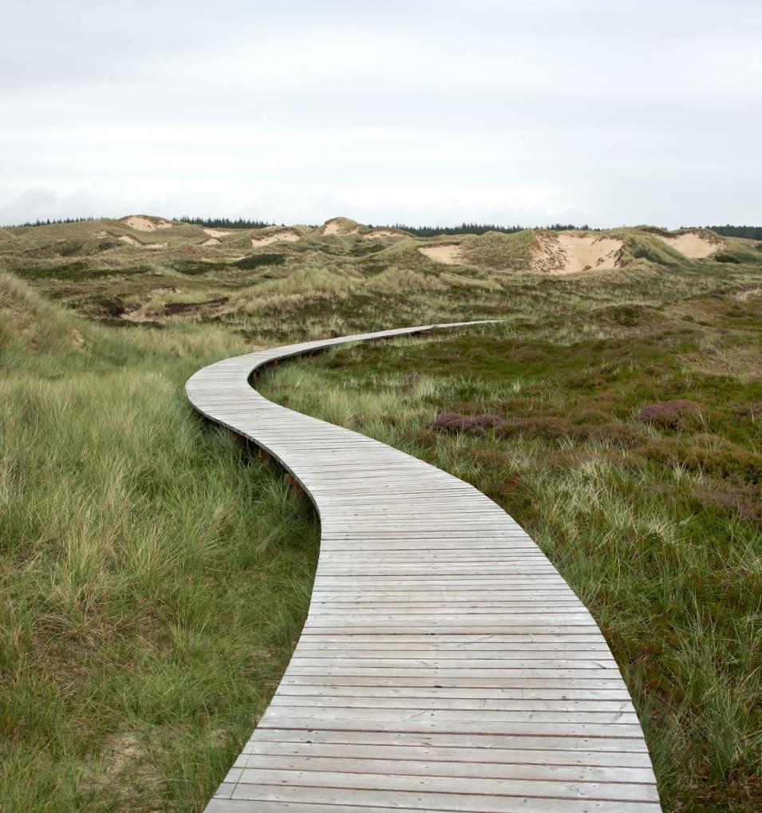
Routes into the archive sector
The two main routes for archivist and record management roles are:
A Master’s degree in Archive Studies or Records Management, which you can do after a variety of undergraduate degree options
Level 7 Archivist and Records Manager apprenticeships
But with a wide variety roles, there are other pathways. An undergraduate degree is certainly an asset, but so are different types of work experience.
Notes:
Image taken from: Stock images included free in Microsoft 365 package

Slide 15

Let’s have a closer look at one of these roles!
Notes:
Image taken from: Stock images included free in Microsoft 365 package

Slide 16

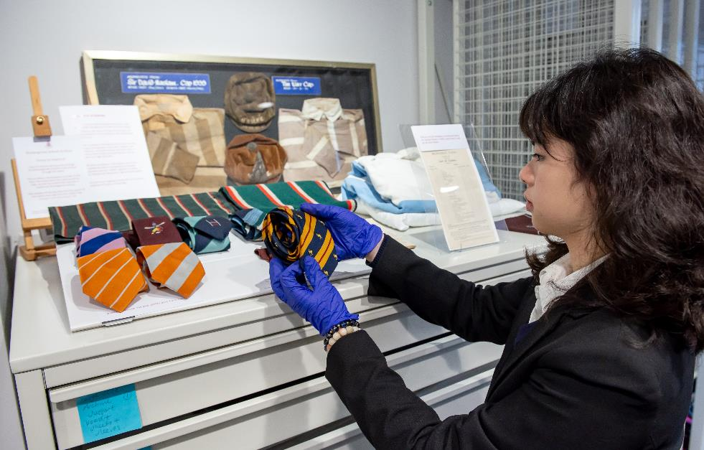
Get thinking like an archivist!
Your headteacher has decided to create a school archive. Your class has been asked to decide on the best way to do this…
Notes:
Image taken from: Stock images included free in Microsoft 365 package
Image: Bromsgrove School Archive ©The National Archives

Slide 17
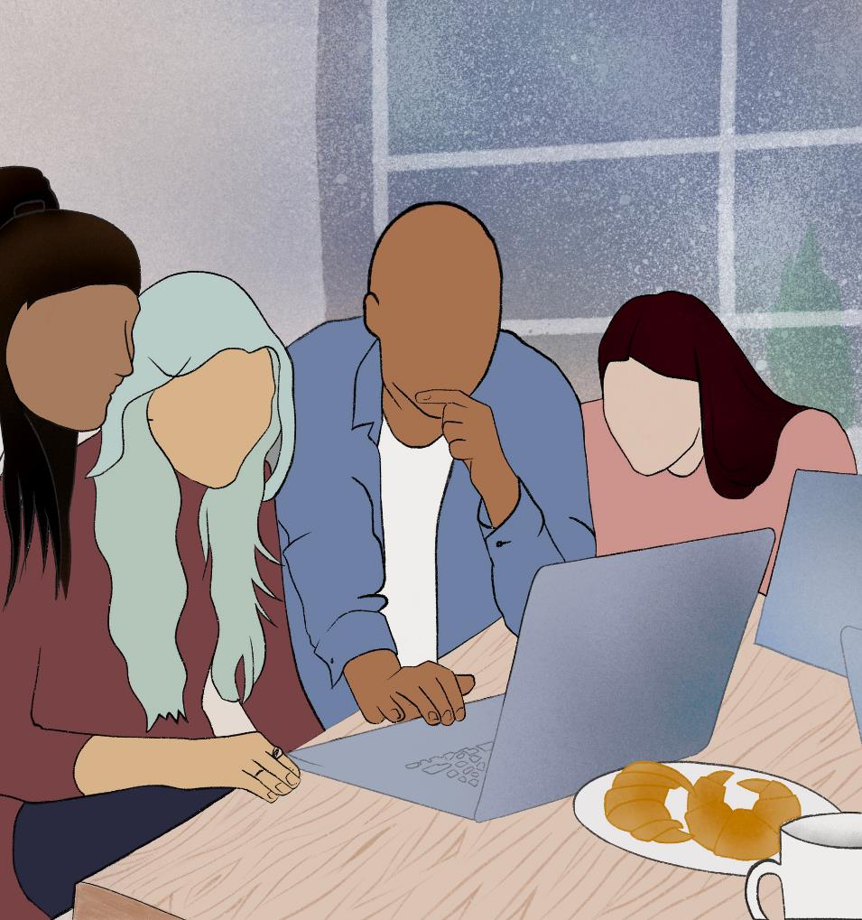
Archivist Challenge!
Get into groups of four and read the brief carefully
You have 10 minutes to put together your ideas.
You will then have two minutes to present your ideas and reasoning to the rest of the class.
It is up to you how you split the task/use the time, but everybody must say something in the pitch
Notes:
Image taken from: Stock images included free in Microsoft 365 package

Slide 18

Decide
Which were the best suggestions?
Can you agree as a class which three you’d like to take forward as your recommendations to the head?
Notes:
Image taken from: Stock images included free in Microsoft 365 package

Slide 19

Reflect
Can you remember which skill you wrote down for a key skill an archivist would need to do their job?
Having done the challenge, do you still agree with that?
With your group, add three more skills you now think you might need for the role of archivist.
Share with the class

Slide 20
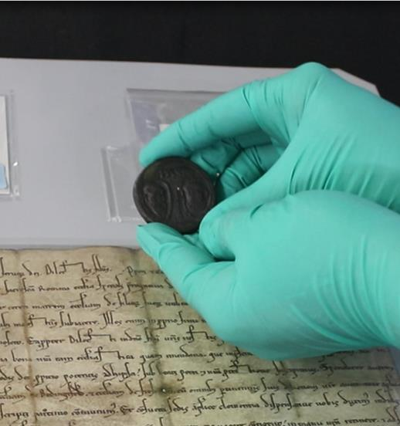
Explore further -
Extension activity 1
There many different types of archives. How many different kinds can you find?
Where could you look?
Helpful places to start:
https://discovery.nationalarchives.gov.uk/find-an-archive
https://en.wikipedia.org/wiki/List_of_archives_in_the_United_Kingdom
Which one do you think it might be most interesting to work in and why?
Notes:
Image taken from: https://blog.nationalarchives.gov.uk/handling-historic-collections-the-gloves-are-still-off/

Slide 21
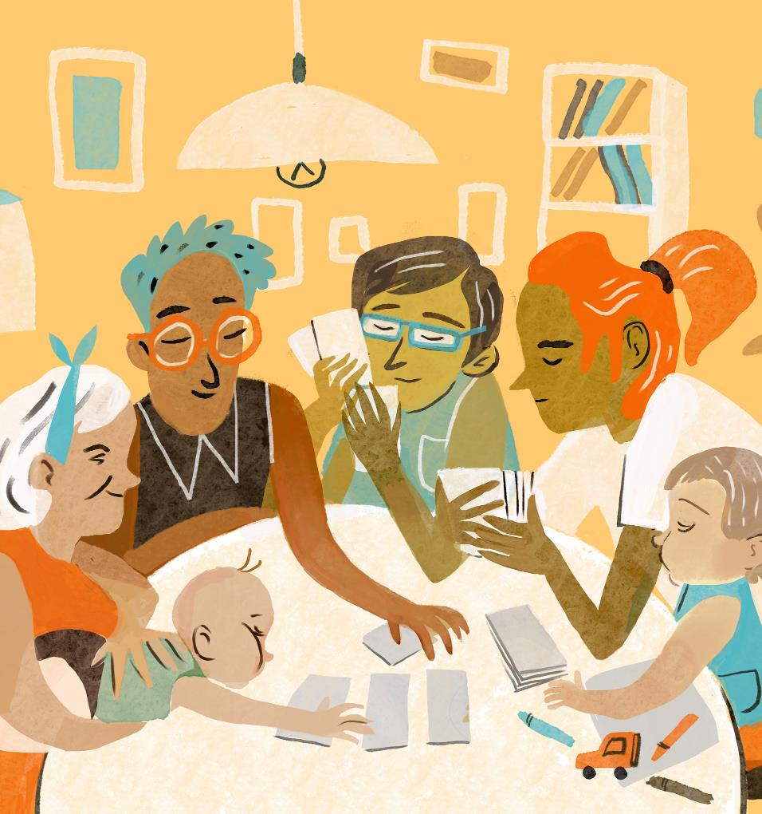
Explore further -Extension activity 2
Create an archive about your family!
Think about:
What things are most important to your family?
What documents do you already have?
Do you have any gaps that you feel you might need to fill – and if so, how might you do that?
Who would you be creating this archive for and why?
Notes:
Image: Microsoft

Slide 22
What have we discovered today?
Whole Class discussion
Can you explain what an archive is?
Can you name three roles you might find in the archival sector?
Is there a role which stood out for you?
What made that role sound interesting?
How could you find out more?
https://www.nationalarchives.gov.uk/archives-sector/careers-in-archives/archivist-and-records-manager-apprenticeships
https://www.archives.org.uk/a-career-in-recordkeeping

