Slide 1

Screen, film and TV

Slide 2

Aims and objectives…
LO: To demonstrate you can identify careers in film and TV and to understand how you can find more information on careers in film and TV.
AIM: To virtually visit a workplace (using the first day on set film) in order to experience the environment

Slide 3












12 sectors = lots of opportunities
Advertising
and marketing
Design (product graphic, fashion)
Film TV,
video radio and photography
Animation and
VFX (visual effects)
Video games
Heritage
IT, software and computer services (‘creative tech’)
Museums, galleries and libraries
Music, performing and visual arts
Crafts
Publishing
Architecture

Slide 4


Images: Erroll Jones ©WeShootLondon

Slide 5

Watch ‘Introducing the screen industries’
What did you find out you didn’t know before?
Why would this industry be interesting for someone to work in?
Teacher/student discussion - what did you learn about the industries you didn’t know before?

Slide 6

Watch here

Slide 7

Jobs in film and TV include roles like director, camera operator, runner, floor manager, production assistant…

Slide 8

Animators, artists, 3D modelists or visual effects artists….

Slide 9

Musicians, composers,
sound effects...

Slide 10

Location managers, set designers and builders, sustainability managers, props and researchers...

Slide 11

Audio engineers, sound designers, and lighting technicians...

Slide 12

Studio managers, facilities, operations, marketing managers, sales, distribution, and administrators…

Slide 13

Lawyers, accountants,
HR professionals, and
business managers...

Slide 14

plus, carpenters,
electricians, hair &
make-up stylists, and
caterers.

Slide 15

Find out more about careers
Visit www.discovercreative.careers
Use the careers finder to explore job profiles in the screen sector
Can you write down some definitions for the list of roles provided in bullet points?

Slide 16
Watch ‘First day on set’
What things happen on a film and TV set?
Are there any roles present in this video you haven’t heard of? What do these particular roles entail?

Slide 17
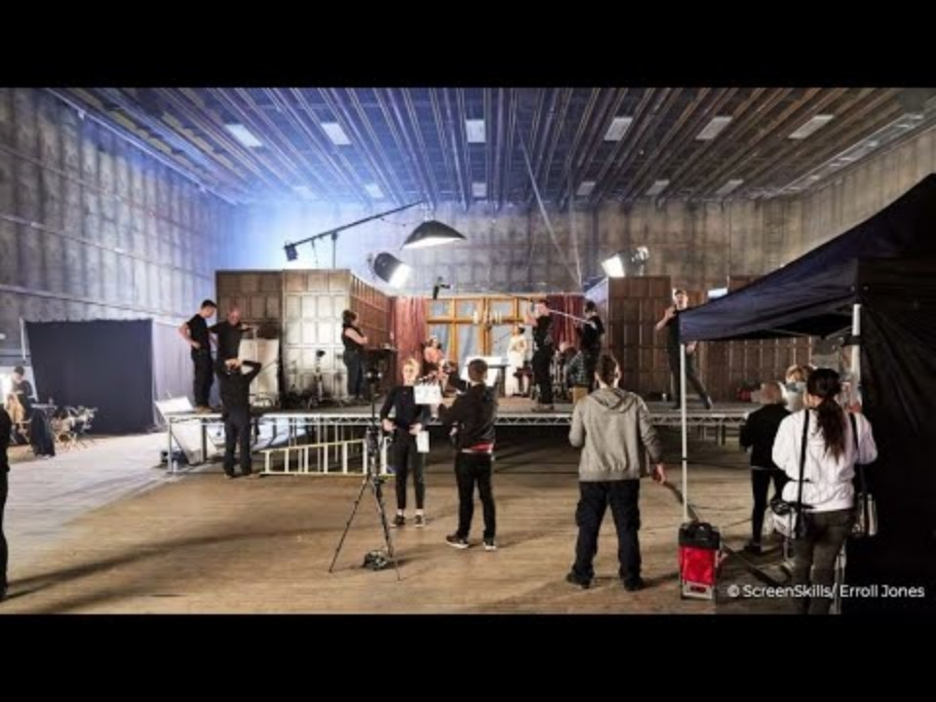

Slide 18
James Bond task: Production
TASK - 10 Minutes
TASK - 10 Minutes - Group work
The new James Bond film is due to go into production.
On your desks, assign yourself roles from the list provided outlining why you have chosen these roles.
What skills do you need to do to perform your role effectively? For instance, to be a producer, you must be organised and have a good attention to detail.

Slide 19
James Bond task: Distribution
Continued 10 Minutes Extension
Your job is now to distribute the film. Assign yourself roles (examples would be: Marketing Manager, Marketing Coordinator, PR and Materials Coordinator) and come up with some marketing strategies to reach Bond’s target demographic.
Examples of these marketing strategies could be: a poster campaign, teaser trailer, trailer, social media campaign (how would you do it?), merchandising and giveaways.
You need to be creative here, it is exciting to see what you can come up with!

Slide 20

Learning check
Using your whiteboard or a post it note, note down how many different roles you can remember from the lesson today.
Note down the website where you can find out more information regarding the TV/Film industry.

