Slide 1


Performing Arts

Slide 2
Focus on Performing Arts - Session Aims
Identify careers in performing arts
Virtually visit a workplace – Royal Opera House
Experience and solve a set design task set by the National Theatre
Understand where to find more information on careers in performing arts

Slide 3
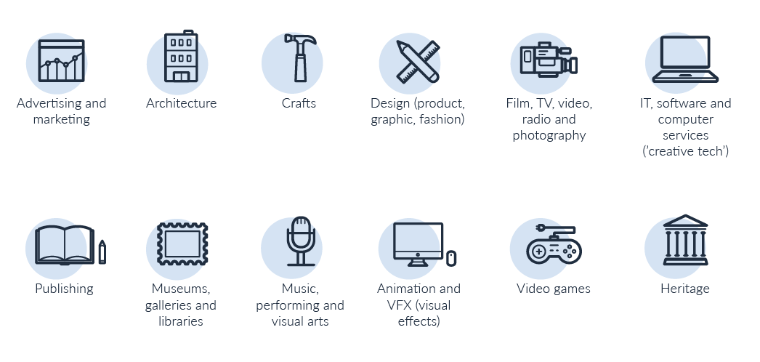
12 sectors = lots of careers!
Notes:
What are the creative industries?
12 sub sectors
The Creative Industries were defined in the Government's 2001 Creative Industries Mapping. Defined as “those industries which have their origin in individual creativity, skill and talent. and which have a potential for wealth and job creation through the generation and. exploitation of intellectual property”.
Think how often in every day of your life you interact with creative industries – music, radio, newspapers, magazines, books, TV content on YouTube, podcasts, billboard posters, architecture – so much of what you see is designed, produced, created.
(1 min)

Slide 4
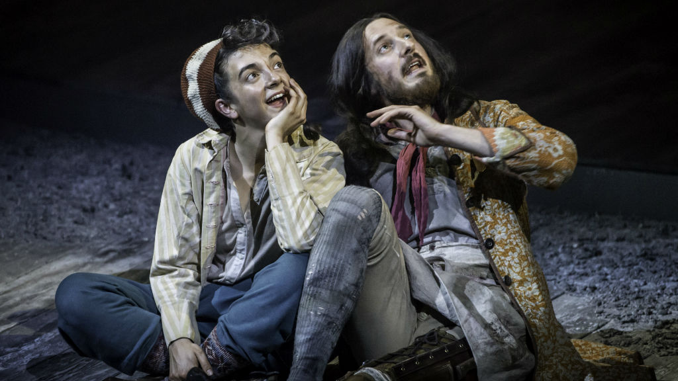

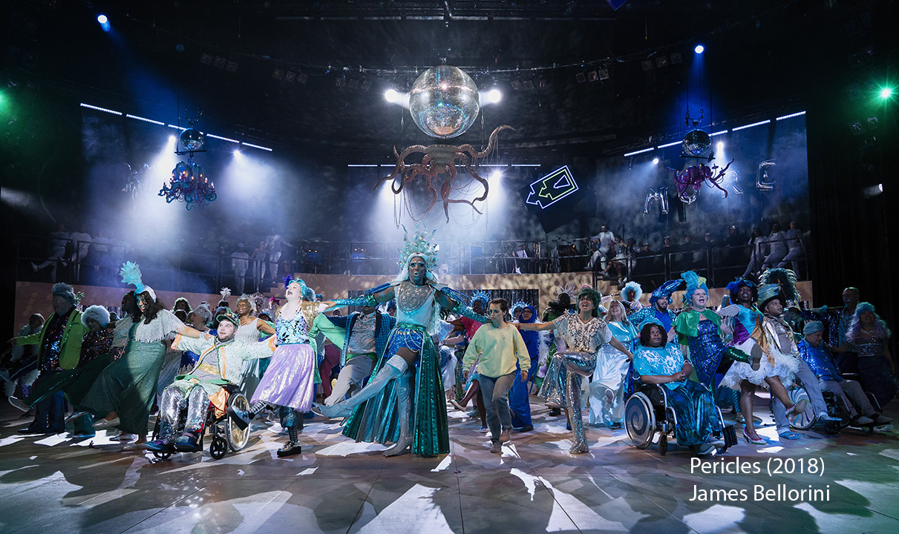
The Performing Arts
Forms of creative activity that are
performed in front of an audience,
such as drama, music, and dance.

Slide 5

Take a look at the sector
(15 mins)
VISIT NOW
Notes:
Intro and film (15 mins)

Slide 6
How many different careers can you think of in performing arts?
Notes:
ICEBREAKER
Teacher to refer students back to the sector overview they might have seen in their assembly, or perhaps a school production, and ask them to think about all the different roles it might take to put on a live show – both backstage and in the running of a venue or production company. Then teacher or nominated student to jot answers called out from class on to flipchart paper. How many do you get? Allow 4 mins for shoutout, then spend time reflecting on infographic on next slide.

Slide 7
Artist/performer
Electrician
Sound technician
Roadie
Tour manager
Artistic director
Fight director
Finance Officer
Lighting director
Fundraiser
Production manager
Front of house
Musician
Playwright
Scenic automator
Backstage crew member
Assisting photographer
Finance officer
Stage manager
Marketing Assistant
Set designer
Fight director
Make-up artist
Pattern cutter
Admissions/bookings officers
Flyperson
Musical director
Producer
Catering
Prop maker
Carpenter
Outreach manager
Theatre manager
Usher
Wardrobe assistant
Voice over artist
Choreographer
Notes:
Any surprises?

Slide 8
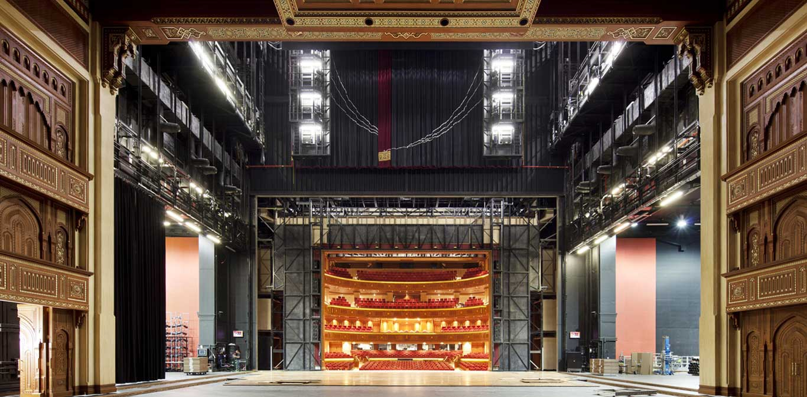
Play film
Notes:
Any surprises?

Slide 9
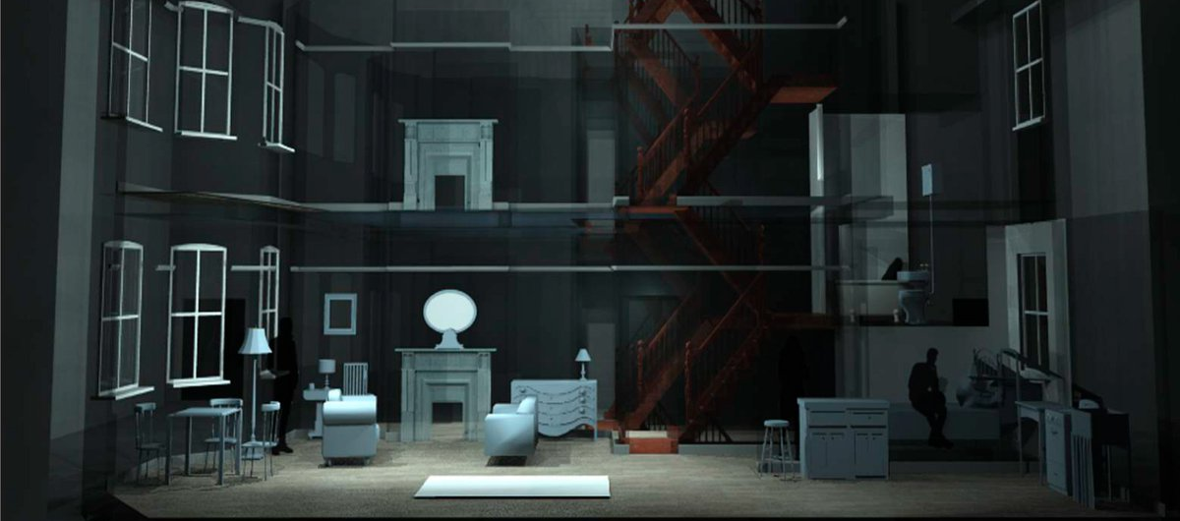
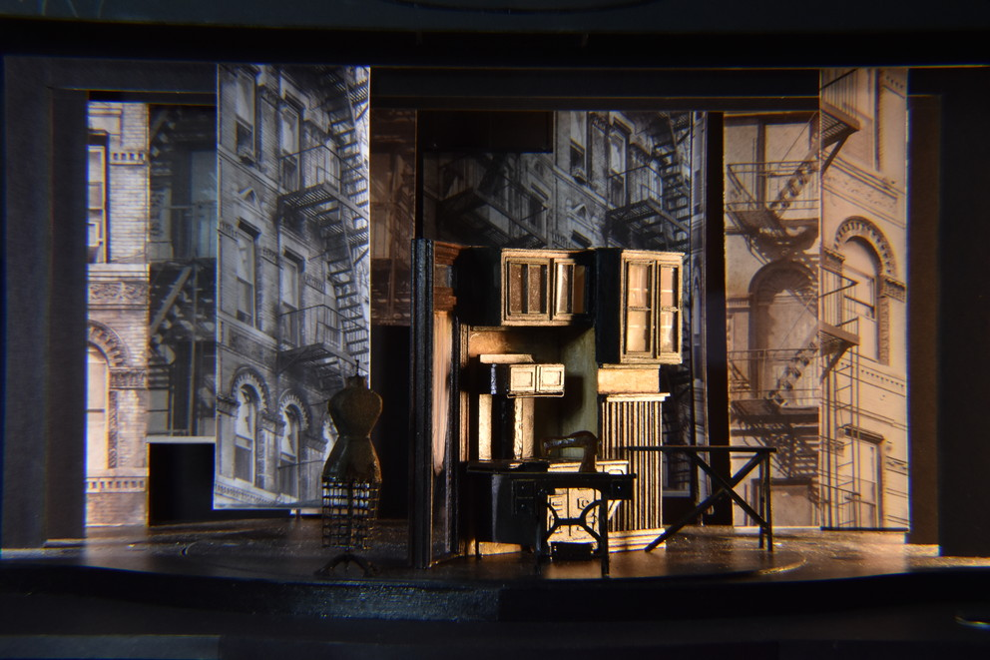
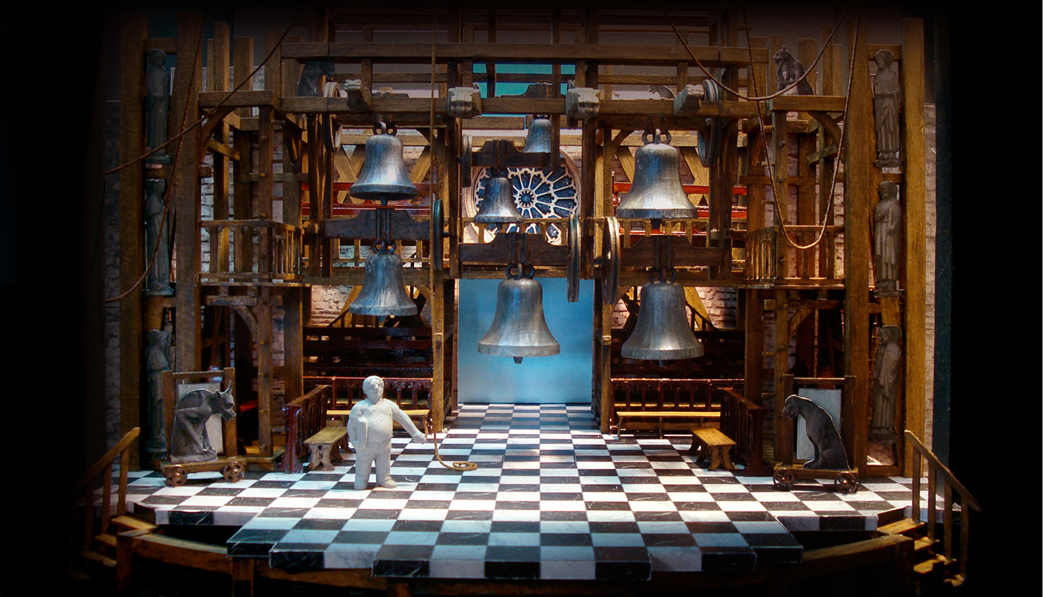

Focus on Set Designer
The Set Designer gets to interpret the story and create the world of the play.
This is done by choosing shapes, colours and textures that tell the audience where they are and how they feel.
A model, a scaled down version of the set design is made. Usually 1:25, so model is 25 times smaller than it would be on stage. This is used to show all the other departments working on the show what will be on stage and helps everyone to visualise the world and plan all the other work needed to create it.

Slide 10
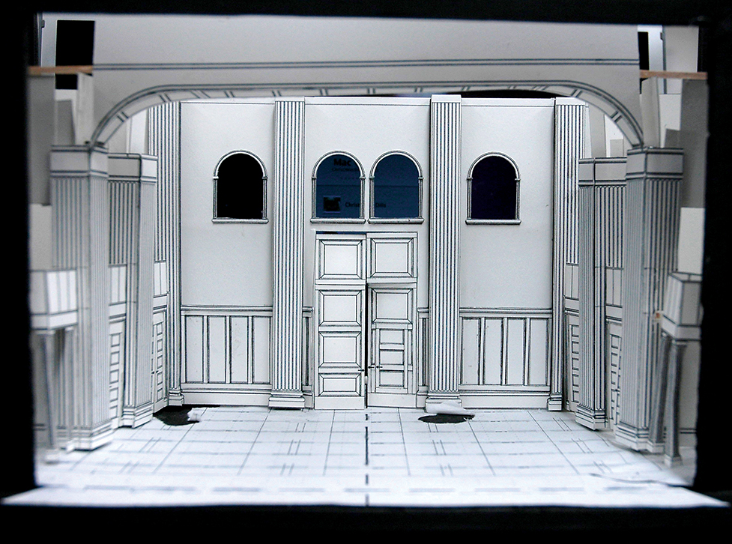
Focus on Set Designer
(Activity)
Before the final model is created, a model box (the theatre space itself rather than the model pieces of set) is a place of play and experiment.
Set Designers do something called ‘Sketch Modelling’ where they play with shape and texture and form by making shapes made of basic materials and moving them around in the space.

Slide 11
The National Theatre – Set Design Task
(Activity)
1) Read the ‘Dream Room’ poem provided. In pairs or individually, pick one of the lines to design the set for in your box. Imagine each line as a scene from a play.
2) Pick a pose from the sheet that best reflects the person in their dream room.
TIP: To help the person stand up, strengthen the back by sticking it onto card. To create a simple back support, you will find a guide in your pack.
3) Create the world of the dream in the box using the materials available. Keeping as much as possible to the scale.
TIP: By cutting out the pose first you will have a good idea of the size the other things need to be. It doesn’t have to be precisely 1:25 (as this can be very tricky and set designers use a special ruler to help them). Creative use of space is encouraged so if you make something bigger or smaller deliberately then go with it for the concept! This is a dream space after all.
Notes:
Things to encourage:
Imaginative interpretation of the poem line. What does the line mean to them?
Use the grid print out to help the understanding of the size the world needs to be
How could they visually show the weirdness of the dream? Proportion? Colour? Shape?
Remember sight lines. Could an audience member see everything?
Movement, if the scene has action how could the set design show that?

Slide 12
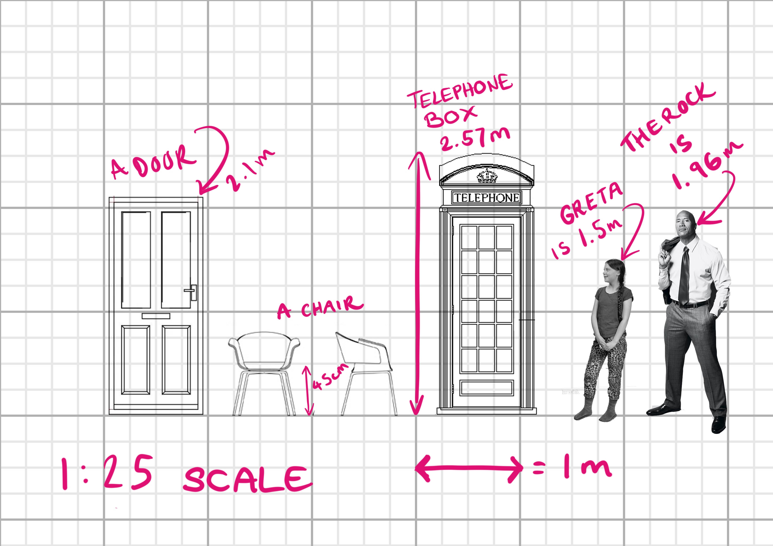


The National Theatre – Set Design Task
(Activity)
Cutout your chosen poses, stick to card and make a strut:
If you don’t have a suitable box to use, make one using template provided in your kit:
Think about scale (grid paper provided in kit)
Notes:
Teachers to see ‘Extra help’ hints and tips in their notes.
Students to either photograph their creations and email to teacher, or present their ideas to the class (2 mins each presentation)
If you have been able to organize external employer observers for student presentations, the lesson could achieve against Benchmark 5.

Slide 13
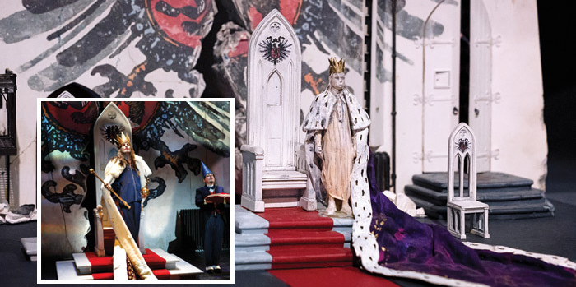
The National Theatre – Set Design Task
(Student presentations / Submissions)
Notes:
Teachers to see ‘Extra help’ hints and tips in their notes.
Students to either photograph their creations and email to teacher, or present their ideas to the class (2 mins each presentation)
If you have been able to organize external employer observers for student presentations, the lesson could achieve against Benchmark 5.

Slide 14
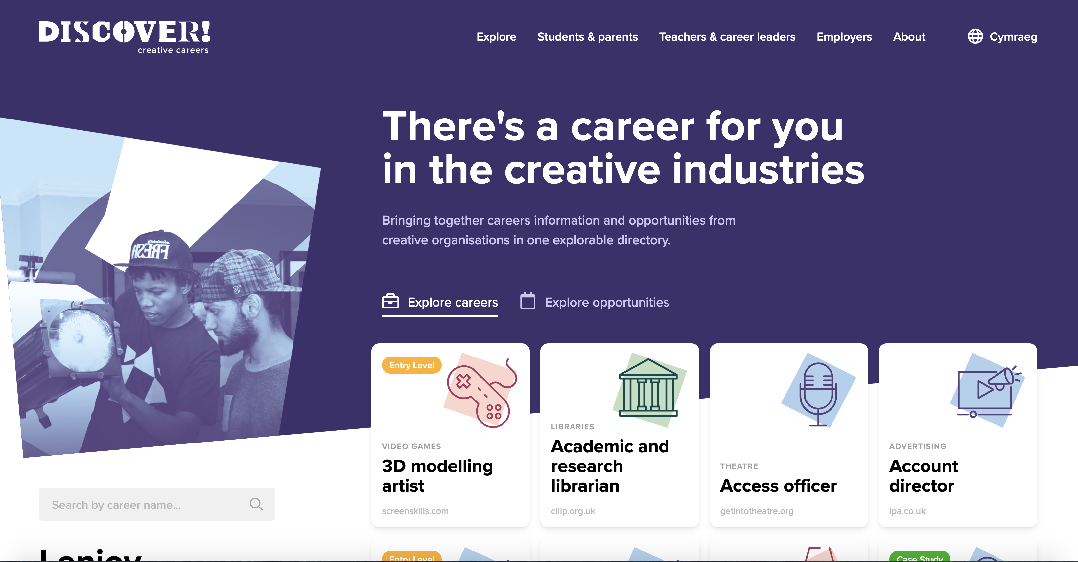
Find out more about careers
(Activity – 10 mins)
Visit www.discovercreative.careers
Find ‘set designer’ job profile;
Then find a job you have never heard of;
Then find a job you would like to do.
Notes:
If you are running a one hour session, this is a round up and signposting for further info. Suggest all students key url into their phones so that they check out site more fully in their own time (5 mins)
If you are running a longer session, invite students to visit website and answer the two questions

Slide 15

Learning check
(3 mins)
How many sub-sectors of the creative industries are there? Can you name them?
What did you learn about set design today?
Where do you look to find out more about careers and pathways into the creative industries?

Slide 16
Employer Q&A Panel
(1 min)
If you have any questions from today’s session that you would like to ask our employer panels this week, please visit the Discover website to find out more
Notes:
To enable your activity today to meet Gatsby Benchmark 5, active and two-way communication needs to take place between student and employer. This can be done in a number of ways:
Employers can be invited to review the mood boards/student presentations and give feedback
Employers can be invited to review the motion capture scene reading/performance and give feedback
Invite students to ask questions of our expert Q&A panels during NCW. Details on timings and contributors are on the website.

Slide 17
Discovercreative.careers
@creativecareer5

