Slide 1

Focus on advertising and marketing
Is there a career for you?
Notes:
Today we are talking about the Creative Industries and finding out what careers you might follow post school or university.

Slide 2


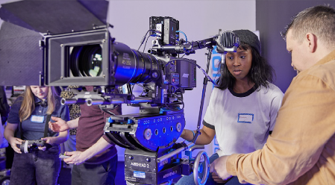
The Creative Industries Opportunity
In 2020:
GVA £95bn
In 2023 estimated
£108bn
Growing 1.5 X rate of economy
2.3M+ people work in creative industries – 6.9% of jobs across the UK
Growing 5X UK total
87% of creative jobs are at low or no risk of automation
Notes:
All of this means that the Government's ambition is to grow the creative industries by £50bn and create another one million jobs by 2030!
Sources: IPA Foundation Certificate, The Advertising Association, DCMS Creative Industries Sector Vision, Nesta Innovations Foundation

Slide 3




What are these brands?
Notes:
EXERCISE 1 (STARTER TASK):
Handout: Key vocabulary - please note there are basic definitions for younger students but also some stretch quotations for older students to discuss, as required.
Slide: Whole class asked to say what brand this is for even though only partial logo and b/w. A: YouTube, Audi, Apple, Starbucks
How do you know them? Where have you seen them? Discuss stores, social media, TV, cinema etc.
You know them because they have been advertised for years by people working in the advertising industry, one of the most successful of the creative industries, in order to build brands. Brands are remembered, people have feelings about brands.
If you don’t recognise them, why might that be? Explain the idea of a Target Audience, aiming at a particular age group or other demographic.
What makes them stand out? What do you like/dislike about them? Who do you think they are aimed at/target audience?

Slide 4
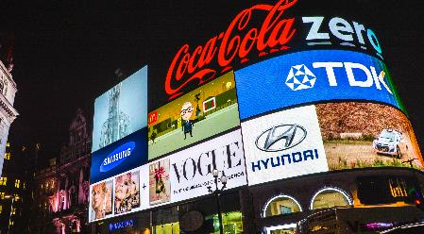


The UK Advertising Industry Opportunity
In 2021: UK Ad Market was worth £31.9bn
Largest advertising market in Europe and 3rd in the World
1 million jobs are supported by the ad industry
Notes:
What is Advertising?
So within the creative industries we find today’s sector – the ad industry. Sources: The Advertising Association, Deloitte, WARC, PEC.
The ad industry is composed of many different types of agency, but the main ones are ad or media agencies. How many advertising agencies do you think exist in the UK? A: There are 17,015 Advertising Agencies businesses in the UK as of 2023, an increase of 0.6% from 2022. Source: IBIS World.

Slide 5
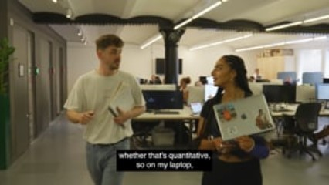
VCCP film:
Notes:
So what is working in an agency like? Play the embedded VCCP film and note that there will be another later in the lesson.

Slide 6



Examples of entry level roles in advertising
Client Service
Media Planner
Creative
Organised, great communicator, persuasive, in the centre of everything, resilient, empathetic
Numerate, good with data, fascinated by how to reach people at the right time/place/price
Loves ideas and how to execute them, lateral thinker
Notes:
HANDS up if you think any of those roles would suit you.
But please note there are many entry level roles available, which can be done by those who are 18 or post university, for example:
Creative Agencies
Client Service/Account Executive/Account Handler
Junior Advertising Creative
Junior Account Planner/Strategist
Social Media Manager
UX (User Experience) Executive
Assistant Producer
Media Agencies
Media Planning/Buying Executive
Biddable Executive
Media Operations Executive
Programmatic Executive
PPC Executive
SEO Executive
Both types of agencies
Junior Web Analytics
Insight Executive
Marketing Executive
New Business Executive/Assistant
Financial Assistant
You can search on the IPA or Discover Creative Careers websites to learn more about all these roles – links at the end of this lesson.

Slide 7

Salaries
Average salary:
Average entry level salary:
Top salary up to:
£52,000
£23,000
£250,000
Notes:
Q: The average entry level salary is £23,000, but what do you think is the range? A: A range of £17,000 to £29,000 depending on location and role.
Source: IPA Salary Survey 2022

Slide 8
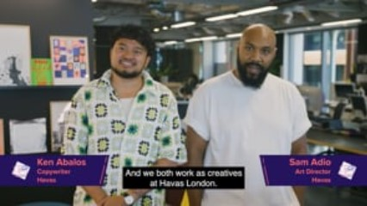
Havas London film:
Notes:
So what is working in an agency like? Play Havas film.
NOTE after this slide EXERCISE For children under 13. (They do not do the Nike EXERCISE on slides 9-11)
Redesign popular brands using different colours using print outs of blank logos and colouring pens [HANDOUTS]
Class discussion: How does colour affect the mood of the logos? Do you think this has impacted the target audience? Why do you think the original logos were chosen by the companies? Can also be an EXTENSION EXERCISE for older children who have completed the Nike Exercise

Slide 9
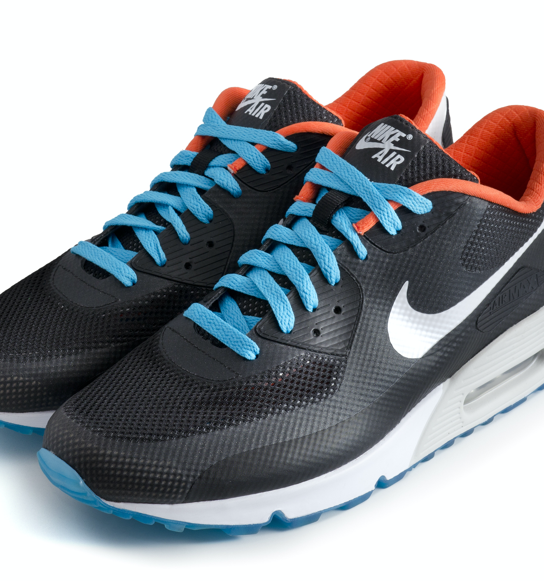
Task A: Group Work
You are an agency team which has been asked to mastermind the launch of a new line of Nike trainers. These trainers are limited edition and bright orange.
Which is the target audience that will make the most money? 15-34 men who are interested in sport? Teenagers? Collectors? Who?
What are the two best media ‘channels’ to reach this audience? Sky Sports? TikTok? The Daily Mail? You can pick any channel.
Think up a tagline/slogan which will appeal to your target audience across all media.
Notes:
Refer again to GLOSSARY HANDOUT

Slide 10

Group Work and Presentation
Which is the target audience that will make the most money? 15-34 men who are interested in sport? Teenagers? Collectors? Who?
What are the two best media ‘channels’ to reach this audience? Sky Sports? TikTok? The Daily Mail? You can pick any channel.
Think up a tagline/slogan which will appeal to your target audience across all media.
Notes:
Groups can be any size that works for teacher.
One person will present for the group, answering the three questions in one minute

Slide 11


Feedback
Notes:
Teacher feeds back generally on e.g. most coherent, golden thread answer to the three questions
Peer review as to route most successful.
Teacher connects this to the curriculum

Slide 12


Task B
Redesign popular brands using different colours using print outs of blank logos and colouring pens
Class discussion: How does colour affect the mood of the logos? Do you think this has impacted the target audience? Why do you think the original logos were chosen by the companies?

Slide 13
Where can I find out more about working in Advertising?
www.dicovercreative.careers
https://ipa.co.uk/talent-diversity/careers-in-advertising/

Slide 14
There’s a career for you in the creative industries
Notes:
Plenary: Ask members of the class to define a brand, what is advertising, and offer one of the entry-level roles and starting salary. By a show of hands, who thinks they would be good at a job in the advertising sector?
Hands up if you think now that you could have a career in advertising.

