Slide 1
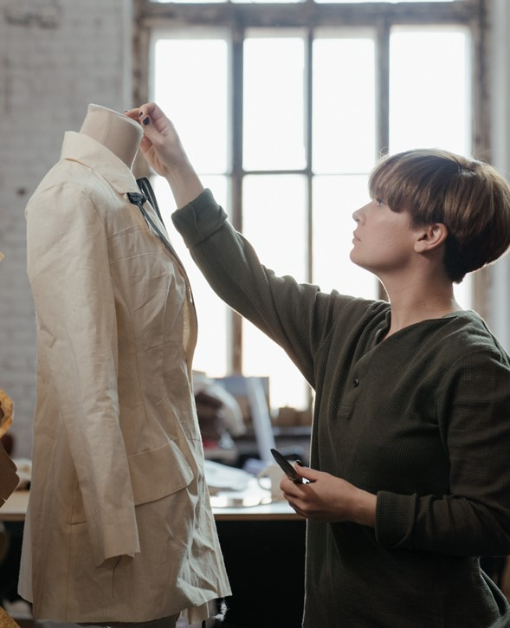
Finding a role for you in the creative industries

Slide 2

Aims and objectives…
LO: To be able to know and identify what your skills are.
AIM: To develop an awareness of roles you can do which will correlate to your skill base

Slide 3
Sliding Scale
Very confident
Somewhat confident
Not confident at all

Slide 4
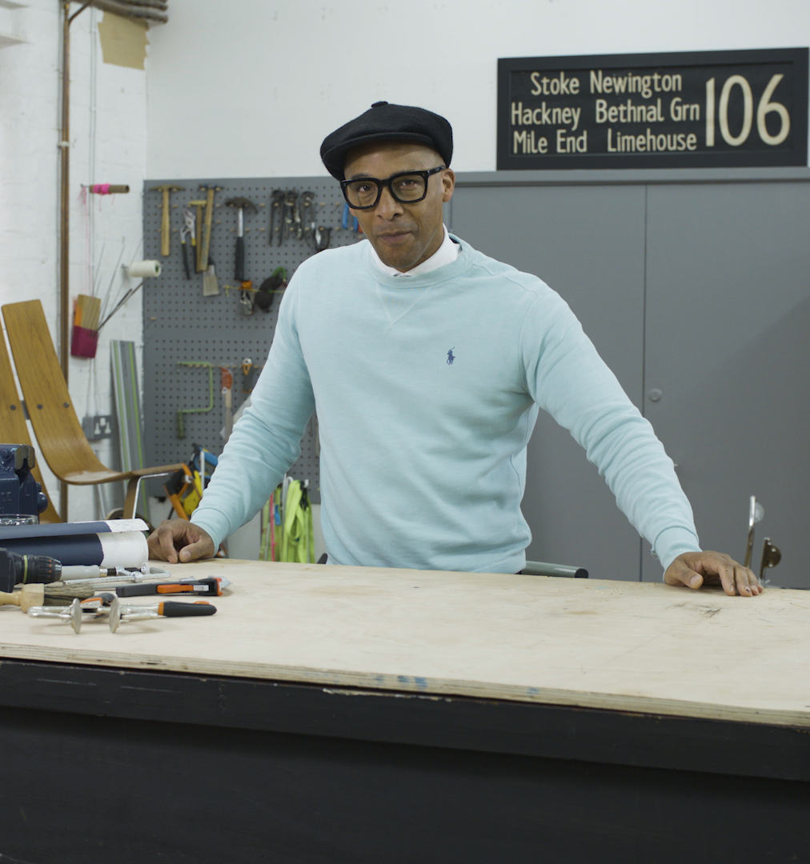
Types of roles in the creative industries…
Crafts
Artists
Planning, Scheduling and Programming
Performing
Customers, Audiences and Services
Designing
Producing
Writing
Preservation and Conservation
Business
Cross-cutting roles like HR, finance, trades

Slide 5



The Creative Industries: A quick recap…

Slide 6

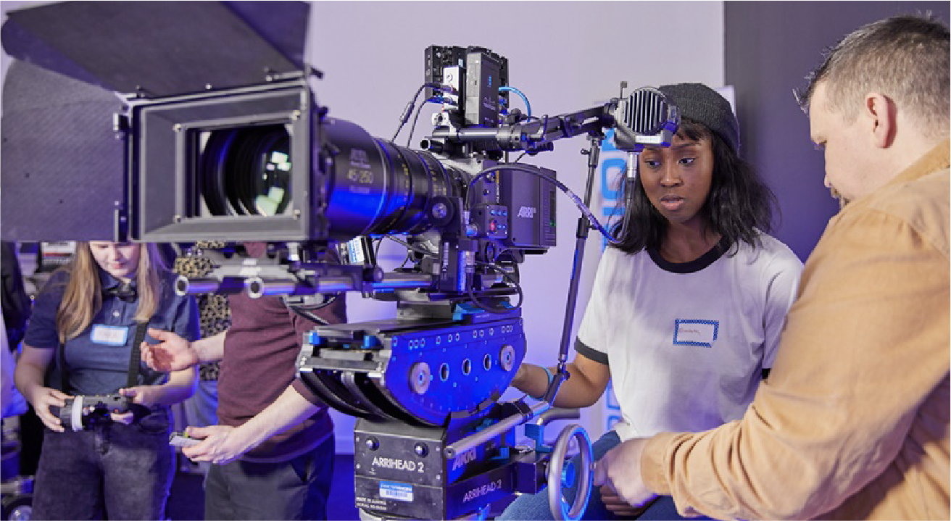

The Creative
Industries Opportunity
The creative industries are growing at four times the rate of the UK economy as a whole
About one in eight businesses are part of the creative industries
Creating jobs at three times the UK average, employing two million across the UK
Source: https://www.wearecreative.uk/champion/statistics/

Slide 7
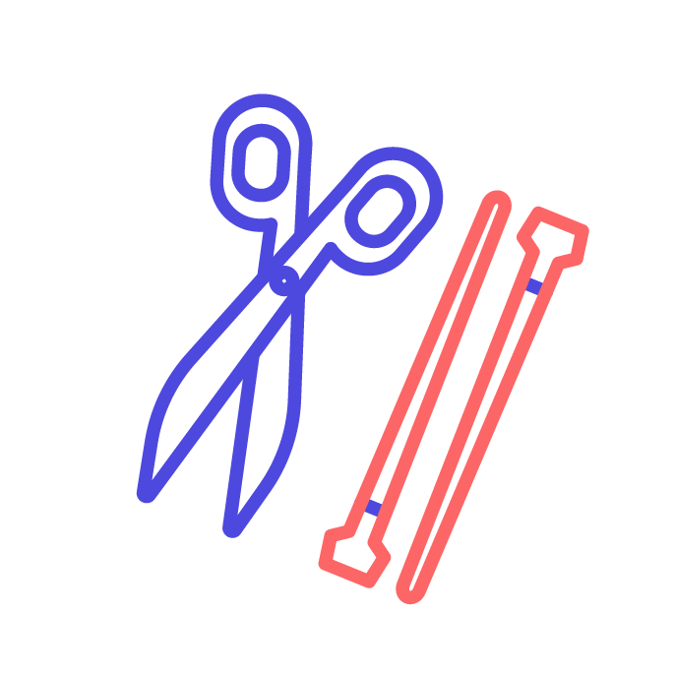


The Creative Industries: Is there a career for you?

Slide 8

What makes you unique?
Think about the experiences and skills you’ve gained from:
Your school work
Experience from part time jobs
Your academic achievements
Your family and cultural background
Your hobbies and interests
Voluntary work and work experience

Slide 9
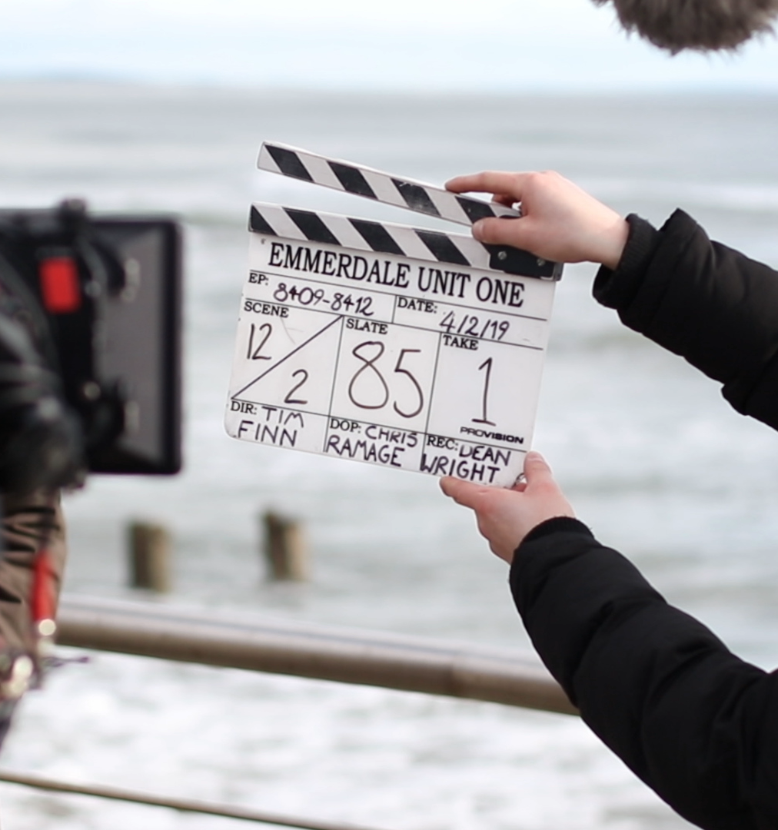

Some skills required in the creative industries:
Being creative
Working on my own
Performing to an audience
Meeting new people
Being organised
Performing in high-pressure situations
Helping people

Slide 10


Your skills…
In pairs and using the worksheet provided – discuss what skills you enjoy using from the list provided.
Are you good at those things?
Does your partner agree?

Slide 11
How can you use this knowledge about your skills?
Offering your skills to your teacher
Looking at courses you can do
Getting feedback on skills from others
Identifying skills gaps you’d like
to fill
Writing your skills on your CV
Matching your skills to your career

Slide 12
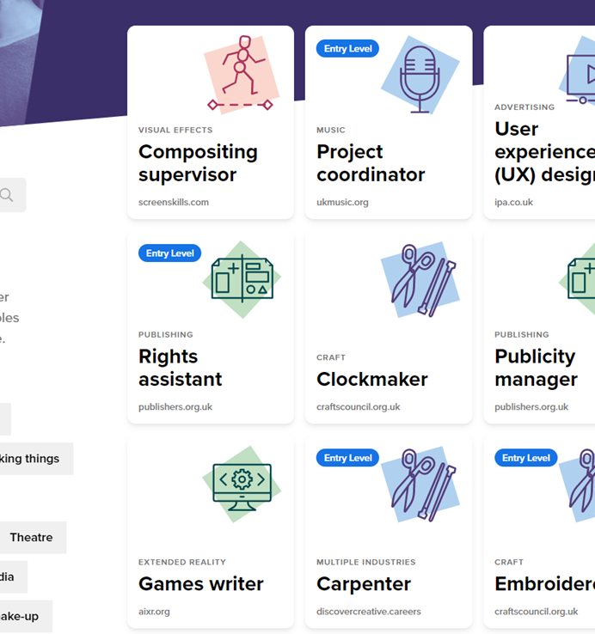
Learning check
Go to https://discovercreative.careers/#/
Use your new-found knowledge to find two jobs that would suit you.
Find out what you would need to do to get into those jobs.

Slide 13
Aims and objectives revisited…
LO: To be able to know and identify what your skills are.
AIM: To develop an awareness of roles you can do which will correlate to your skill base

Slide 14
Sliding Scale
Very confident
Somewhat confident
Not confident at all

Slide 15
There’s a career for you in the creative industries

