Slide 1


Slide 2

The Creative Industries
An Introduction

Slide 3

Aims and objectives…
LO: To be able to know, understand and evaluate roles within the creative industries.
AIM: To introduce students to the creative industries.

Slide 4






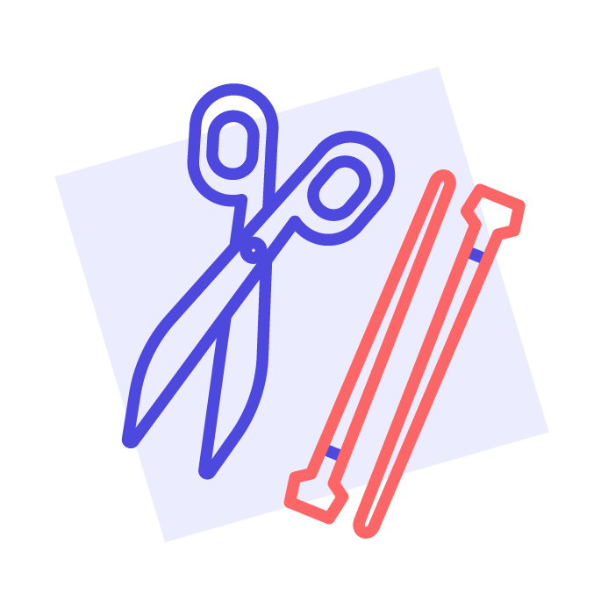





12 sectors = lots of opportunities
Advertising and marketing
Design (product graphic, fashion)
Film TV, video radio and photography
Animation and VFX (visual effects)
Video games
Heritage
IT, software and computer services (‘creative tech’)
Museums, galleries and libraries
Music, performing and visual arts
Crafts
Publishing
Architecture

Slide 5

Take a look…
How many subsectors of the creative industries can be spotted here?
What types of jobs did you see?

Slide 6
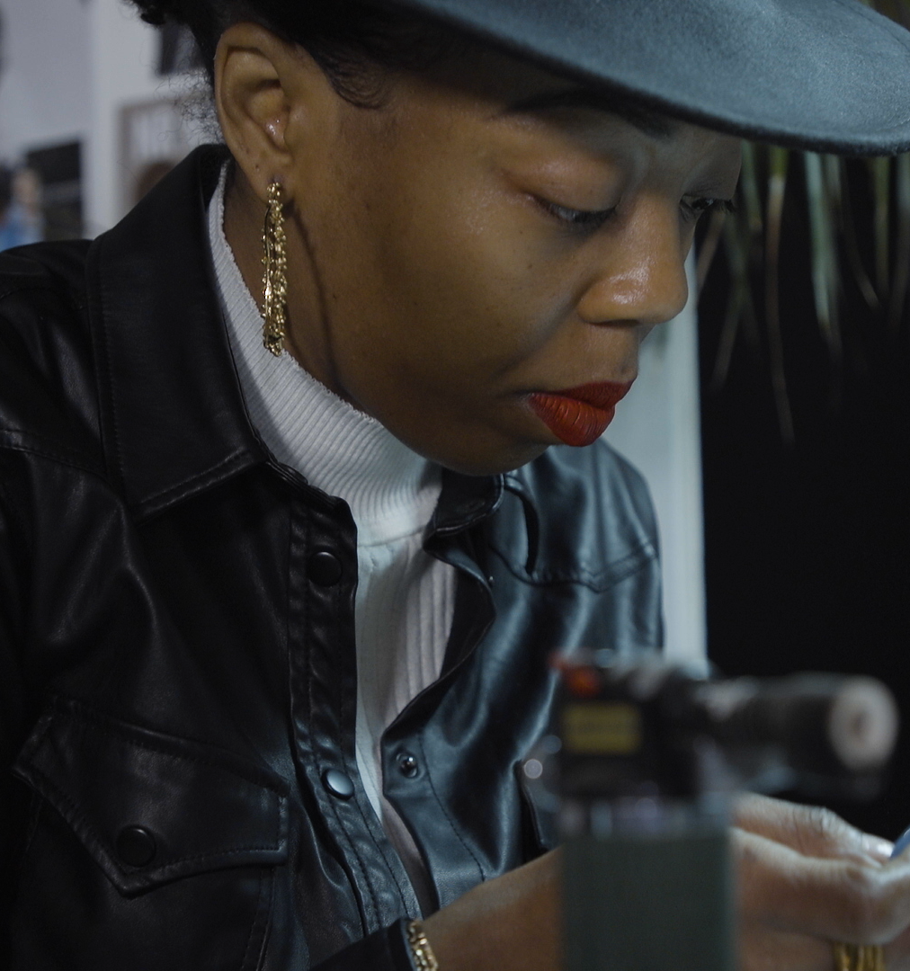
Creativity Matters
1 in 8 businesses in the UK is part of the creative industries.
In 2021, the creative industries contributed £109bn to the UK economy – this was 5.6% of the economy in that year!
The biggest contributor of the 12 subsectors was IT, software and computer services which contributed 2.3% to the UK economy.
Notes:
Sources:
https://www.gov.uk/government/statistics/dcms-sectors-economic-estimates-2019-business-demographics
https://lordslibrary.parliament.uk/arts-and-creative-industries-the-case-for-a-strategy.

Slide 7

Creativity Matters
Since the covid-19 pandemic, the creative industries have performed better than the economy as a whole.
Things have started to recover from the effects of the pandemic, with the sector growing by 6.9% between September 2021 and September 2022.’
Notes:
Source: https://www.prospects.ac.uk/jobs-and-work-experience/job-sectors/creative-arts-and-design

Slide 8
Future Skills: Will there be a job for me?
The UK government has announced plans to add 50bn in value to the Creative Industries by 2023
…growing the sector by a third!
Notes:
Source: Creative Industry sector vision – DCMS, published June 2023

Slide 9
Future Skills: AI
artificial intelligence, n.
The capacity of computers or other machines to exhibit or simulate intelligent behaviour; the field of study concerned with this.
Oxford English Dictionary

Slide 10

Future Skills: AI
Nesta’s Creativity and the future of work report finds that…
Our future economy will be build on creativity and technology combined with AI and automation taking on many routine tasks
But this doesn’t mean all the jobs will disappear…
With artificial intelligence taking on more routine tasks, there will be opportunities for people who combine creative, technical and social skills - skills which are automation-resistant.
Notes:
Source: https://www.nesta.org.uk/report/creativity-and-the-future-of-work/

Slide 11
Future Skills: Creative Apps
Colormind
NVIDIA Canvas
Eb Synth
Runway
Dream Studio
Notes:
TASK – Using your phone, take a look at some of the following creative apps:
Colormind, NVIDIA Canvas, Eb Synth, Runway, Dream Studio. Download them between two.
How intuitive are they? What can you create using these apps? (15 mins)

Slide 12
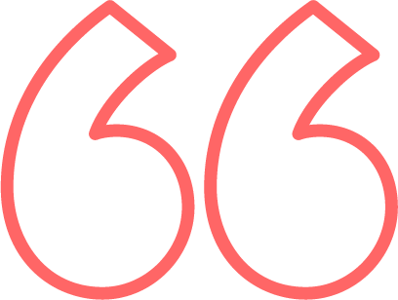
Debate time…
Is AI a useful resource?
What are the pros and cons of AI?

Slide 13

Which roles have you not heard of before? Write them down.

Slide 14
Jobs you could consider
The creative industries need…

Slide 15

Animators, artists
musicians, performers,
designers...

Slide 16

Architects, game developers, or visual effects artists

Slide 17

Publishers, production assistants and researchers

Slide 18
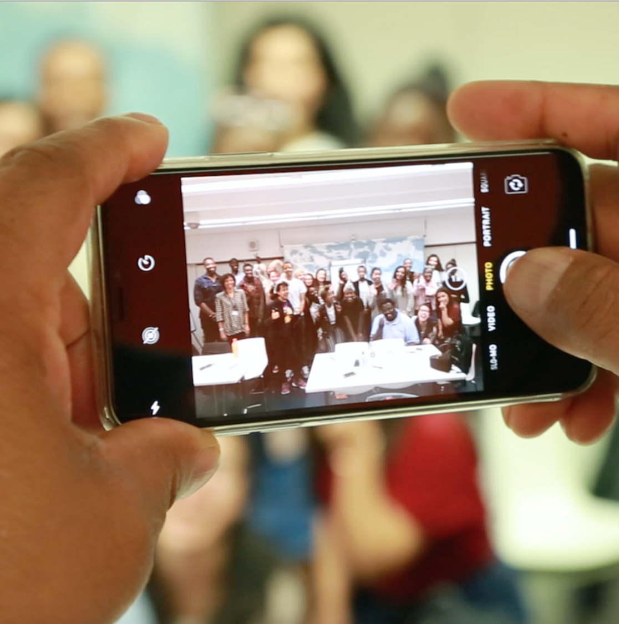
Events coordinators, producers, education & engagement managers

Slide 19

Sound engineers, lighting technicians and stage managers

Slide 20

...Marketing managers, fundraisers, and administrators

Slide 21

Lawyers, accountants,
HR professionals, and
business managers...

Slide 22
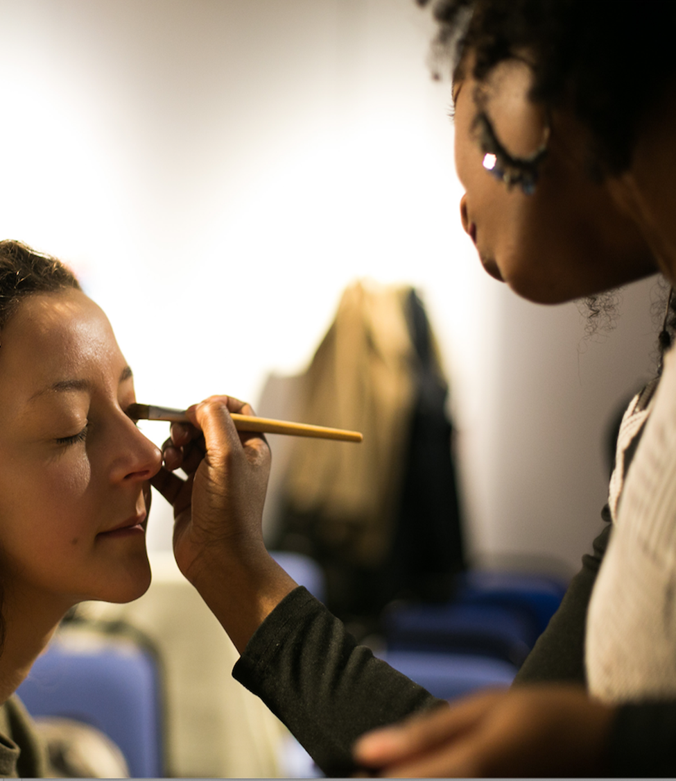
plus, carpenters,
electricians, hair &
make-up stylists,
caterers and more!

Slide 23
Skills Shortages UK Creative Industries
Production
Costume
Distribution
Marketing
Facilities
Fashion and Textiles
Post Production
Construction
Electrical
Craft

Slide 24
Skills Shortages - UK Creative Industries
Production
Location marshal
Accountant
Production secretary
Costume
Costume designers
Prop makers
Distribution
Business/Financial analysts
Rights and sales analysts
Marketing
Pay Per Click Executive
Data experts
Facilities
Caterers
Venue managers
Security staff
Fashion and Textiles
Sewing machinist
Pattern cutter
Post Production
VFX Effects
VFX – Rigging
Sound effects
Construction
Carpenters
Painters
Plasterers
Electrical
Lighting technician
Craft
Marionette making
Violin bow making

Slide 25

Discussion
What do you understand by the term ‘freelance’?
In what ways are being employed and self-employed different?
Have you ever thought about being self employed?

Slide 26
Myth busting…
The Creative industries are too competitive
A job in the creative industries is not a ‘proper job’
You need friends or family in high places to get a job in the creative industries
The creative industries are only for ‘arty’ people
You have to live in London to have a career in the creative industries

