Slide 1


Slide 2

Focus on Publishing
Is there a career for you?
Notes:
Image from: Microsoft 365 royalty free Image Gallery

Slide 3

What is publishing?
Publishing is the business of helping information, ideas and stories reach as many people as possible.
Notes:
Image from: Microsoft 365 royalty free Image Gallery

Slide 4

Icebreaker
Talk about these questions with a partner.
Did your primary school celebrate World Book Day?
If so, what character did you dress up as?
What book do you remember reading as a child that you loved?
Do you still read for fun today? If so, what’s the best book you’ve read recently?
Notes:
Image from: Microsoft 365 royalty free Image Gallery

Slide 5

Winners and best sellers
The Harry Potter books by JK Rowling have sold over 600 million copies worldwide making them the best-selling book series in history.
You Are a Champion, Marcus Rashford’s autobiography co-written with Carl Anka, won Book of the Year at the British Book Awards in 2023.
The young adult romantic novel To All the Boys I’ve Loved Before by Jenny Han was made into a film in 2018 starring Lana Therese Condor.
A Brief History of Time by the physicist Stephen Hawking has been translated into 40 different languages and sold over 25 million copies.

Slide 6

Fact or fiction?
Working with a partner, list:
three different genres of Fiction books
three different genres of Non- Fiction books.
Word power
A genre is a style or type.
Notes:
Image from: Microsoft 365 royalty free Image Gallery

Slide 7
Quercus Books
Design note: please embed Quercus Books video:
https://discovercreative.careers/video-programme/performing-arts/quercus-books/

Slide 8
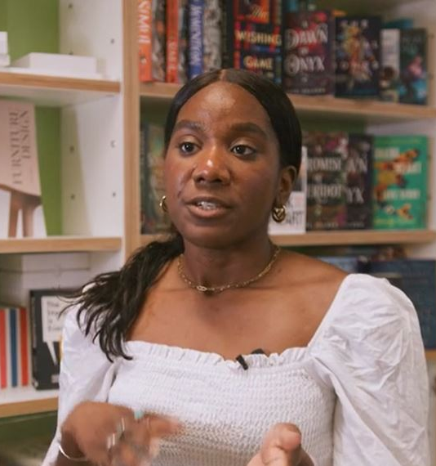
Spotlight on: commissioning editor
What are the two different parts of a commissioning editor’s job?
What examples does Nicole give of some of the specific tasks her job involves?
What do you think she enjoys about her job?
Notes:
Image from: Quercus Books video

Slide 9

Rate your skills
Do you think you’ve got what it takes to be a commissioning editor?
It’s time to rate and practise your skills.
Complete Activity 1 and Activity 2 on your worksheets.

Slide 10

Feedback
What skills did you add to the table?
How did you score?
Share your best career book title.

Slide 11
Opportunities for all
You don’t have to be creative or love reading to work in publishing.
These jobs need different interests and skills.
user experience designer
contracts executive
publishing accounts payable
sales account manager
rights director
Use the job titles to complete Activity 3 on your worksheets.

Slide 12




Facts and figures
The UK has one of the most successful publishing industries in the world.
Over 202 million books were sold in the UK in 2020.
More than 70,000 people are directly or indirectly employed in publishing jobs in the UK.
The UK publishes between 180,000 and 200,000 new book titles every year.
The total revenue for British publishing in 2023 was £7.1 billion.
Notes:
Statistics sources:
https://thecircularboard.com/book-publishing-statistics/
https://www.publishers.org.uk/publishingin2023

Slide 13
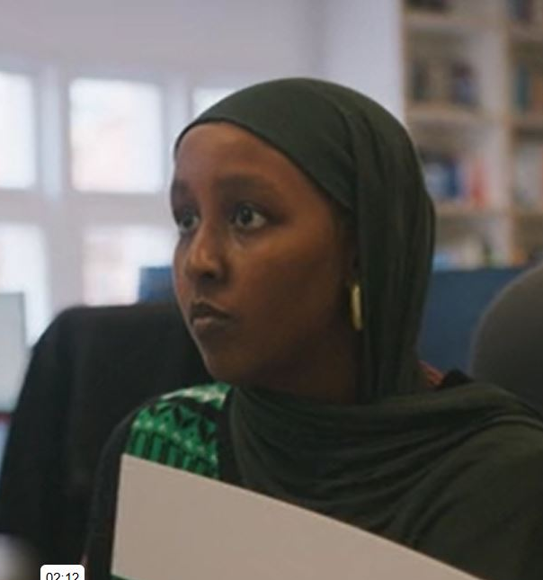
Spotlight on: marketing assistant
What is Yasmin’s main role as a marketing assistant?
How does she make sure readers know about books that would be perfect for them?
What other ways do you think there are of doing this?
Notes:
Image from Quercus books video

Slide 14

Marketing challenge
You are marketing assistants at a publishing company.
You have been tasked to market a new fiction book by a new author. You need to present your ideas to the marketing manager.
The book’s title is: The Cracked Mirror.
Use the Publishing Marketing Challenge worksheet to help you plan your presentation.
Notes:
Image from: Microsoft 365 royalty free Image Gallery

Slide 15

Pitch your strategy
Present your ideas to the rest of the class, as if they are your marketing manager.
Remember to speak clearly and confidently!
Notes:
Image from: Microsoft 365 royalty free Image Gallery

Slide 16
Extension Activity 1:
Design a book cover
You are a designer at a publishing company.
Your brief is to design a cover for The Cracked Mirror.
The brief includes a comparison cover.
The design needs to suit the genre of the book and appeal to the target audience that your group identified.

Slide 17
Extension Activity 2:
Career guide
There are many other roles in publishing.
Choose three of the roles on the extension worksheet to research.
Write the entries for the three jobs in the style of a career guide for young people.
The entries need to be informative and lively.

Slide 18
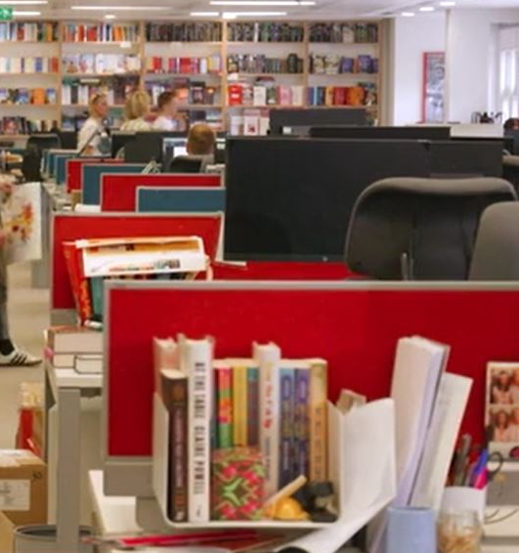

Reflection
Can you name one role in publishing that you hadn’t heard of before today?
Does anyone think they would like to work in this field?
How could you get into publishing?
Notes:
Image from Quercus Books video

Slide 19
Getting started
If you think a career in publishing could be for you, you could:
Open a Bookstagram account.
See if your school or local library has a book club you can join.
Find out if any local publishing companies have work experience schemes.
See if you can get a summer holiday job working part-time in a bookshop or at your local library.
Find out more at
https://www.publishers.org.uk/about-publishing/careers/
https://discovercreative.careers/explore/

Slide 20
There’s a career for you in the creative industries

