Slide 1


Crafts, fashion & textiles

Slide 2
Focus on Crafts - Session Aims
Identify careers in crafts, fashion & textiles
Virtually visit a workplace – Cockpit Arts
Experience and solve a workplace task/challenge
Understand where to find more information on careers in crafts

Slide 3
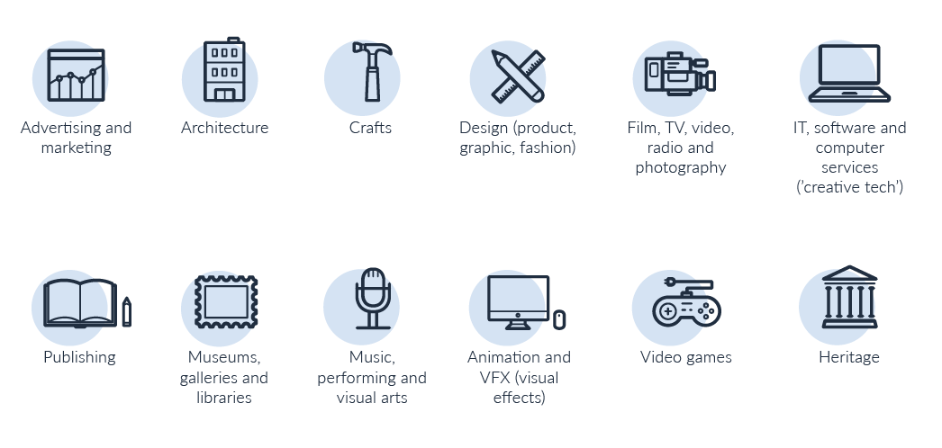
12 sectors = lots of careers!
Notes:
What are the creative industries?
12 sub sectors
The Creative Industries were defined in the Government's 2001 Creative Industries Mapping. Defined as “those industries which have their origin in individual creativity, skill and talent. and which have a potential for wealth and job creation through the generation and. exploitation of intellectual property”.
Think how often in every day of your life you interact with creative industries – music, radio, newspapers, magazines, books, TV content on YouTube, podcasts, billboard posters, architecture – so much of what you see is designed, produced, created.
(1 min)

Slide 4
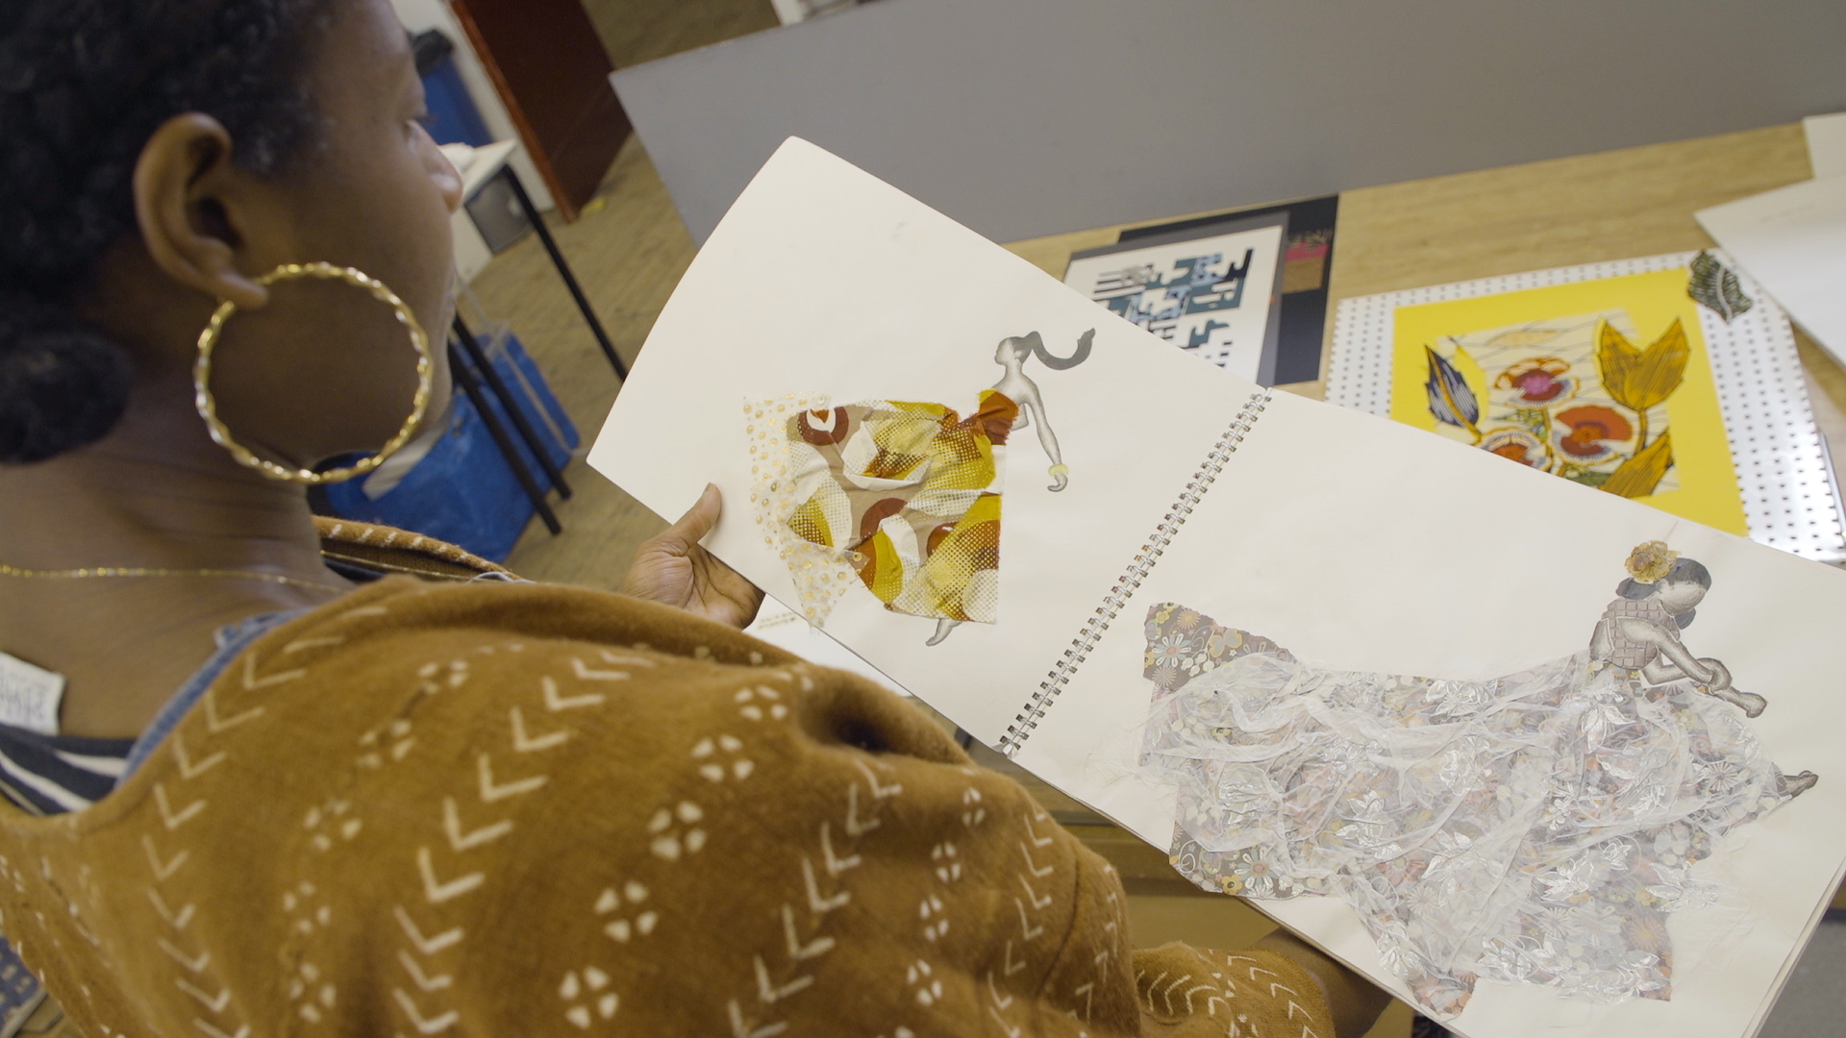
Watch here
Welcome to crafts fashion & textiles

Slide 5
Characteristics of craft sector
The craft industry encompasses goods that are handmade by artisans or those skilled in a particular trade.
Small businesses engaged in the craft trade include everything from art galleries to handmade textiles to culinary products.
Often, craft industry entrepreneurs operate independently and are not franchised.

Slide 6
How many different careers can you think of in crafts, fashion & textiles?
Notes:
ICEBREAKER
Teacher to refer students back to the film they saw in their assembly and ask them to think about crafts markets, crafts beers, artisan breads, handmade Jewellery, different materials and associated trades etc Then teacher or nominated student to jot answers called out from class on to flipchart paper. How many do you get? Allow 4 mins for shoutout, then spend time reflecting on infographic on next slide.

Slide 7
Notes:
Any surprises?
Take note of the circles around the outside and the associated craft and fashion wider careers within

Slide 8
The craft industry
Made up of people who are generating an income from creating, making, designing; always honing their skills and usually doing something they love
It’s a serious business:
  Crafts contributes £3.4bn to the UK economy (2015)
  There are an estimated 11,620 UK crafts businesses, employing 149,510 people.
  Government estimates £6.9bn of exports from the UK crafts sector (2019)

Slide 9
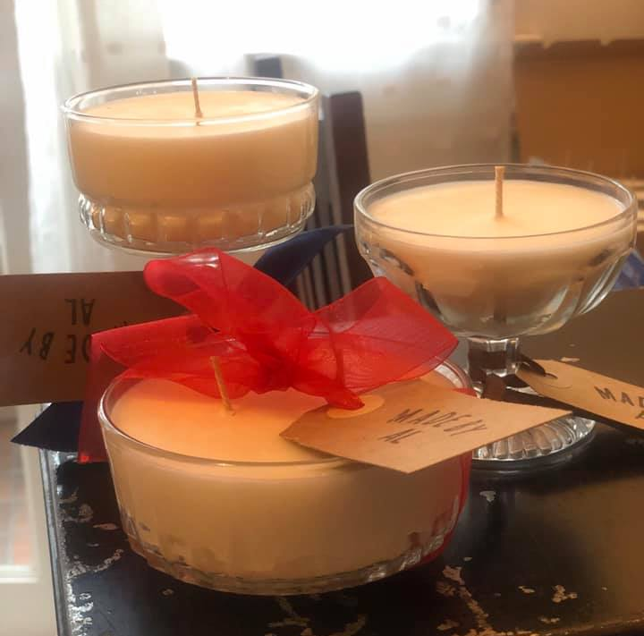
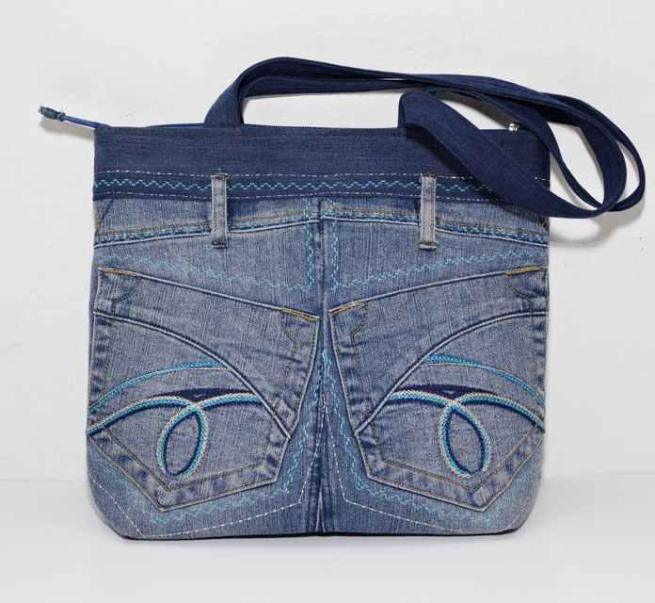
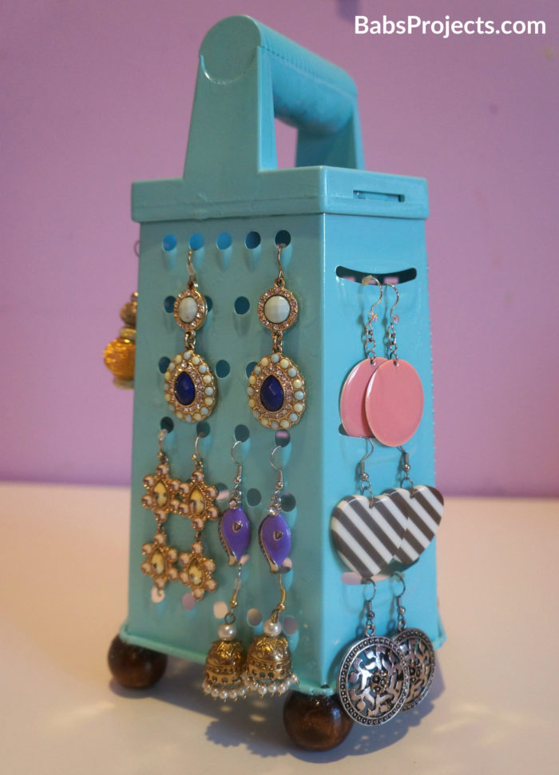
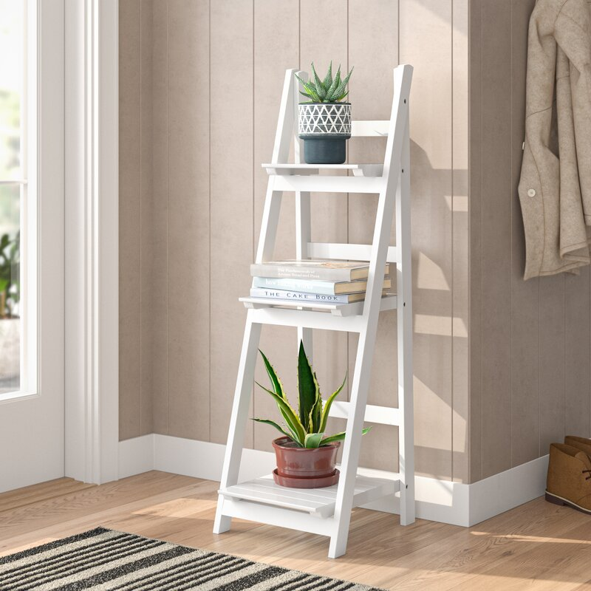
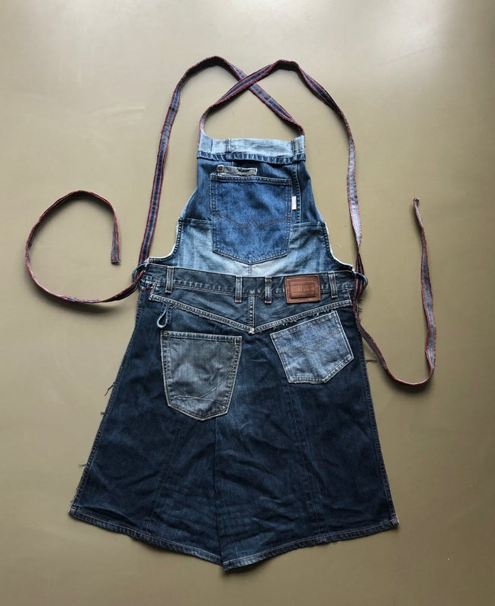

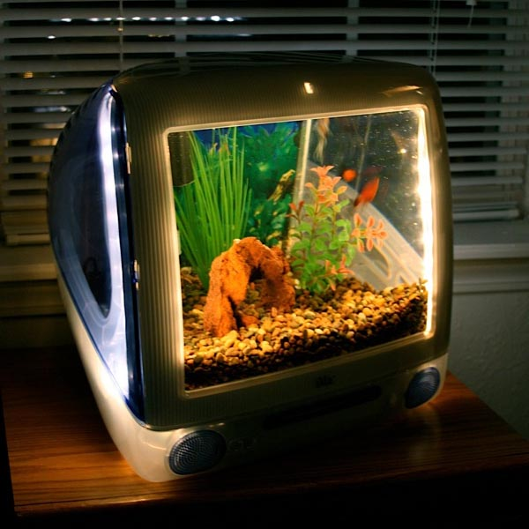
Time to get warmed up
(Brainstorm – 10 mins)
Consider how clothing, accessories or household items can be repurposed:
A stepladder could be a bookcase
Reuse a cheese grater to hold earrings
Repurpose old pairs of jeans to make a bag or an apron
Convert an old iMac into an aquarium – create an iMacaquarium
Repurpose vintage glasses into centrepiece scented candles
Notes:
Everyone think of two items of clothing or an accessory or a household item and write one on each of two post-it notes
Swap one with the person next to you.
You have two objects – can they be put together to create a new product with a new purpose?
After 3 mins, swap one with the person the other side of you, and ideate again
If possible, think of ideas that need to use a craft to produce the item
Collect ideas on a flip chart at the front of class

Slide 10
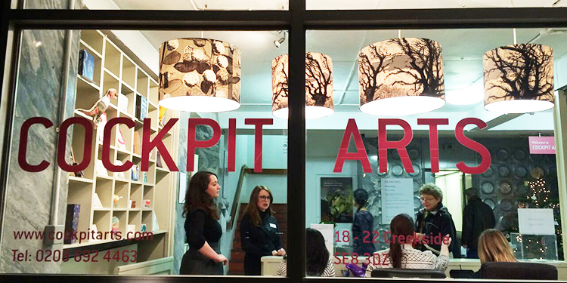
Tour Cockpit Arts
(15 mins)
VISIT NOW
Notes:
Intro and film (15 mins)

Slide 11
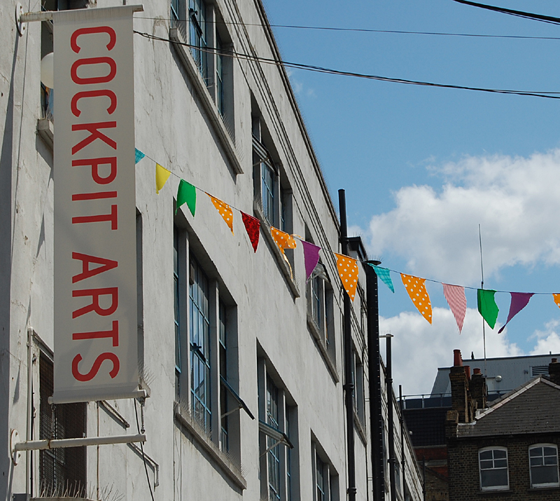
Tour of Cockpit Arts
(Discussion – 10 mins)
Cockpit Arts is London’s leading studios for contemporary makers and an award-winning social enterprise.
Was Cockpit Arts what you expected?
Which crafts appealed the most?
Would you like to work in craft or fashion? Why?
Notes:
Discussion for 5 mins

Slide 12
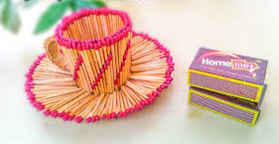
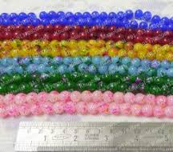
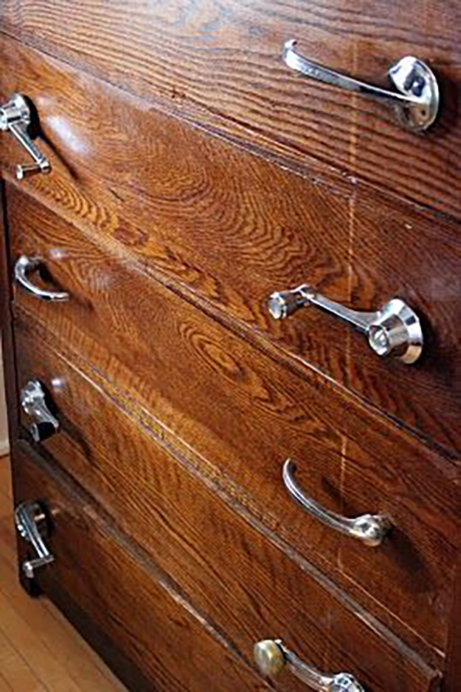
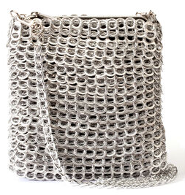
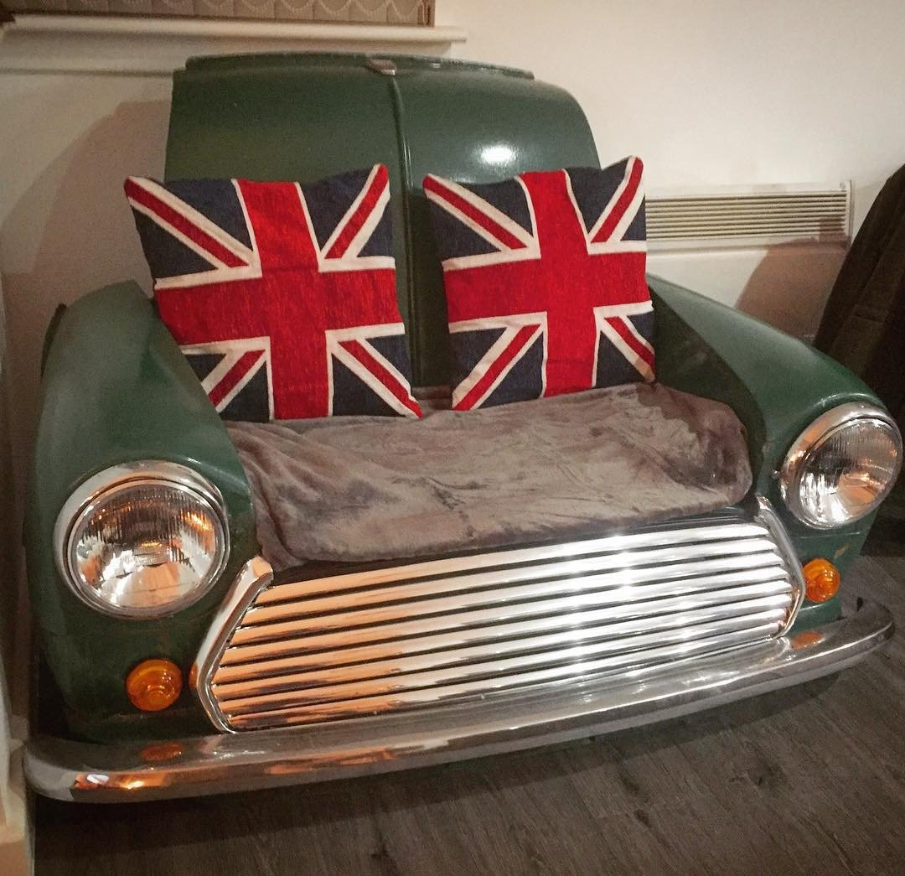

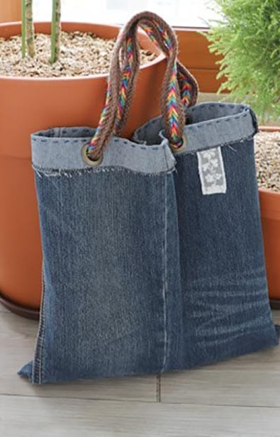
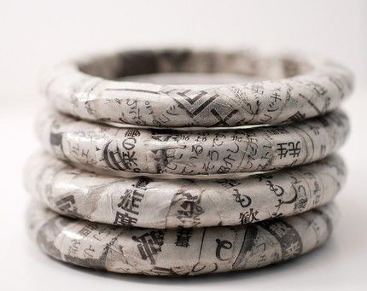
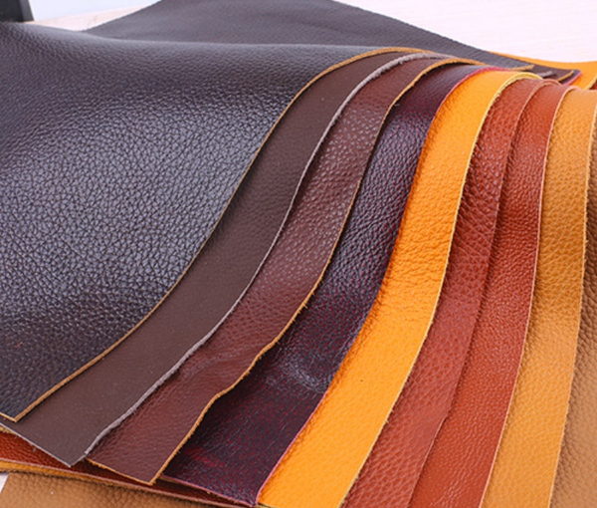
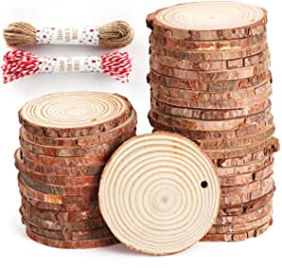

Sustainably innovative
Old car part handles
Ring pull bag
Vintage mini sofa
Newspaper Jewellery
Newspaper jewellery
31% of makers have changed their practice in the last three years in response to environmental concerns.
?
Old jean accessories
Notes:
Consider raw materials. Consider sustainability. Consider upcycling, recycling, even down cycling
Downcycling: to recycle (something) in such a way that the resulting product is of a lower value than the original item : to create an object of lesser value from (a discarded object of higher value)Other companies that claim to recycle carpet actually “downcycle” it, taking used carpet, chopping it up, and reusing it in lower-grade products such as carpet backing.
What two materials could you put together to create a new household item or accessory? EG Make bags from old jeans or ring pulls (https://www.notonthehighstreet.com/jacquelinehammondsmartdeco/product/soda-pop-upcycled-ring-pull-bag?DGMKT=FID__TID_pla-319289372362_PID_894029_CRI_319289372362&gclid=CjwKCAiArIH_BRB2EiwALfbH1JtU6BO_IH5T_aQdRFrdh6REsZbtjlVDDgdf5JDD0XAPJpVoN-EHrhoC2VwQAvD_BwE)

Slide 13
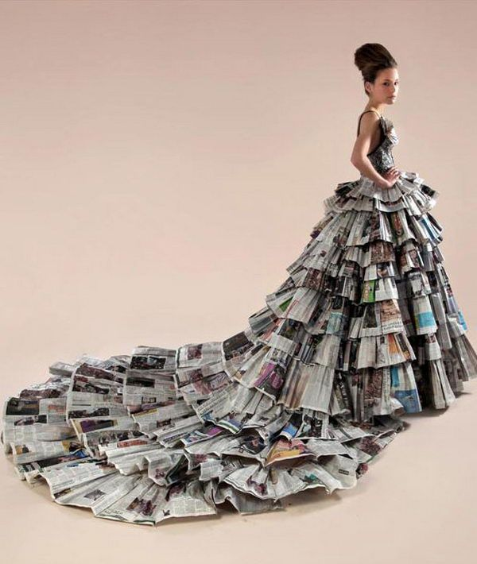
Sustainably innovative
(Activity – 40 mins)
Students to work in pairs:
Discuss possible raw materials that could be recycled, upcycled or downcycled – consider what would happen if you pair up two materials, what product could you create – be innovative, sustainable, creative and crafty!
For your product to be a craft industry idea, the product must always be made-by-hand rather than manufactured in vast quantities.
Consider what issues your product might solve or why would your customer want or need it. (see worksheet)

Slide 14

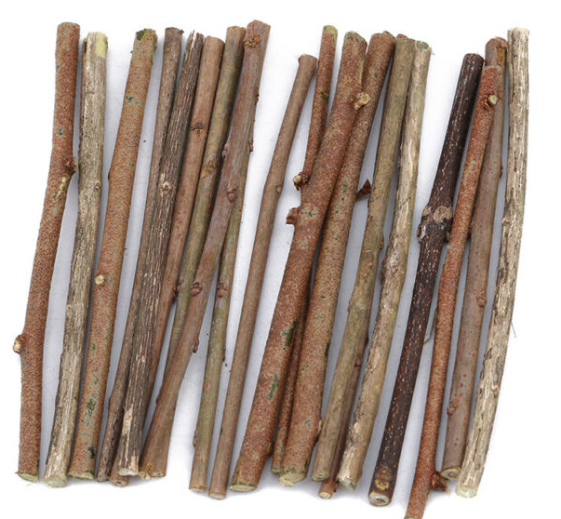
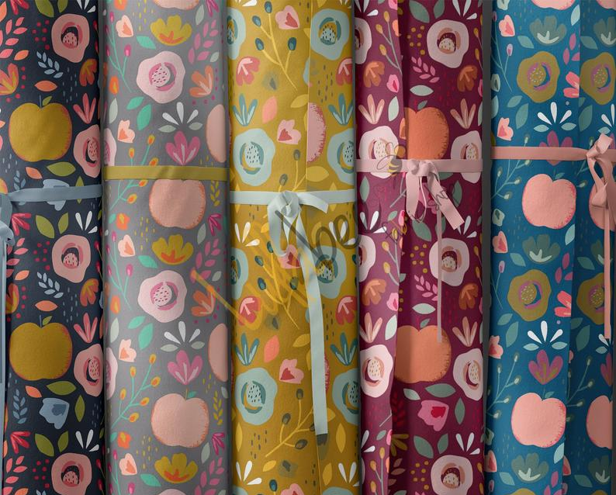
Sustainably innovative
(Activity)
Students to work in pairs (or individually if learning from home):
Craft is different from manufacturing because it is making-by-hand.
What item of clothing or accessory could you make from raw materials you have to hand?
Present your creation to the class!

Slide 15
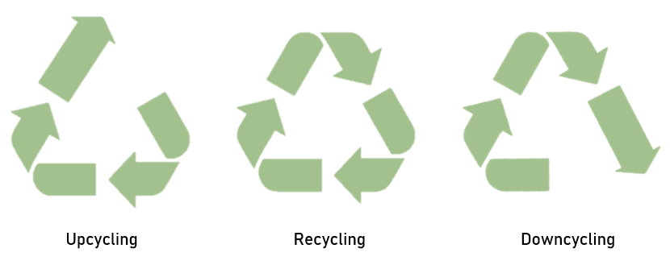
Sustainability and craft
(Student presentations – 15 mins)
Notes:
Students to present their ideas to the class (2 mins each presentation)
If you have been able to organize external employer observers for student presentations, the lesson could achieve against Benchmark 5.

Slide 16
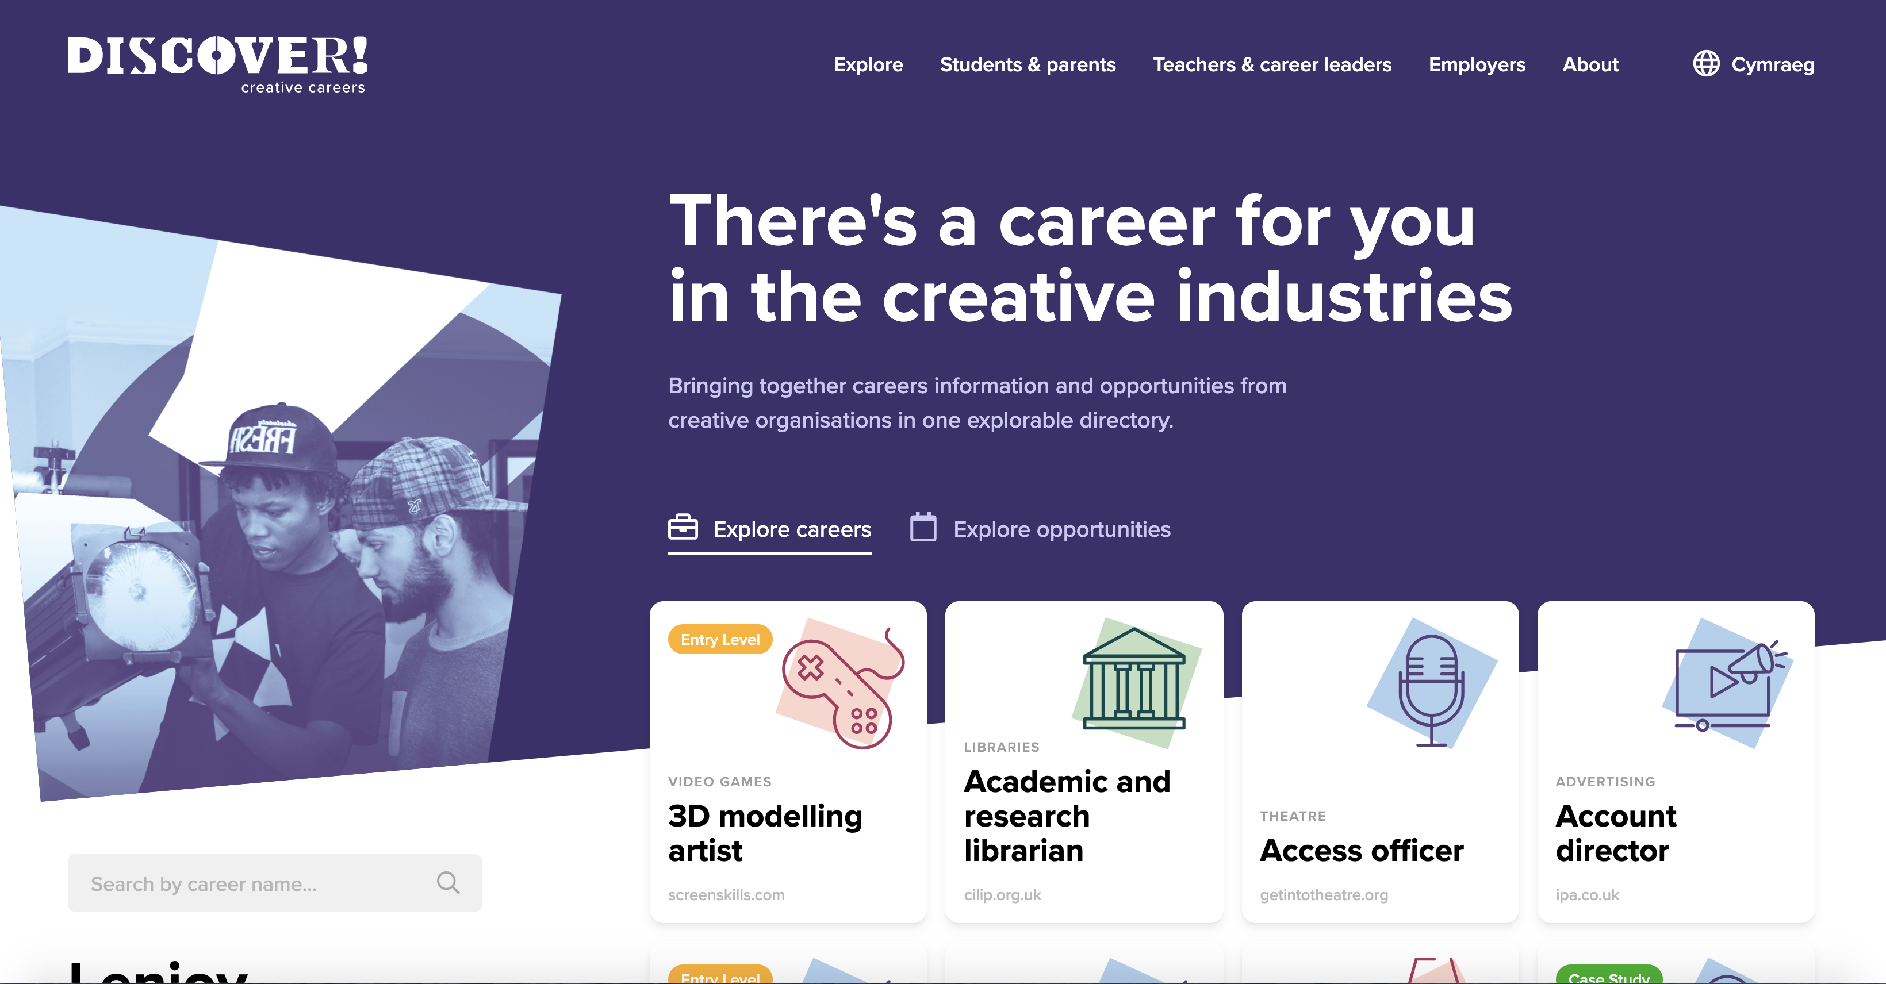
Find out more about careers
(Activity – 10 mins)
Visit www.discovercreative.careers
Find a job you have never heard of
Find a job you would like to do
Notes:
If you are running a one hour session, this is a round up and signposting for further info. Suggest all students key url into their phones so that they check out site more fully in their own time (5 mins)
If you are running a longer session, invite students to visit website and answer the two questions

Slide 17

Learning check
(3 mins)
How many sub-sectors of the creative industries are there? Can you name them?
Are those who work in craft industry likely to be employed or run their own businesses?
Where do you look to find out more about careers and pathways into the creative industries?

Slide 18
Employer Q&A Panel
(1 min)
If you have any questions from today’s session that you would like to ask our employer panels this week, please visit the Discover website to find out more:
Crafts panel is at 11am on Tuesday 2 March 2021
Notes:
To enable your activity today to meet Gatsby Benchmark 5, active and two-way communication needs to take place between student and employer. This can be done in a number of ways:
Employers can be invited to review the mood boards/student presentations and give feedback
Employers can be invited to review the motion capture scene reading/performance and give feedback
Invite students to ask questions of our expert Q&A panels during NCW. Details on timings and contributors are on the website.

Slide 19
Discovercreative.careers
@creativecareer5

