Slide 1


Gaming, XR and Animation
Immortals – Fenyx Rising

Slide 2
Session Aims
Identify careers in gaming, XR and animation
Virtually go on a research tour with Ubisoft
Experience and solve a workplace task/challenge
Understand where to find more information on careers in gaming, XR and animation

Slide 3
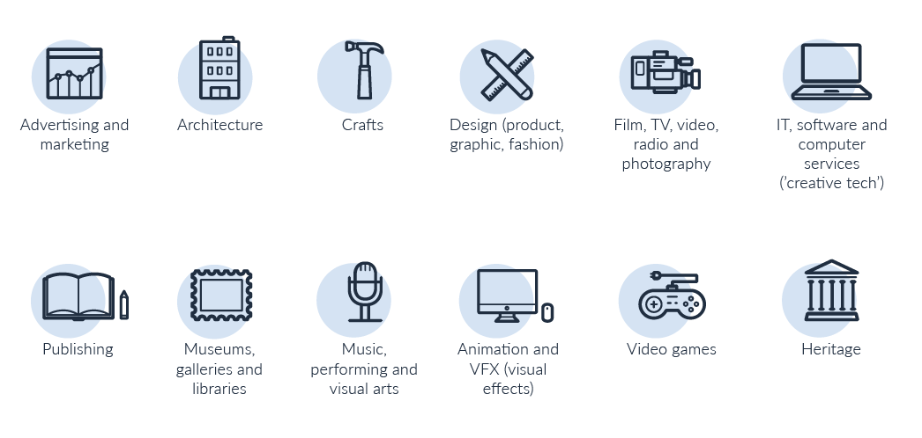
12 sectors = lots of careers!
Notes:
What are the creative industries?
12 sub sectors
The Creative Industries were defined in the Government's 2001 Creative Industries Mapping. Defined as “those industries which have their origin in individual creativity, skill and talent. and which have a potential for wealth and job creation through the generation and. exploitation of intellectual property”.
Think how often in every day of your life you interact with creative industries – music, radio, newspapers, magazines, books, TV content on YouTube, podcasts, billboard posters, architecture – so much of what you see is designed, produced, created.
(1 min)

Slide 4
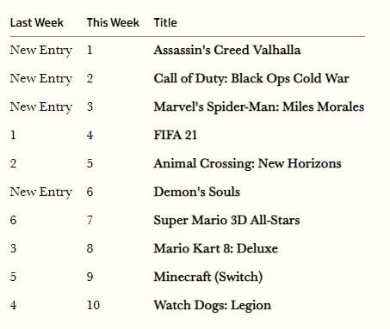
By 2020 total UK sales revenue for games (£5.5bn) is expected to overtake total spend on books (£4.9bn)
Source: GfK, 15 November 2020
Notes:
Impact of Covid-19 has been felt more keenly in some areas than others. Consider also impact on audiences, viewers, appreciators – what has not being able to go to the cinema or theatre or to see live music meant to you?
But gaming has thrived. Why do students think this is? https://ukie.org.uk/news/covid-19-an-opportunity-for-the-gaming-industry-to-take-a-leaf-out-of-the-news-ecosystem
(2 mins)

Slide 5
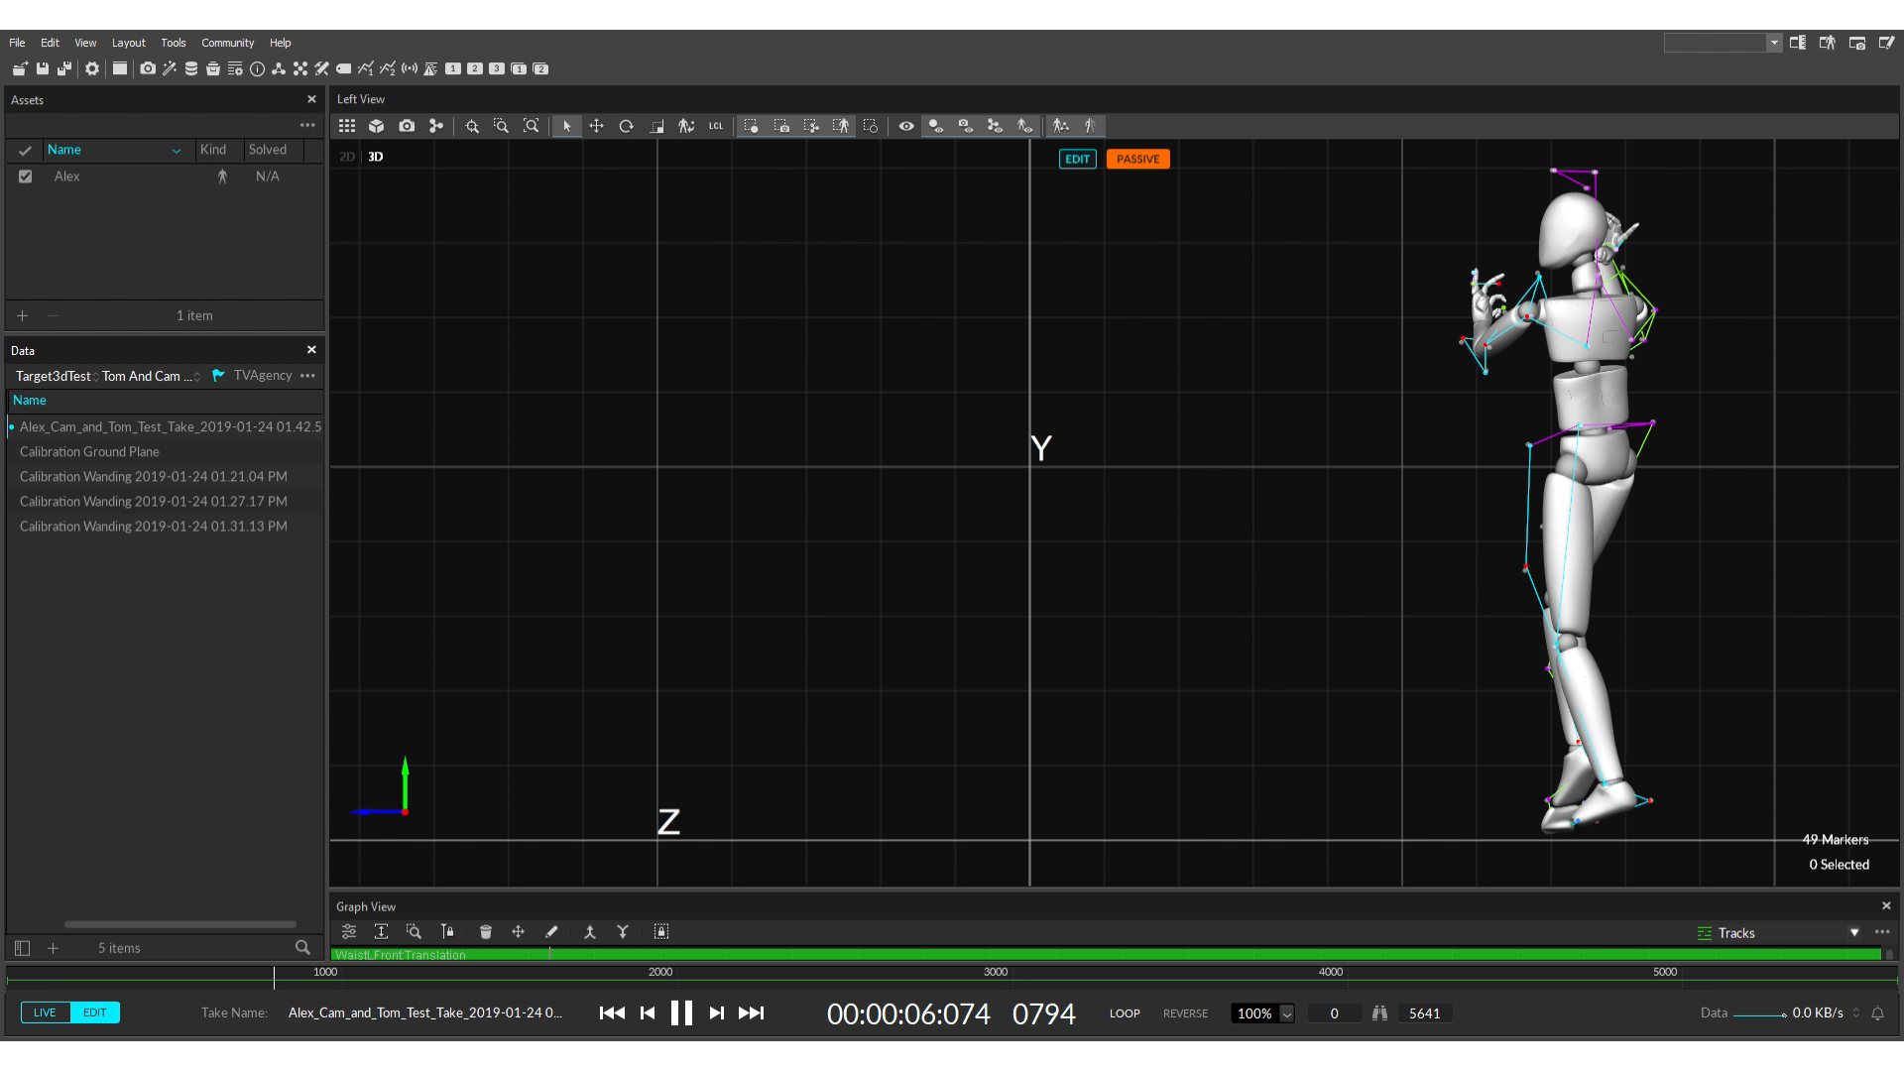
Watch here
Introduction to the games industry
Notes:
Sector overview

Slide 6
How many different jobs can you think of in gaming, XR and animation?
Notes:
ICEBREAKER
What is XR? What do students understand by the term Extended Reality? Wikipedia definition:
Extended reality (XR) is a term referring to all real-and-virtual combined environments and human-machine interactions generated by computer technology and wearables, where the 'X' represents a variable for any current or future spatial computing technologies. e.g. It includes representative forms such as augmented reality (AR), mixed reality (MR) and virtual reality (VR) and the areas interpolated among them. The levels of virtuality range from partially sensory inputs to immersive virtuality, also called VR.
XR is a superset which includes the entire spectrum from "the complete real" to "the complete virtual" in the concept of reality–virtuality continuum introduced by Paul Milgram. Still, its connotation lies in the extension of human experiences especially relating to the senses of existence (represented by VR) and the acquisition of cognition (represented by AR). With the continuous development in human–computer interactions, this connotation is still evolving.
XR is a rapid growing field being applied in a wide range of ways, such as entertainment, marketing, real-estate, training and remote work
Refer students to the Academy of International Extended Reality https://aixr.org/
Teacher to refer students back to the film they saw in their assembly or form time and ask them to think about how many jobs they could remember. Consider how a game gets made – what are its components? Then teacher or nominated student to jot answers called out from class on to flipchart paper. How many do you get? Allow 3 mins for shoutout, then go through next few slides quick fire – slides 7-14 should take 1 min.

Slide 7

Jobs in gaming, XR and animation include roles such as developer, research scientist, games writer, software developer

Slide 8
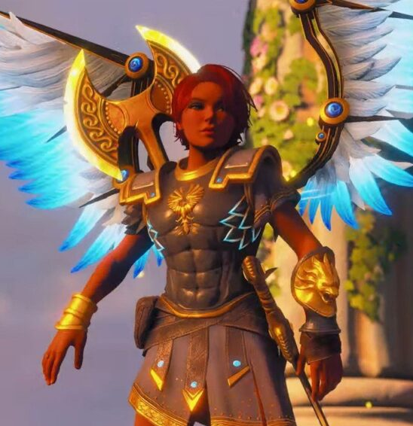
Animators, artists, 3D modelers, VFX artists, rotoscopers, graphics programmers, lighting technicians

Slide 9

composers,
sound recordists, audio programmers, audio engineers, sound designers

Slide 10
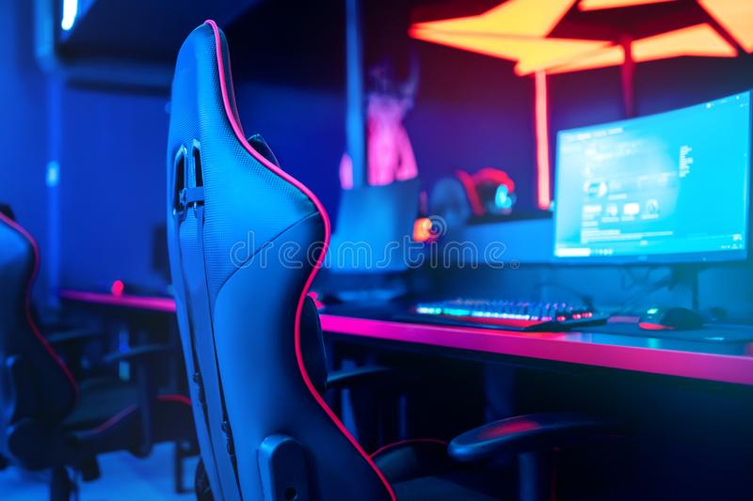
electrical engineers, games or QA testers, esports producers

Slide 11

lawyers, accountants,
XR sourcers, and
business managers

Slide 12
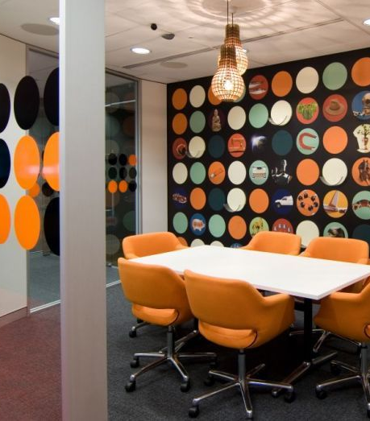
plus marketing managers, sales, distribution, and administrators.
Notes:
Ask what surprised students

Slide 13
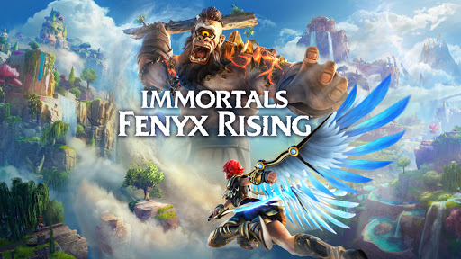
Immortals Fenyx Rising – the trailer
Play trailer
Notes:
Intro and film (15 mins)

Slide 14
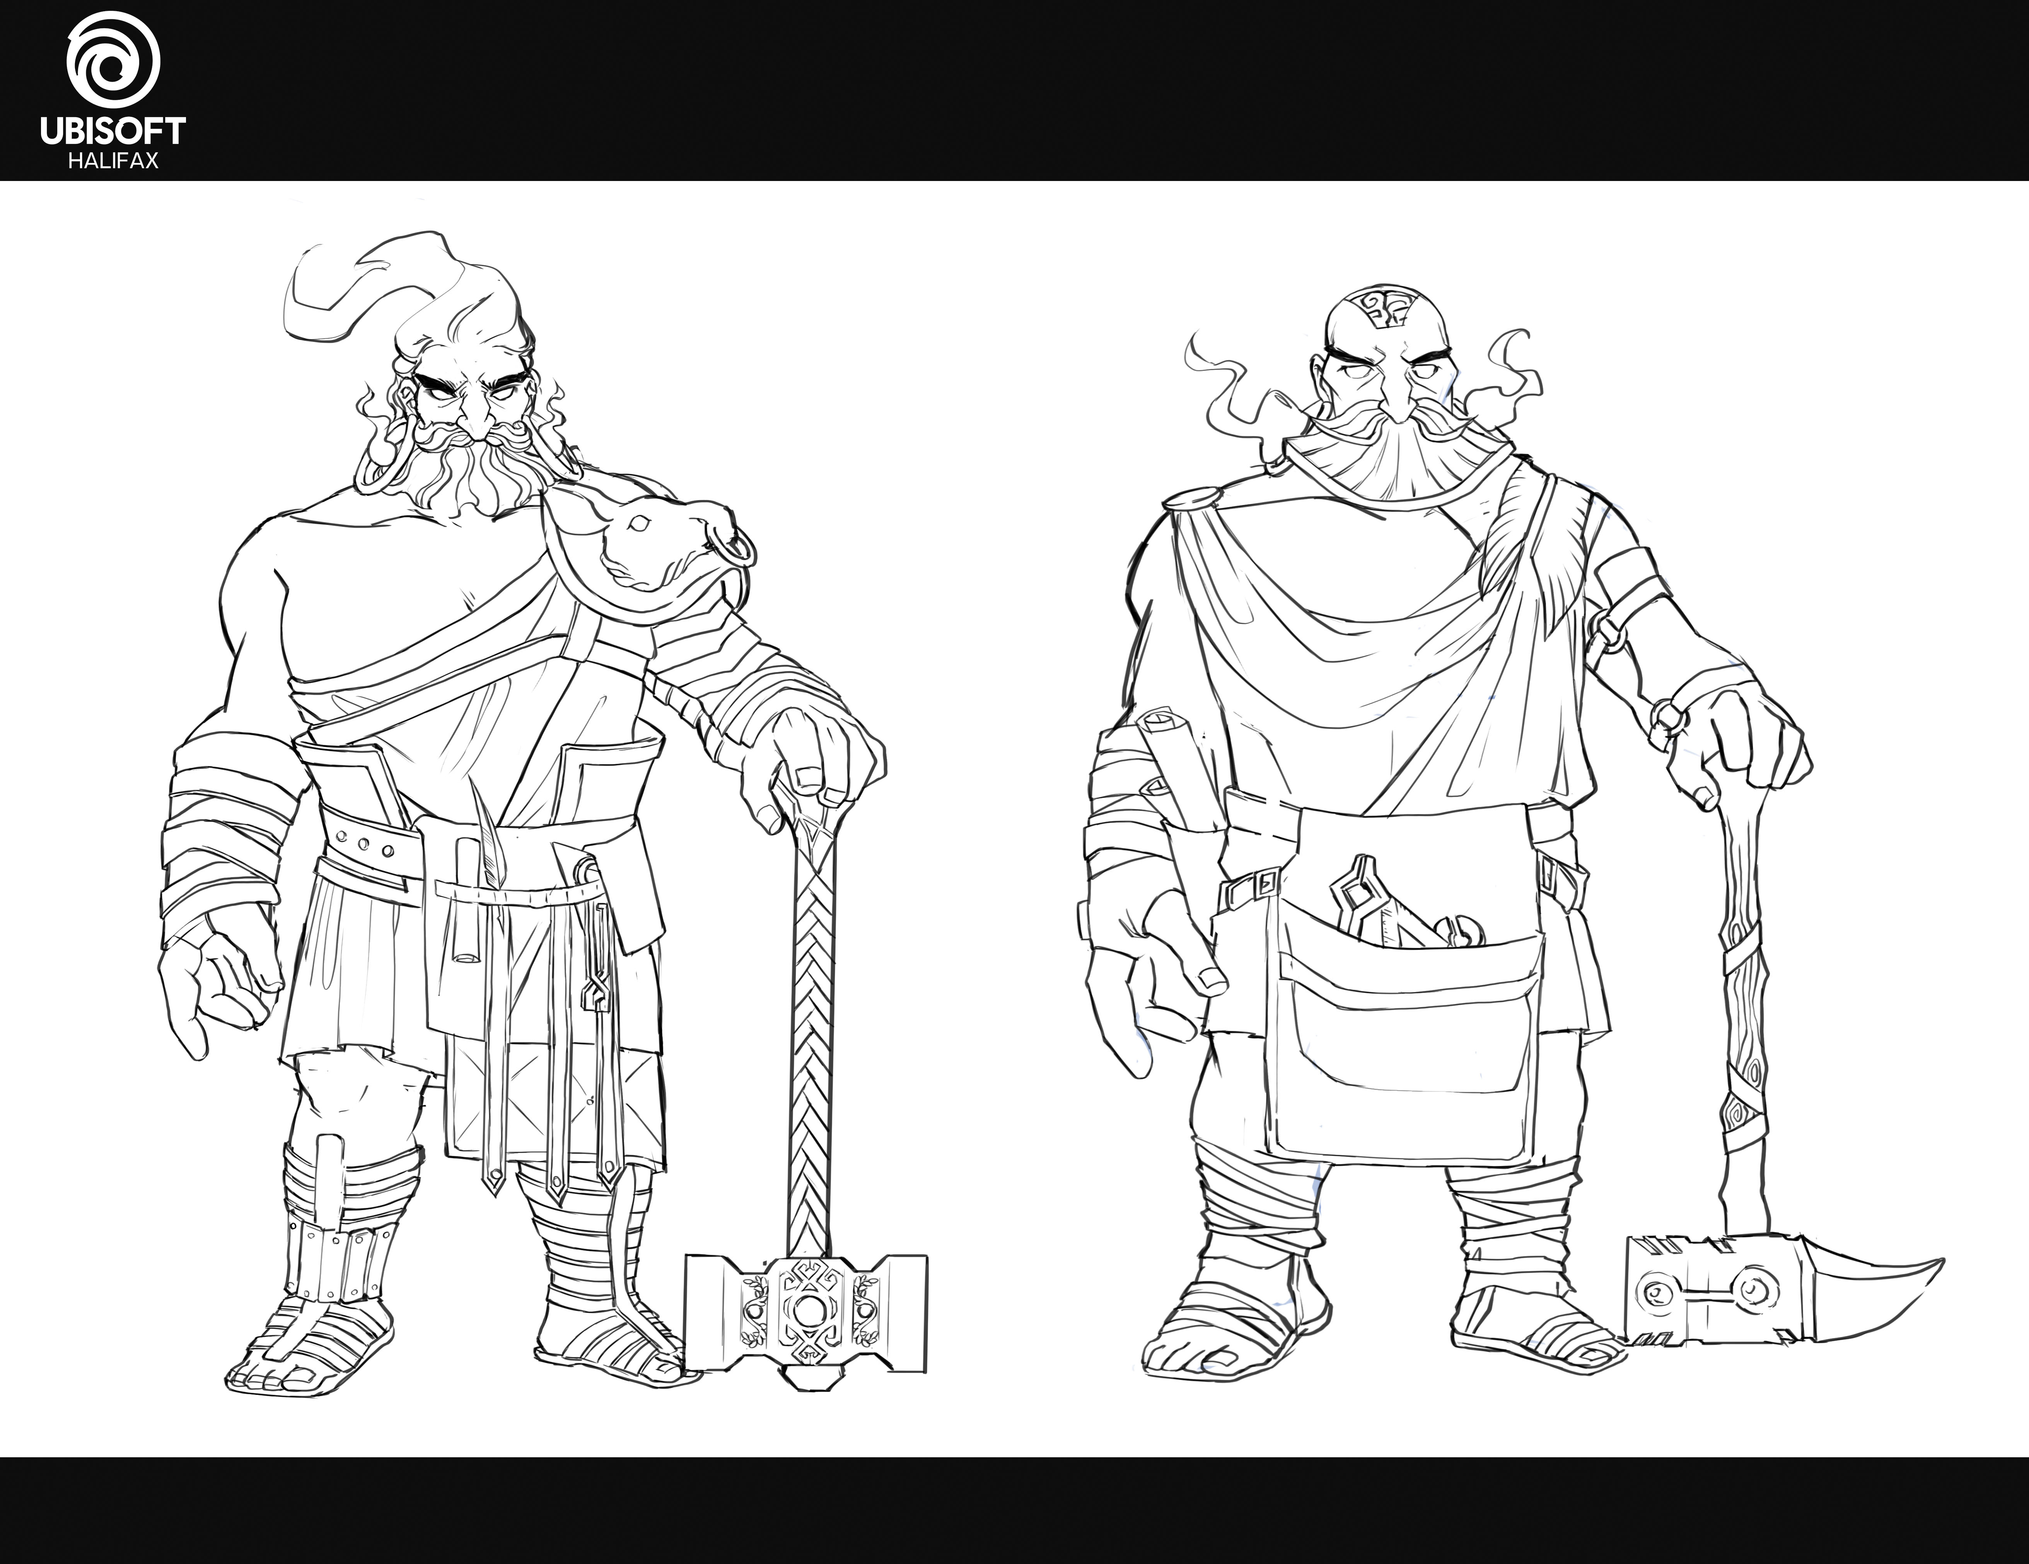
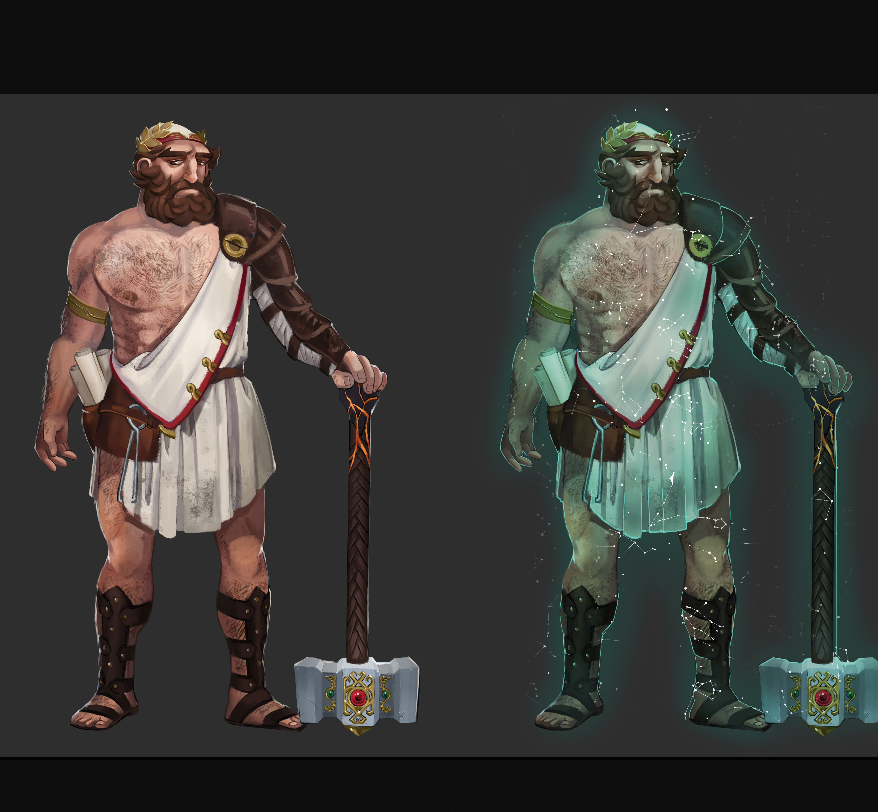
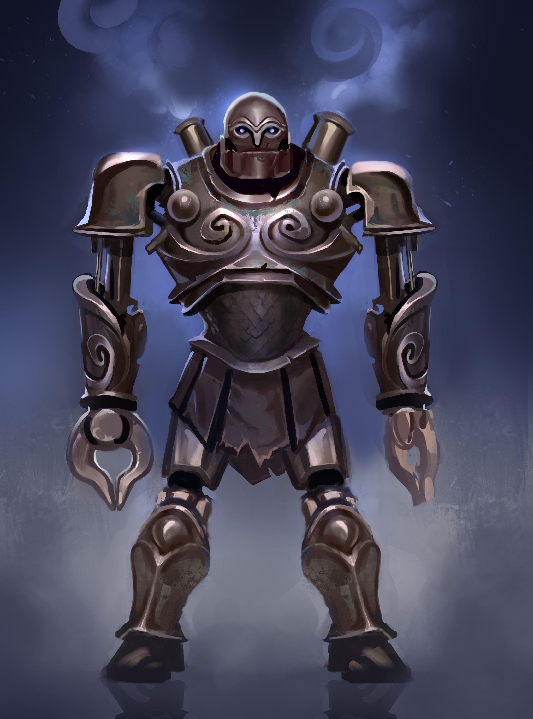
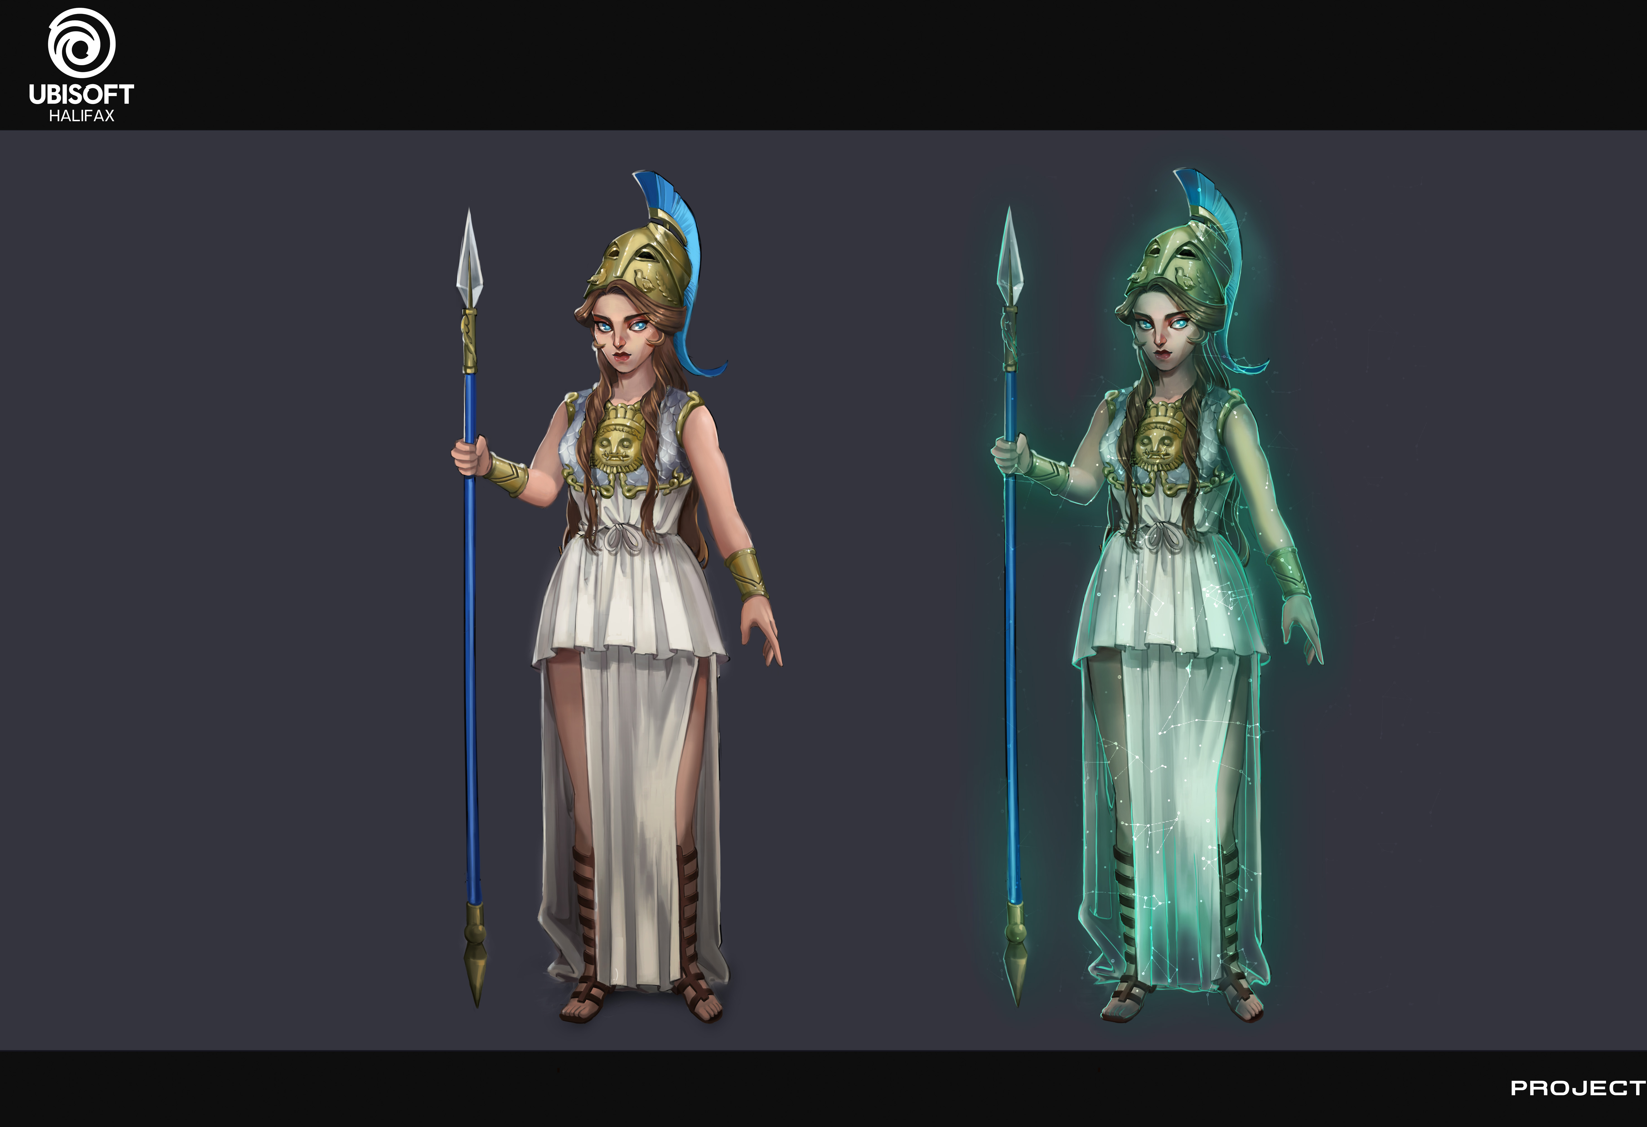
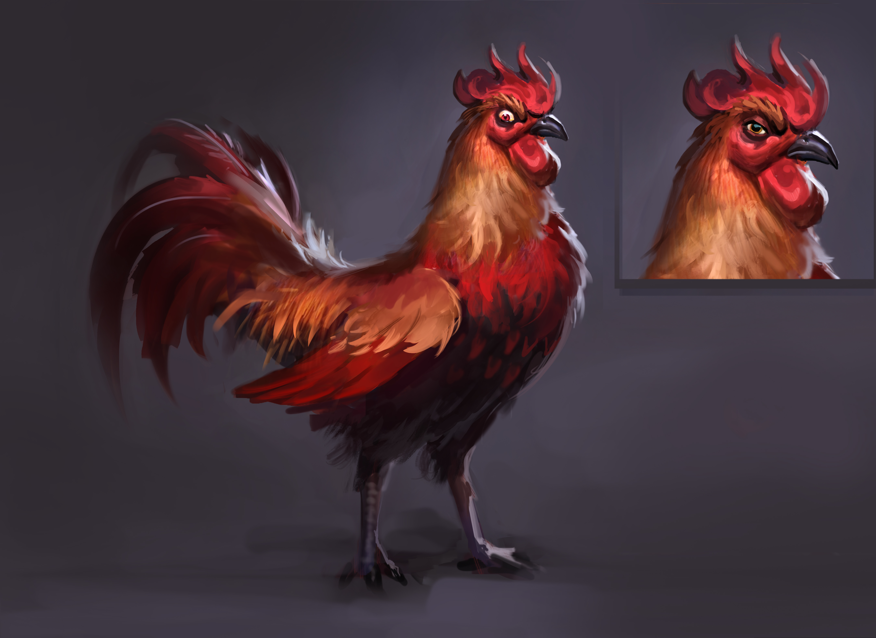
Immortals – Fenyx Rising
Immortals – Fenyx Rising is set in a fictional world.
These visuals are from the development stage of Immortals Fenyx Rising
What are the key influences?

Slide 15
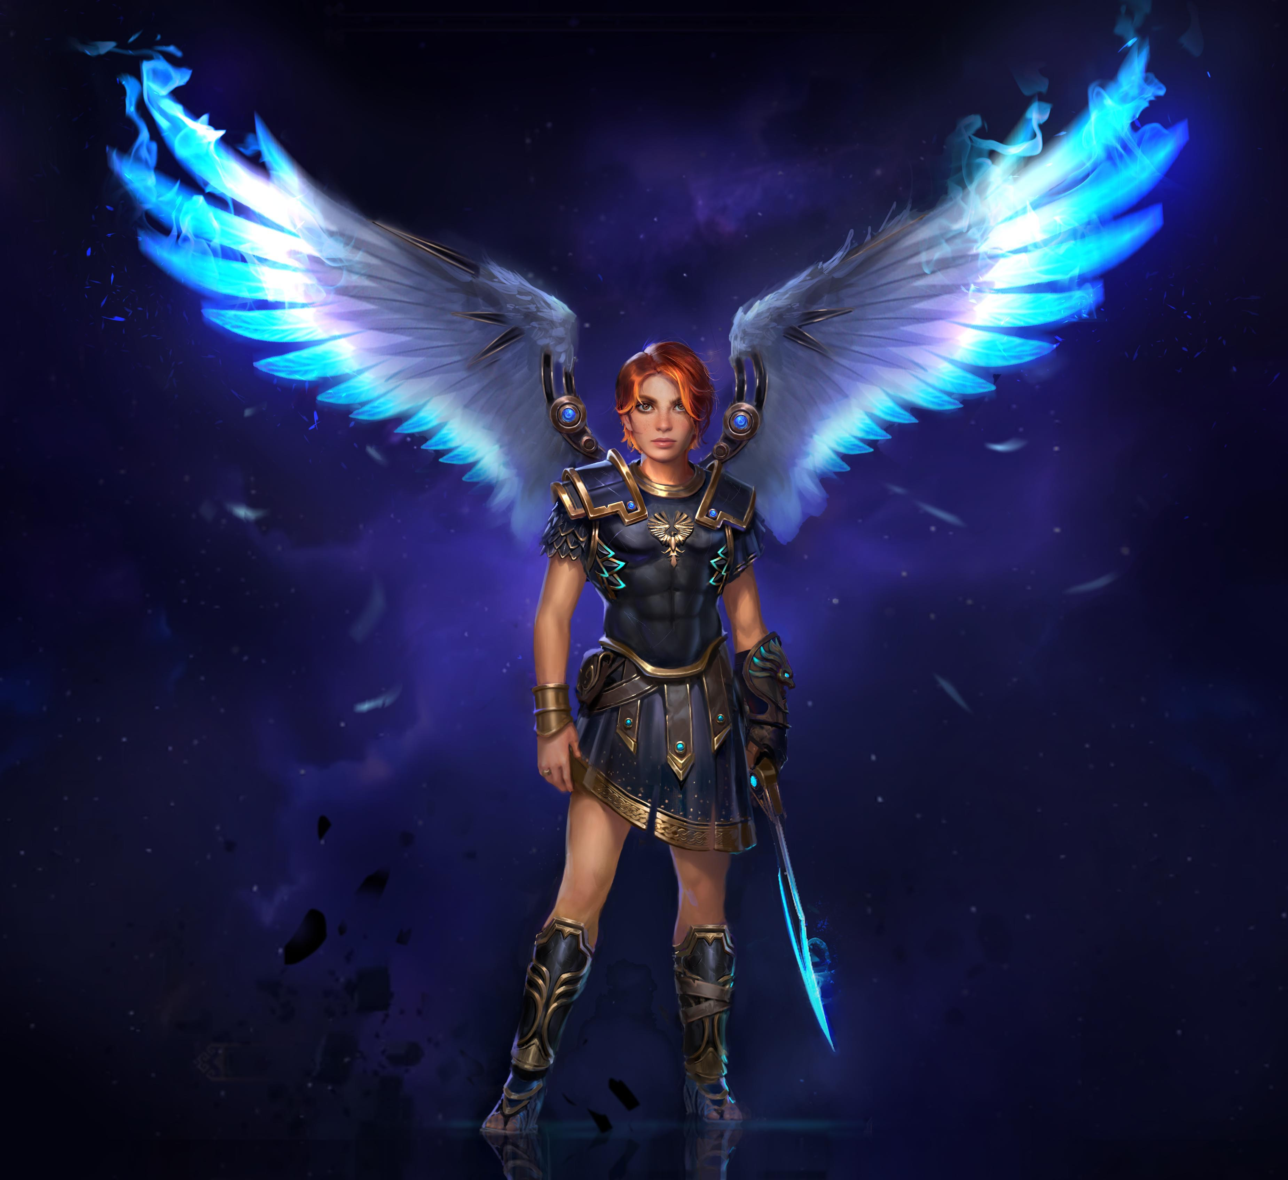
Immortals – Fenyx Rising
(Research Task)
Task: To create a new world for an action-adventure game.
When and where will you base your game?
Who will your two main characters be based on?
What will you use for inspiration and insight?
Consider what you will need to create an authentic multi-sensory experience.
Present a mood board of ideas.

Slide 16
Immortals – Fenyx Rising
(Art-based Activity)
Student presentations.

Slide 17
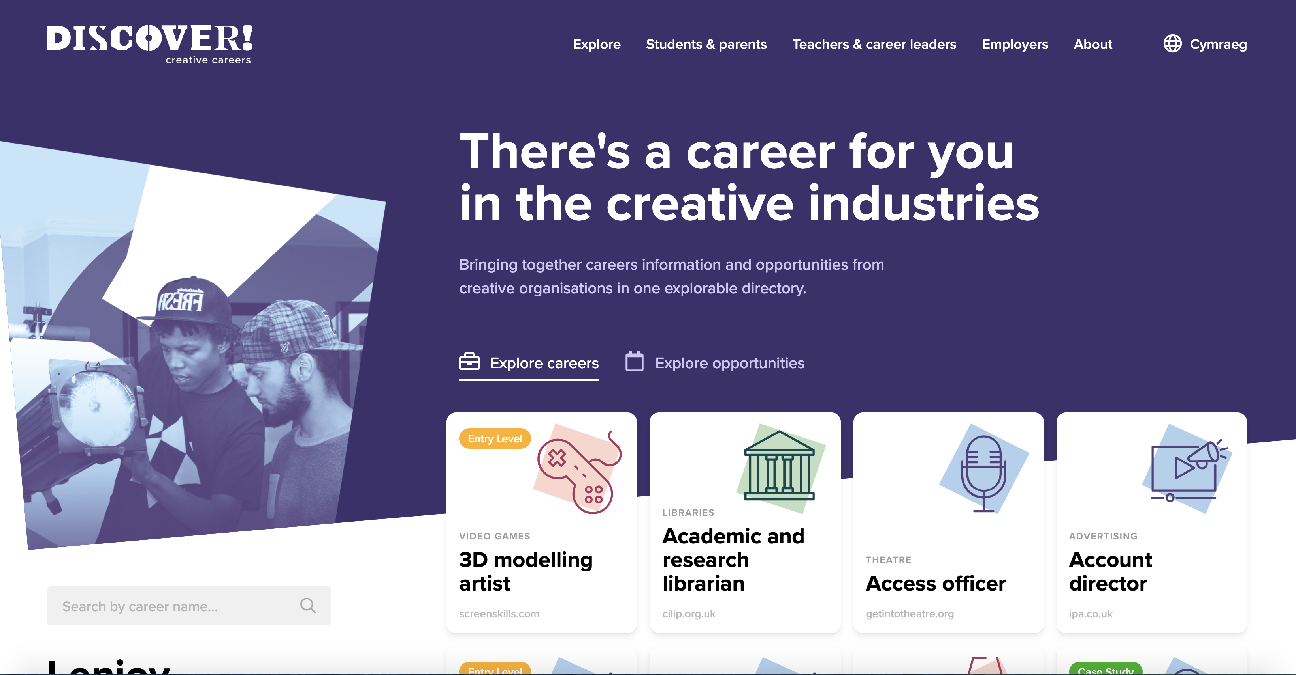
Find out more about careers
(Activity)
Visit www.discovercreative.careers
Using search tags:
Find a job in Extended Reality (XR) you have never heard of
Find a job you would like to do
Notes:
If you are running a one hour session, this is a round up and signposting for further info. Suggest all students key url into their phones so that they check out site more fully in their own time (5 mins)

Slide 18

Learning check
(2 mins)
How many sub-sectors of the creative industries are there? Can you name them?
Where do you look to find out more about careers and pathways into the creative industries?

Slide 19
Employer Q&A Panel
(1 min)
If you have any questions from today’s session that you would like to ask our employer panels this week, please visit the Discover website to find out more
Notes:
To enable your activity today to meet Gatsby Benchmark 5, active and two-way communication needs to take place between student and employer. This can be done in a number of ways:
Employers can be invited to review the mood boards/student presentations and give feedback
Employers can be invited to review the motion capture scene reading/performance and give feedback
Invite students to ask questions of our expert Q&A panels during NCW. Details on timings and contributors are on the website.

Slide 20
Discovercreative.careers
@creativecareer5

