Slide 1


Slide 2
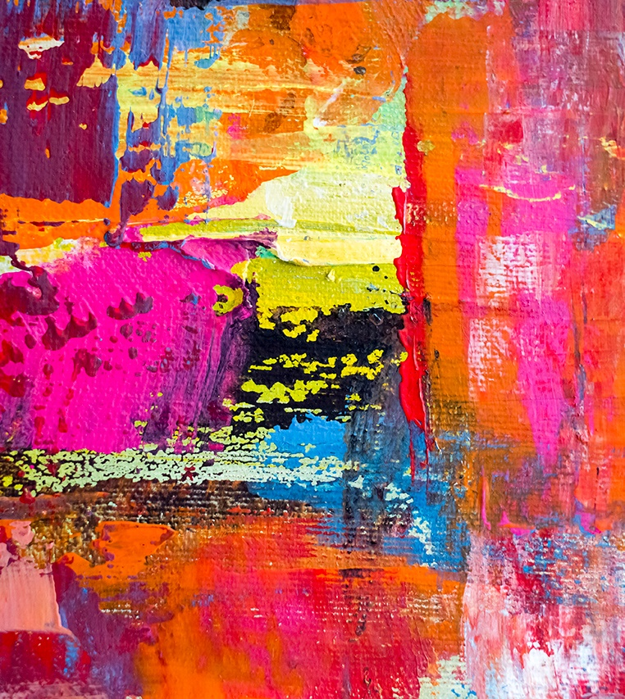
Focus on
Visual Art
Is there a career for you?

Slide 3

What is visual art?
Visual art appeals to the sense of sight.
Visual artworks can include images, objects, and experiences.
Notes:
Image from: Microsoft 365 royalty free Image Gallery

Slide 4
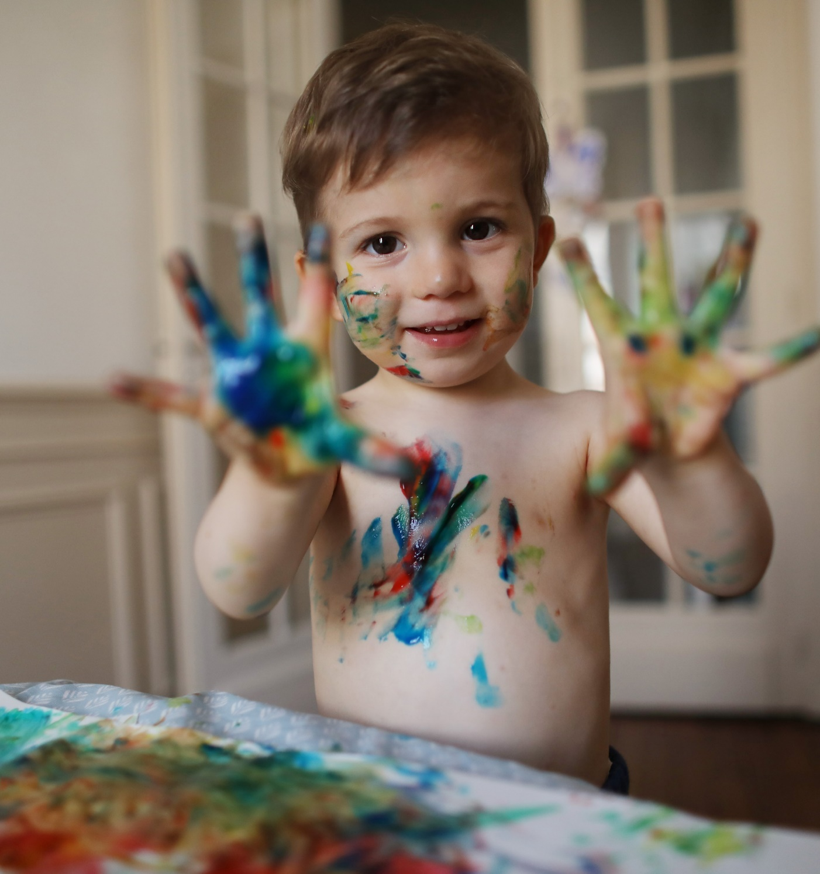

Art for arts sake?
Did you enjoy art activities when you were little?
If so, what did you enjoy about them?
A famous artist once wrote: ‘Every child is an artist. The problem is how to remain an artist when he grows up.’
What do you think the artist meant?
The earliest known artworks are cave paintings in Indonesia that are at least 40,000 years old.
Why do you think humans have created artworks for thousands of years?
Notes:
Image from: Microsoft 365 royalty free Image Gallery
Quote: Pablo Picasso

Slide 5


Art is all around
What examples of visual art can you name?
Where can you see them?
HINT: Think about indoor and outdoor spaces, public and private.
Do you think it is important to preserve old artworks and to create new ones?
Why or why not?
Notes:
Image: Angel of the North, Antony Gormley, Gateshead. Photo attribution: Andy Wright, licensed under the Creative Commons Attribution 2.0 Generic license.

Slide 6
Name that artworker
There are estimated to be around 50,000 artists working in the United Kingdom.
Match the careers with the correct job description on your Activity Sheets.
installation artist
street artist
printmaker
painter
photographer
craftsperson
digital artist
draftsman or woman
tattoo artist
sculptor
Notes:
Statistics source: https://www.statista.com/statistics/319264/number-of-artists-in-the-uk
Images on activity sheet: developer’s own.

Slide 7



Arts and crafts
Fine art: original artworks such as paintings and sculptures that are valued for their beauty and/or because they express ideas and emotions or challenge the way people see and think.
Craft: handmade objects such as furniture and pottery that are designed to be beautiful and to have a practical purpose.
Commercial art: art that is created to sell products and services, such as posters and packaging.

Slide 8
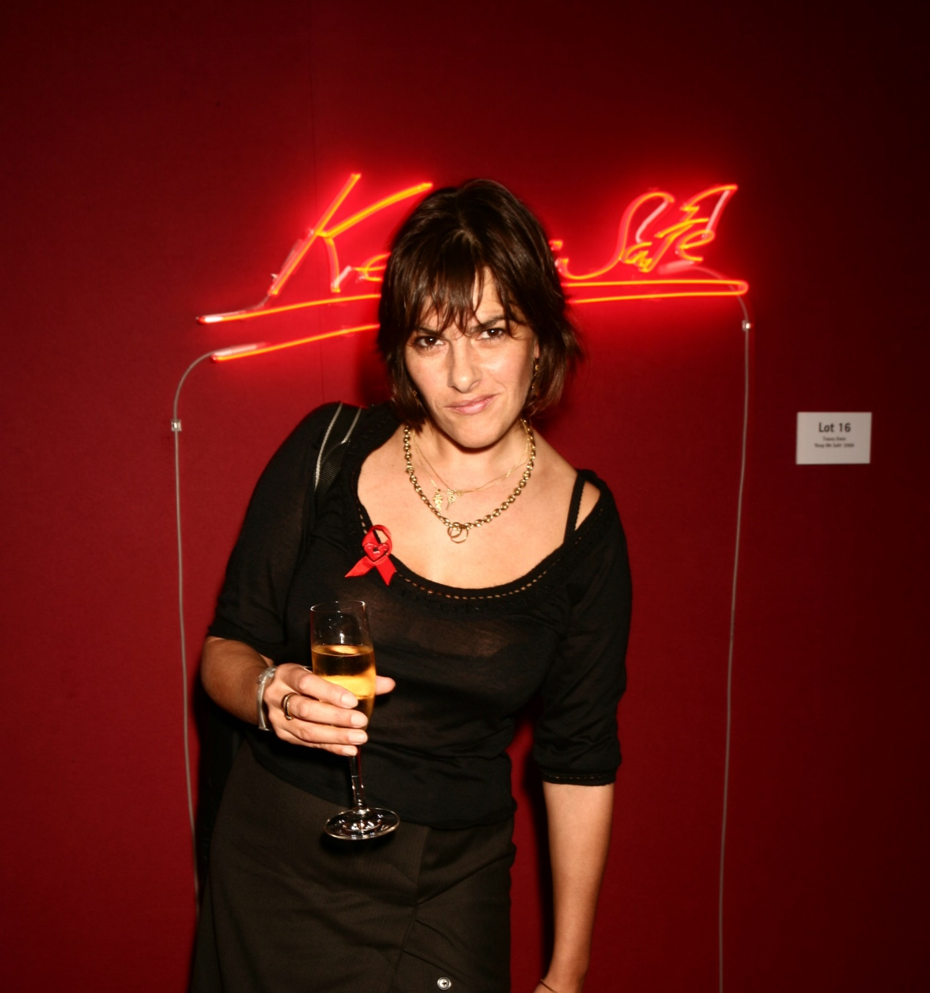
But is it art?
Dame Tracey Emin is a British artist who produces work in a variety of different media including drawing, painting, sculpture, photography and neon lighting.
Her neon works include one with the words ‘You Loved Me Like a Distant Star’ illuminated within a love heart. It is also sold as a print.
Do you think Emin’s neon signs are art? Why or why not?
Notes:
Image: Tracey Emin at the Lighthouse Gala Auction in aid of Terrence Higgins Trust
Photo attribution: Piers Allardyce, licensed under the Creative Commons Attribution 2.0 Generic license

Slide 9

Focus on: Fine artists
What do they do? Fine artists create original works of art such as paintings and sculptures.
What are they good at? They have excellent visual and artistic skills and work well with their hands. They are imaginative and creative. They pay attention to detail, use their initiative, are flexible and can work under pressure. They must also be resilient and able to accept criticism.
What knowledge do they need? They need a knowledge of the fine arts and of different media and materials. They must also be able to use a computer and the main software packages competently.

Slide 10
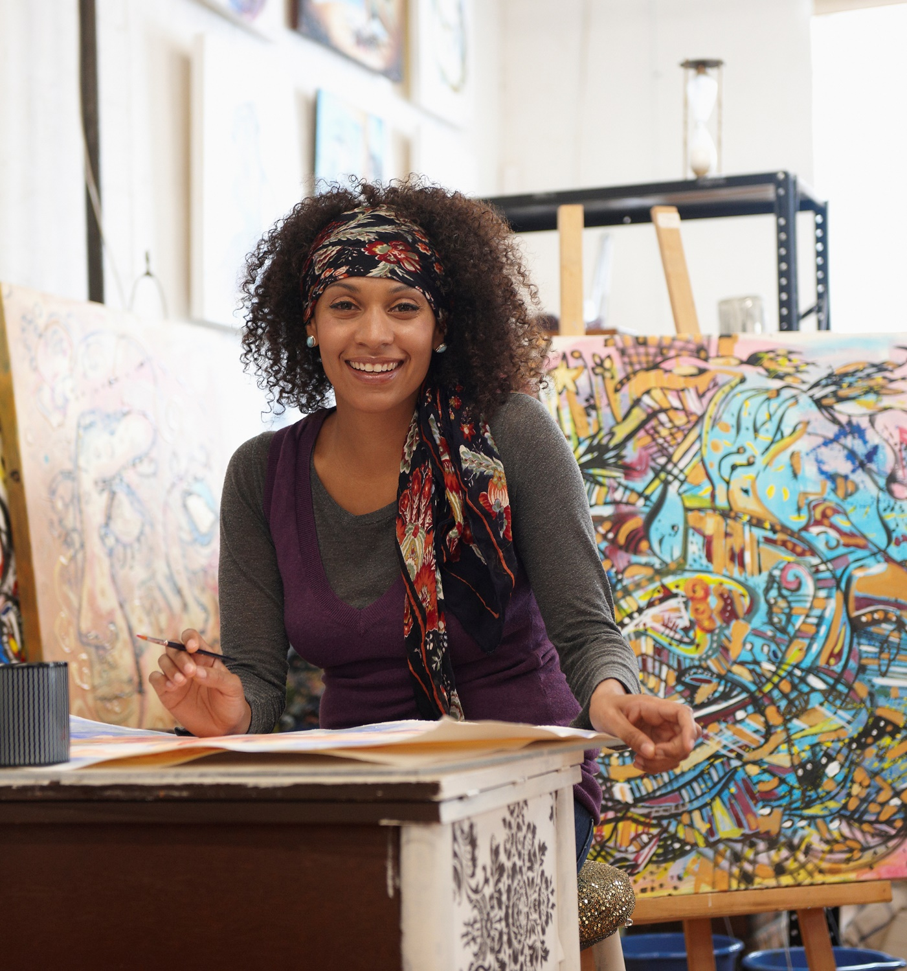
Diary of an artist
You are an artist. You are currently working on three projects: a large painting that is a commission from a wealthy client, a smaller commission with a tight deadline, and your own pastel drawings for an art exhibition.
You have several tasks you need to work on over the next two days. You also have some fixed commitments in your diary.
Plan your diary on your Activity Sheets.
Notes:
Image from: Microsoft 365 royalty free Image Gallery

Slide 11

Freelance quiz
Many artists are freelancers. This means they are self-employed and are only paid when they sell an artwork or complete a commission.
They might have several projects that they are working on at the same time.
Artists often have other employment to supplement their income.
They might run workshops in schools, art galleries, museums or libraries, or teach art students in colleges.
Have you got what it takes to work as a freelancer?
Take the Freelance quiz to find out!
Notes:
Image from: Microsoft 365 royalty free Image Gallery

Slide 12



To freelance or not to freelance?
There are 7.4 million people freelancing in the UK (either part or full time).
Around 2.6 million people in the UK freelance full time for a living.
Freelancers contribute over £270 billion to the UK economy each year.
Notes:
Images from: Microsoft 365 royalty free Image Gallery
Statistics Source: https://archimediaaccounts.co.uk/freelancing-statistics-uk

Slide 13
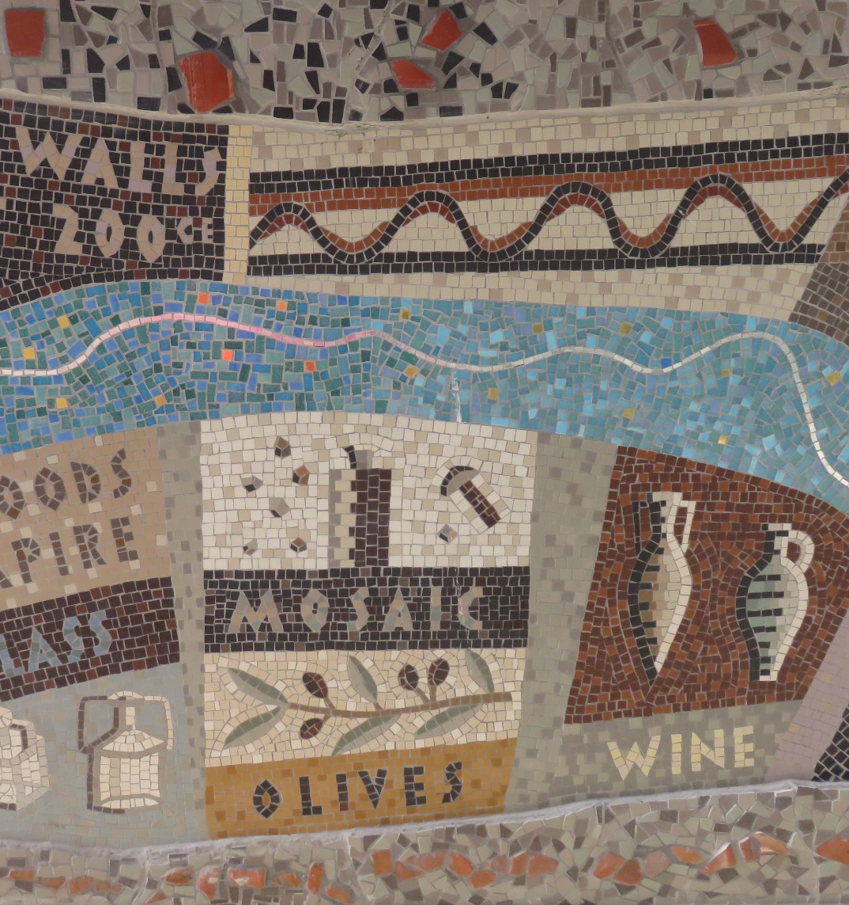
Community art projects
A community art project is a project that involves a community working together to create art.
They are often a collaboration between professional artists and the local community including people of different ages and from different backgrounds.
Can you suggest some examples of community art projects?
What do you think are the value of these?
Notes:
Image of Queenhithe Dock Mosaic, developer’s own.

Slide 14
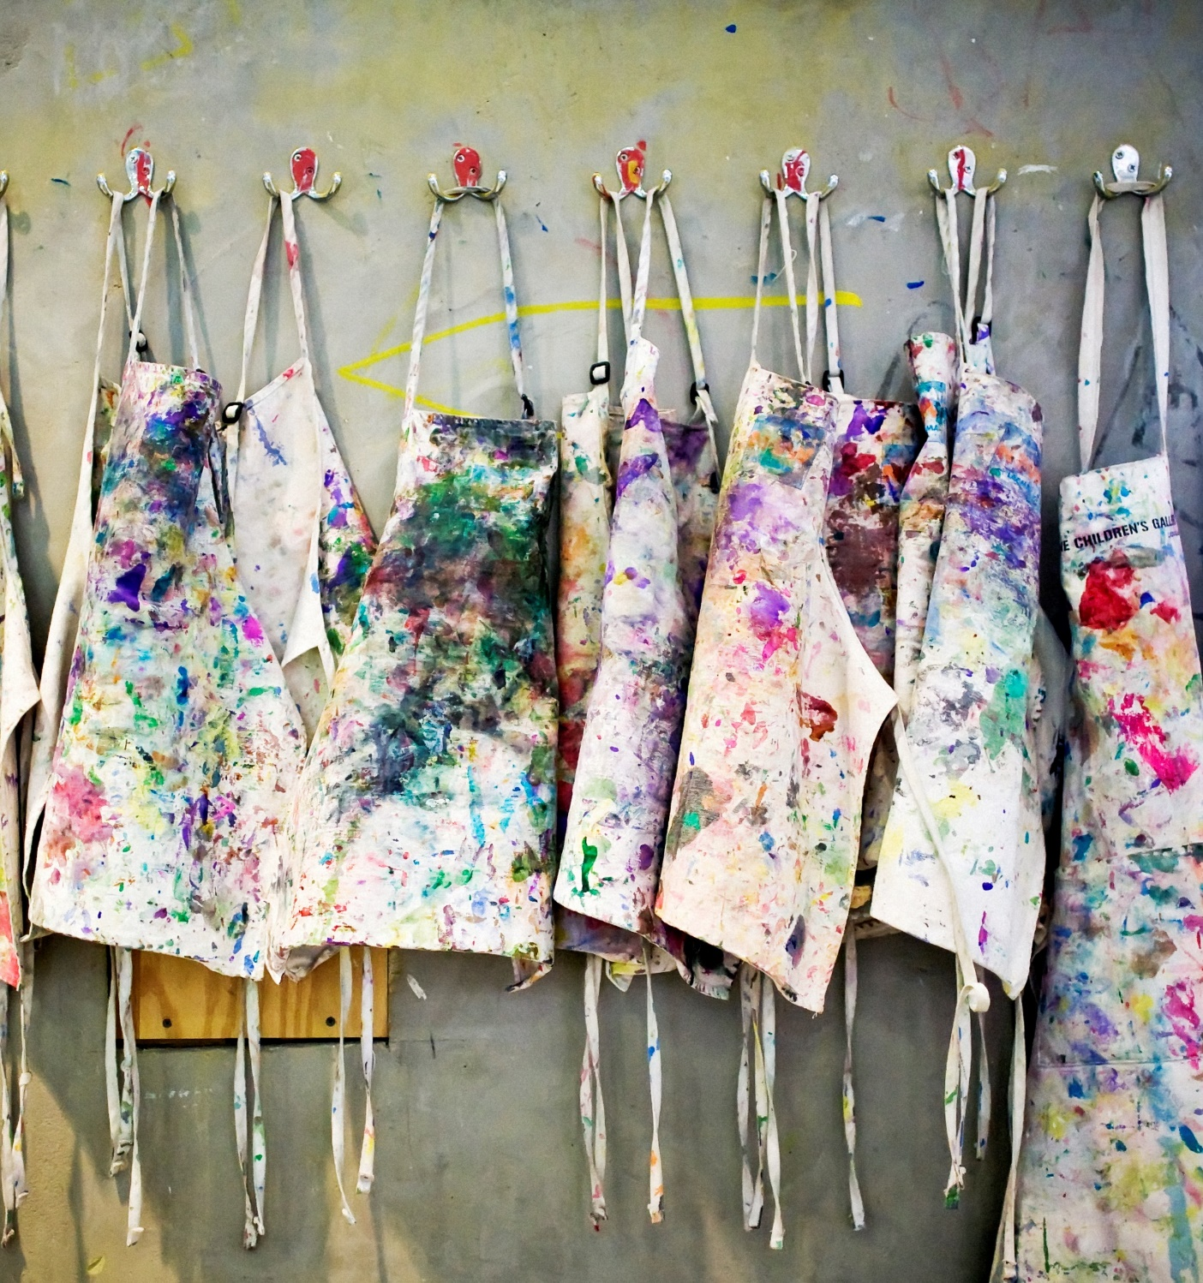
Community art project:
Group proposal
Your local authority has a grant of £3,000 to award to a community art project.
The aim of the project is to foster community pride and a sense of belonging.
You are a group of artists. You want to submit a proposal to the local authority to be considered for the grant.
Discuss your ideas as a group, then complete a joint application.
Notes:
Image from: Microsoft 365 royalty free Image Gallery

Slide 15

Present your proposal
Your proposal has been shortlisted by the local authority.
They have asked you to present it before a selection panel.
Plan how you will present your proposal.
Remember to speak clearly and confidently!
Notes:
Image from: Microsoft 365 royalty free Image Gallery

Slide 16
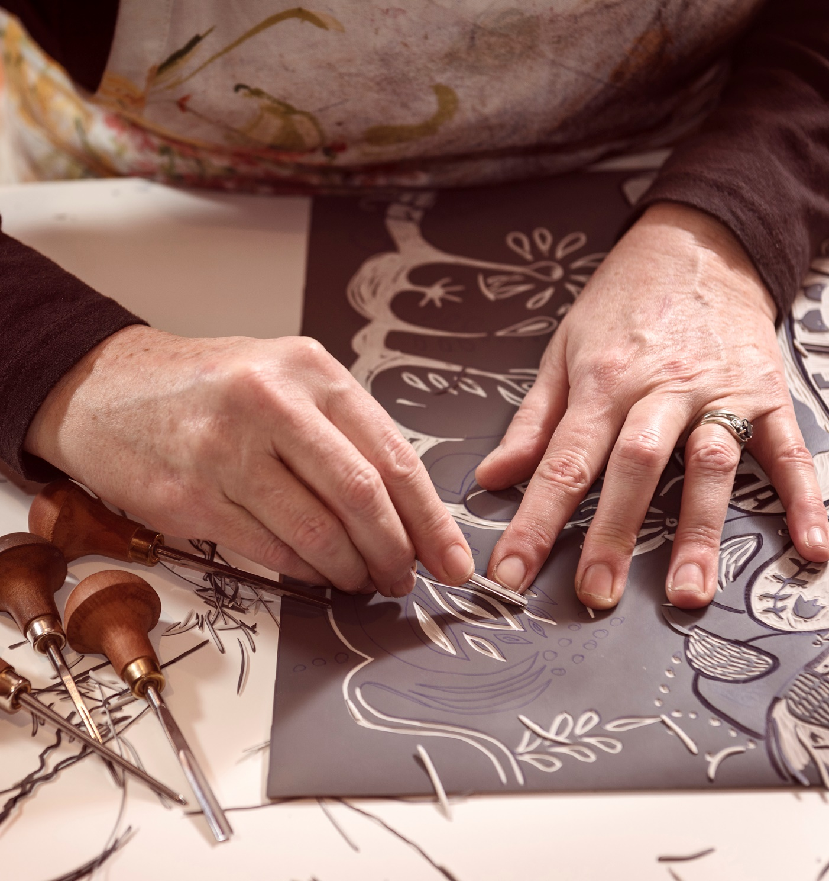
Extension activity 1:
Design a greeting card
Craftspeople produce individual handmade items.
Could this be a job for you?
Practise your craft skills by designing and making a greeting card.
Notes:
Image from: Microsoft 365 royalty free Image Gallery

Slide 17

Extension activity 2:
Cereal box challenge
Commercial artists create art that is designed to market a product.
You are a commercial artist.
Your brief is to design the packaging for a new children’s breakfast cereal called ‘Crunchy Critters’.
The cereal will be marketed to adults as a healthy option for children.
The challenge is that the packaging should appeal both to children and to the adults who will buy it.
Research the brief then plan and sketch your design for the front of the box.
Notes:
Image from: Microsoft 365 royalty free Image Gallery

Slide 18
Opportunities for all
If you are interested in art but don’t want a career as an artist, these jobs could be for you.
art conservator
art agent
arts administrator
art dealer
art
exhibition designer
art teacher
art
auctioneer
commercial art gallery assistant
art therapist
picture framer

Slide 19


Reflection
Can you name one career in art that you hadn’t heard of before today?
Does anyone think they would like to work as an artist?
If so, what do you think will be the challenges?
How would it be a rewarding career?
Notes:
Image from: Microsoft 365 royalty free Image Gallery

Slide 20

Ways in
You don’t need qualifications to be an artist, but it does help to study. You could consider:
a college course in your preferred medium such as painting or drawing, printmaking, photography, digital art, ceramics or sculpture.
a university degree. For example, in art and design, fine art, visual arts or graphic arts.
visiting lots of art exhibitions and art galleries. Many public galleries offer short courses and lecture series, sometimes online.
Notes:
Image from: Microsoft 365 royalty free Image Gallery

Slide 21
Getting started
If you think a career in visual art could be for you, you could:
Enter art competitions and exhibitions. There are lots open to young artists.
Keep a sketchbook. Record the world around you like a visual diary. Try to do one drawing a day, even just a quick one. Use your sketchbook to develop ideas for paintings too.
Start a portfolio of your artwork. You will often need one if you apply for an art course.
Find out if any art galleries near you are running free art classes or workshops.
Start creating an online media presence through social media channels such as Instagram.
Volunteer with a community art project, or to help with children’s art workshops in your local museum or library.
Go to local artists’ open studio weeks. Talk to the artists and ask lots of questions.
Find out more at
https://discovercreative.careers/explore/
https://nationalcareers.service.gov.uk/job-profiles
https://www.mallgalleries.org.uk/ (Federation of British Artists)

Slide 22
There’s a career for you in the creative industries

